Slide 1
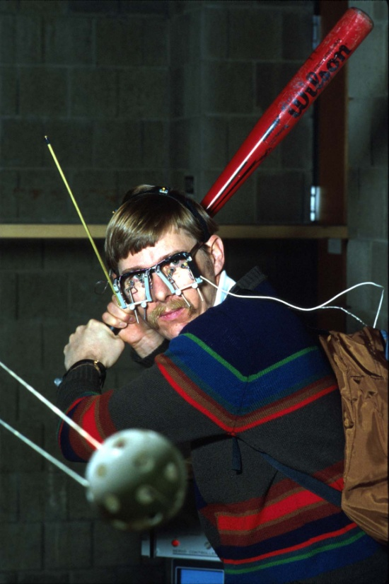

The Science of Baseball,
Chapter 1
A. Terry Bahill
Emeritus Professor of
Systems Engineering
University of Arizona
terry@sie.arizona.edu
©, 2017-2018, Bahill

Slide 2
Reference
Terry Bahill, The Science of Baseball: Modeling Bat-Ball Collisions and the Flight of the Ball, Springer Nature, NY, NY, 2018
ISBN 978-3-319-67031-7
Chapter 1

Slide 3
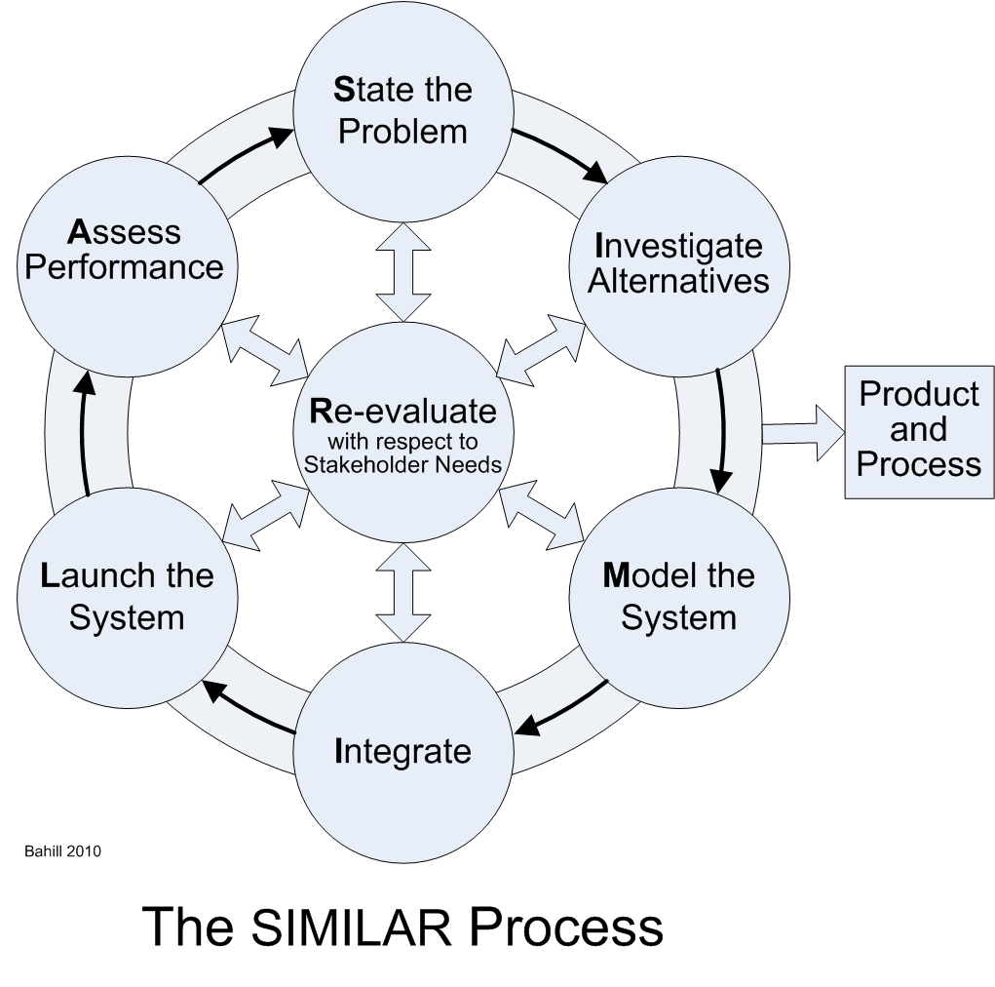
The systems engineering process
The SIMILAR process is a life-cycle model. But, it is not a serial process.
It is parallel and highly iterative.

Slide 4
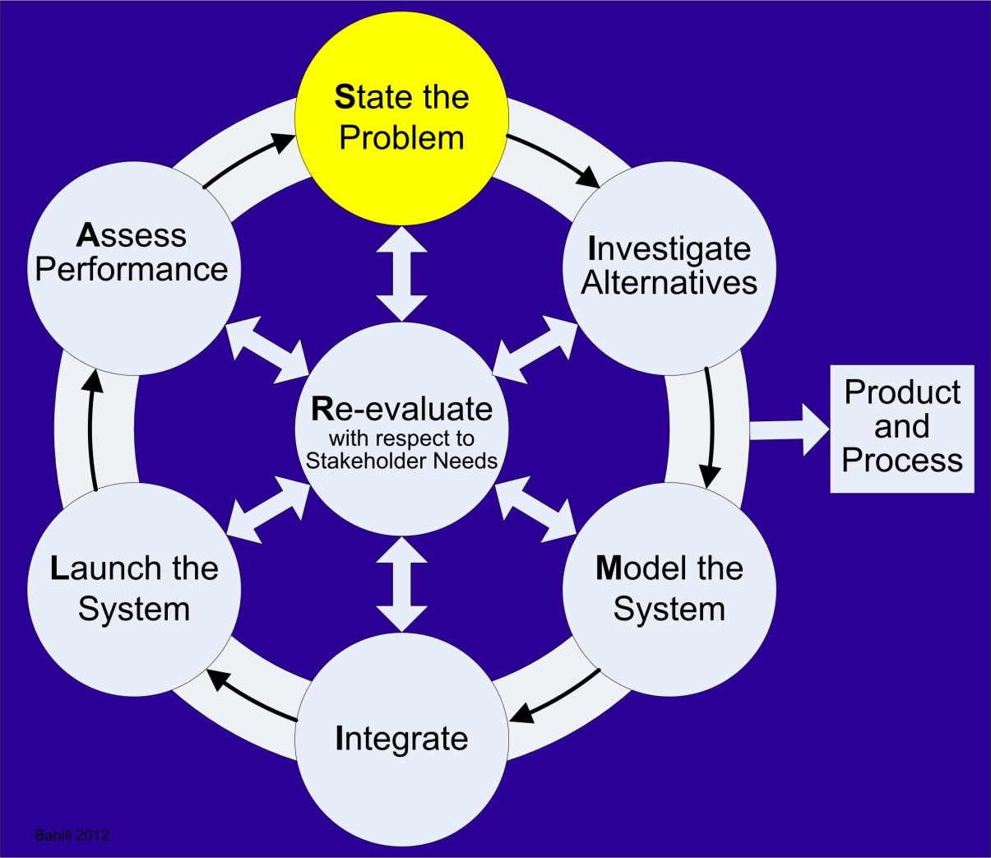
State the problem
“Reason must be the beginning of every activity, reflection must come before any undertaking.” Ecclesiasticus 37:16
Notes:
Begin with the end in mind
Steven Covey and Omega Alpha Association

Slide 5
Product Position Statement
For engineers and students of the science of baseball, who want to understand bat-ball collisions and the flight of the ball, this book The Science of Baseball presents equations for the speed and spin of the bat and ball after the collision in terms of those same four variables before the collision.
Unlike existing books on the physics of sports, this book uses only Newton’s axioms and the conservation laws. It also contains alternative models for bat-ball collisions and the flight of the ball.

Slide 6
Newton’s axioms
I. Inertia or uniform motion. Every object remains at rest or continues to move at a constant velocity, unless acted upon by an external force.
II. Impulse and Momentum. Applying a force changes the momentum of a body.
III. Action/reaction. For every action there is an equal and opposite reaction.
IV. Restitution. The coefficient of restitution (CoR) is the ratio of the relative speeds of two objects after and before a collision. The CoR models the energy lost in a collision.

Slide 7
Overarching conservation laws
Energy, linear momentum and angular momentum cannot be created or destroyed.
Notes:
These laws are more general than the principles and apply in all circumstances.

Slide 8
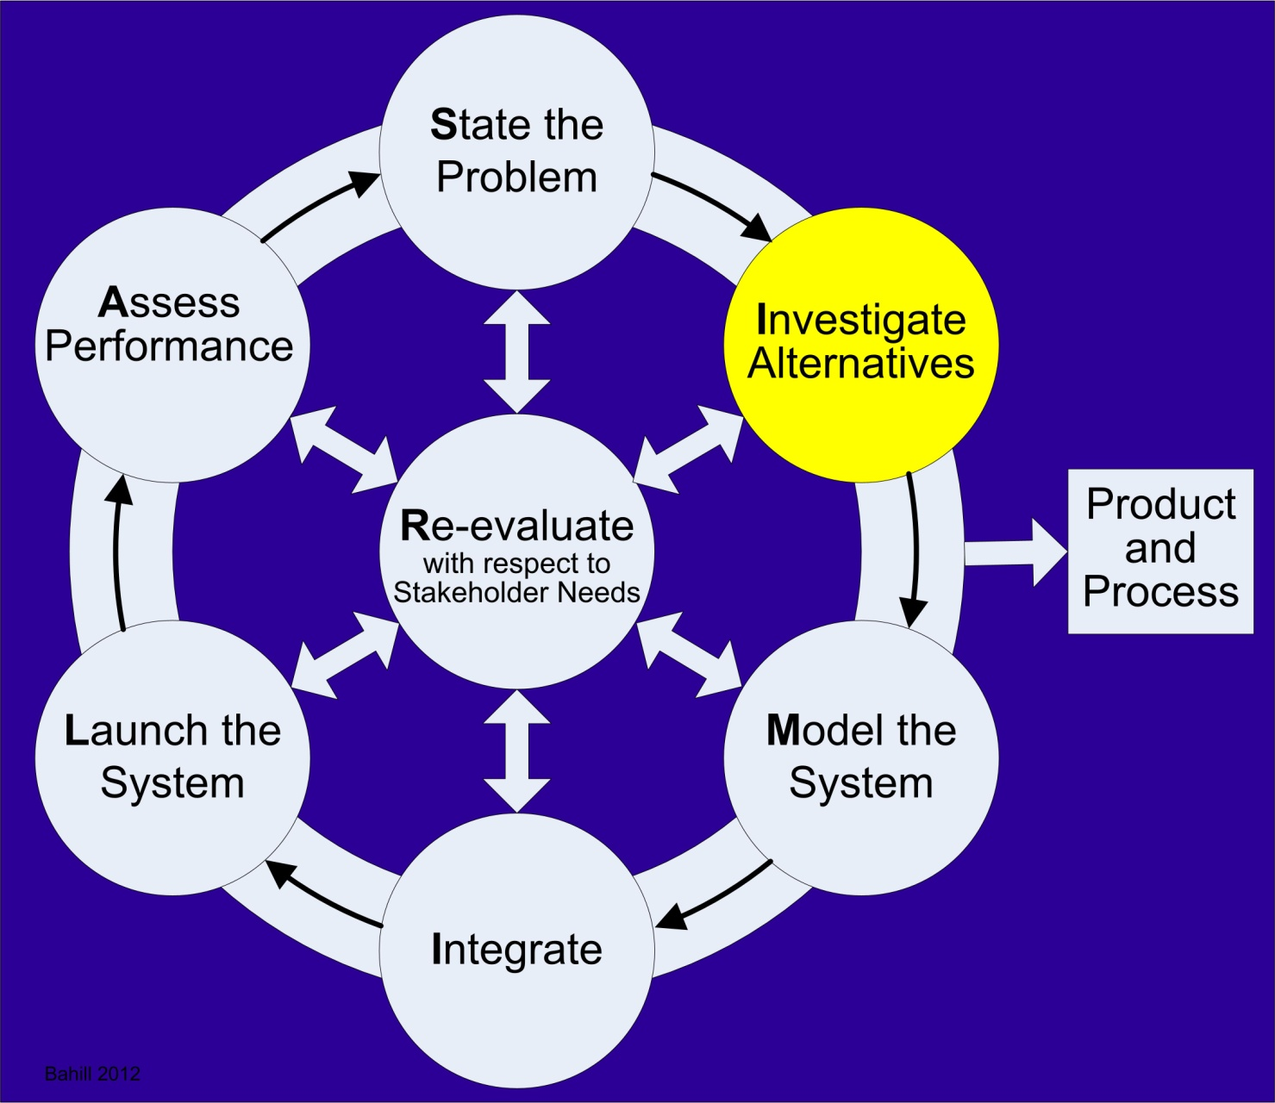

Slide 9
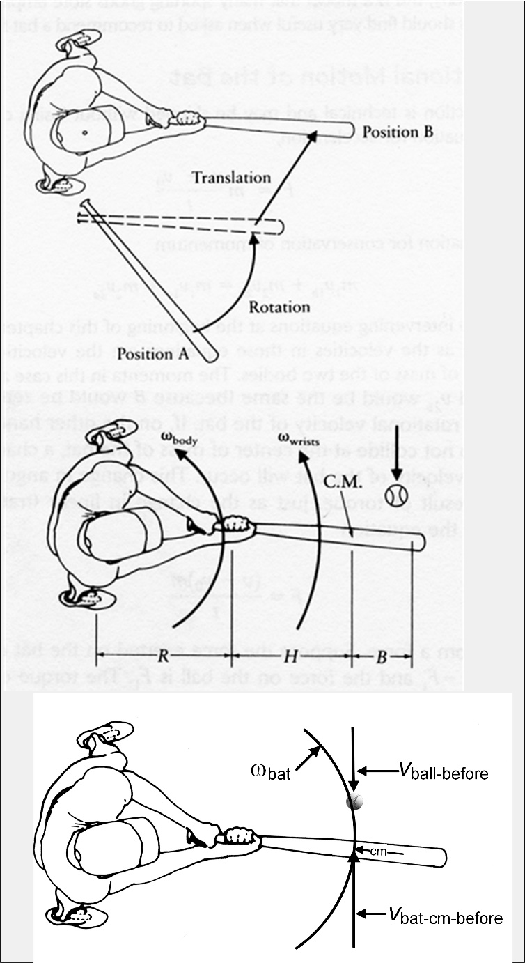
Three swing models

Slide 10
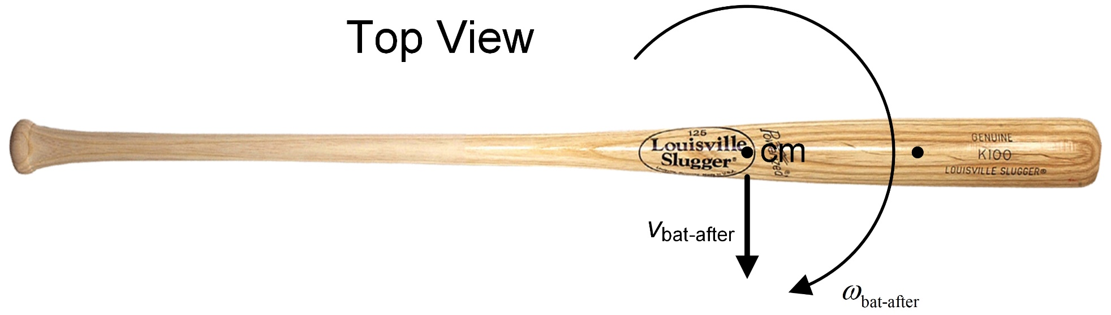
Free-end motion
Notes:
Kirkpatrick

Slide 11
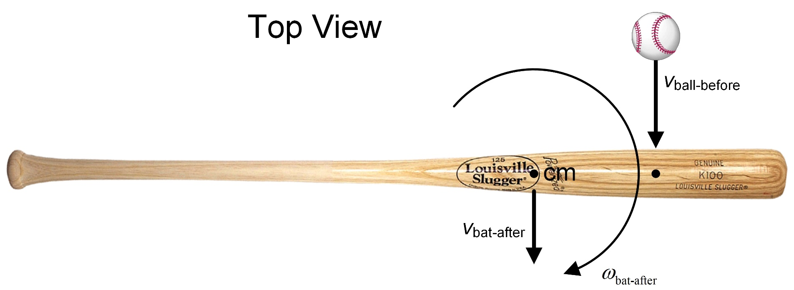
Free-end collision
Notes:
Kirkpatrick

Slide 12
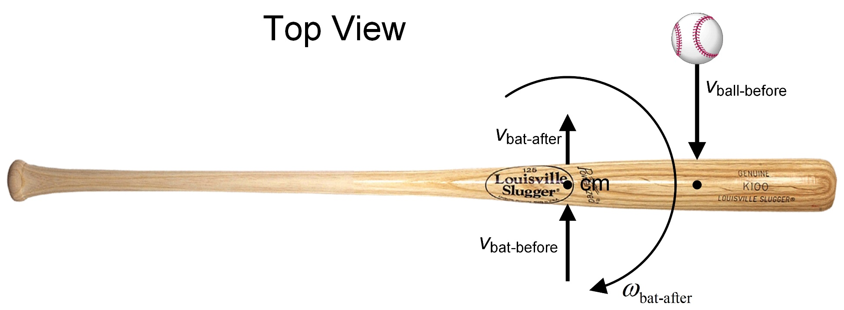
Free-end collision with bat motion

Slide 13
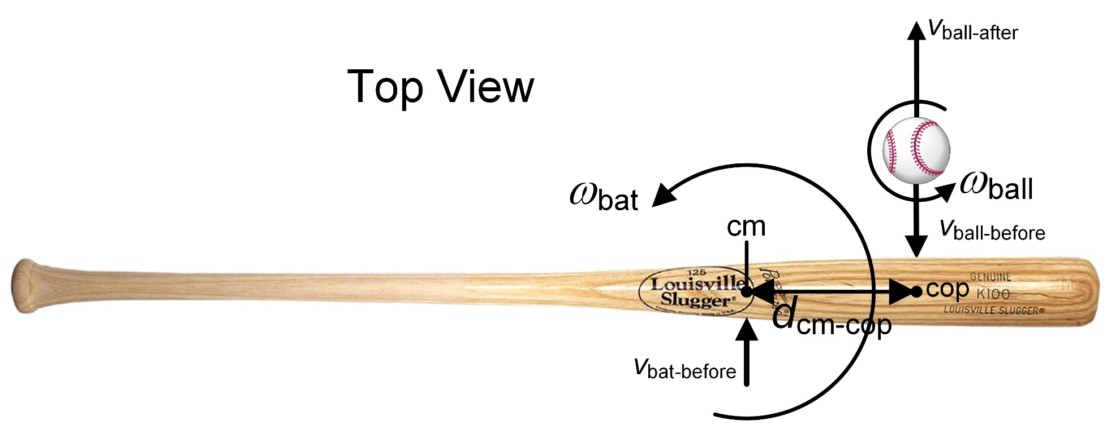
BaConLaws model

Slide 14
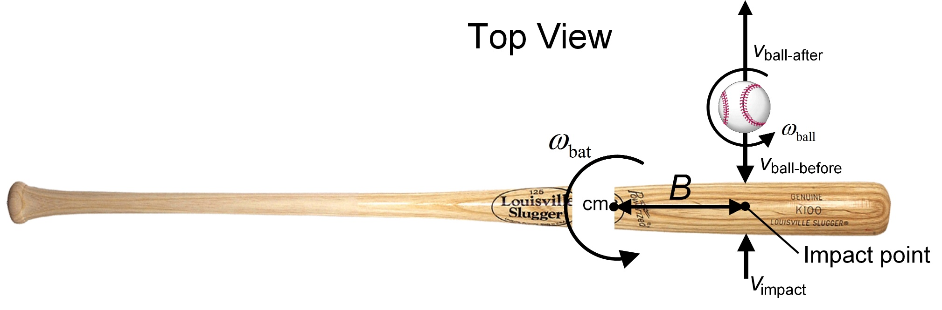
Effective Mass model

Slide 15
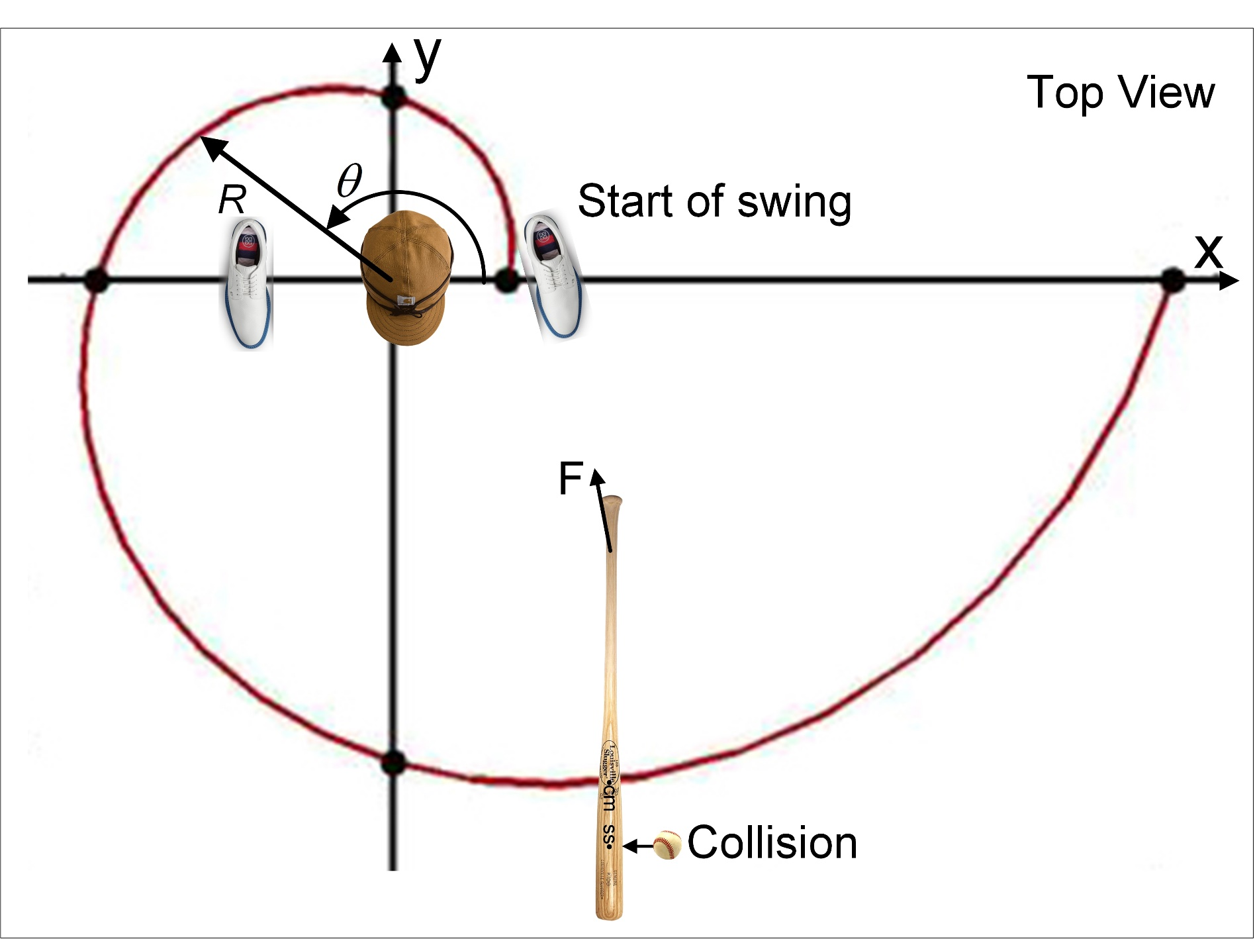
Spiral Center of Mass model

Slide 16
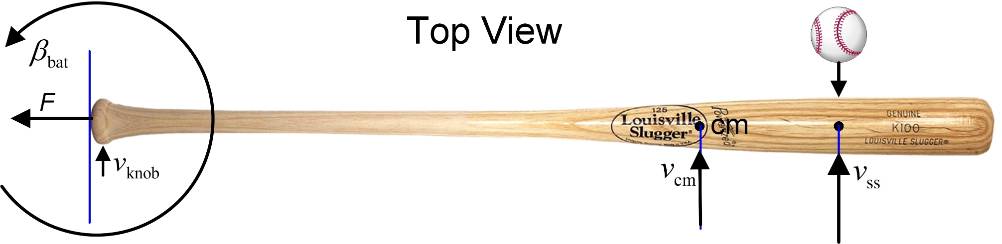
Sliding Pin model

Slide 17
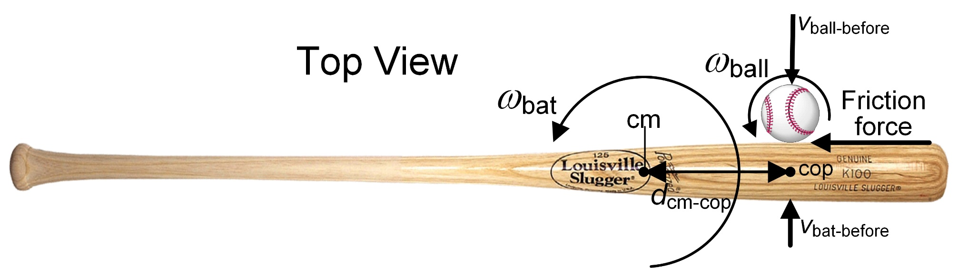
Collision with Friction model

Slide 18
