Slide 1
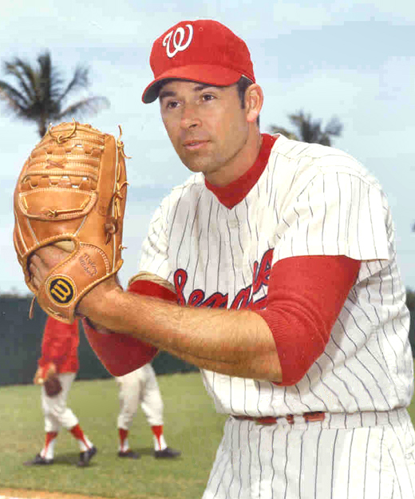
Nickel and Dime Pitches
Dave Baldwin
Chicago White Sox Baseball Organization, et al.
SnakeJazz_37@brainpip.com
Terry Bahill
Emeritus Professor of Systems Engineering
University of Arizona
terry@sie.arizona.edu
Copyright © 2009-2017, Bahill and Baldwin

Slide 2
The paper and slides of the this presentation were written Dave Baldwin, not me
Please note the difference in language, attitude, and approach to the problem between this presentation and my others.

Slide 3
References
Dave Baldwin, Terry Bahill and Al Nathan, “Nickel and Dime Pitches,” Baseball Research Journal, 35, pp. 28-32, 2007.
Videos of our spinning baseballs are at
http://www.sie.arizona.edu/sysengr/baseball/index.html

Slide 4
Problem statement
What visual clues does the pitcher give to the batter and how can he avoid giving them to the batter?

Slide 5
Spin on the pitch
Most major league batters (that we know of) who had life-time batting averages above .300 have said or wrote that they did see the spin on the pitch.
Most major league batters (that we have spoken with) who had life-time batting averages below .250 have said or wrote that they did not see the spin on the pitch.

Slide 6
“Nickel” can refer to
Spin pattern
Inferior pitch
Notes:
The term “nickel” is generally only used to describe curveballs and sliders. It can refer to a pattern appearing on these pitches, or it can refer to a curve or slider of poor quality – that is, one that lacks sufficient deflection. In connection with this second meaning, sometimes a slider or a change up curve is called a nickel curve.

Slide 7
Kinds of patterns
Dot (dime)
Circle (nickel)
Fuzzy bands
Notes:
The spin of the pitch can create three kinds of visible patterns. A small red dot is sometimes called a dime pattern. The nickel pattern is a nickel-sized open circle. A third pattern consists of two fuzzy bands near the equator of the ball.

Slide 8
How a baseball is made
http://www.reliableplant.com/view/25724/how-baseballs-are-manufactured

Slide 9
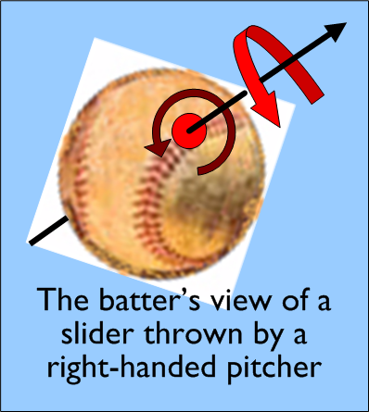
Slider*
Notes:
This is the batter's perspective. The ball is coming toward the batter. So this time you must put your back to the screen when you apply the right-hand rule.
This slider was thrown by a right-handed pitcher.
The slider is thrown like a football, so it spins like a bullet, however the axis of rotation must be pointed up and forward.
It’s not like turning a door knob, because the door knob’s axis of rotation is straight ahead, like a bullet. This would produce the backup slider.

Slide 10
4-seam and 2-seam fastball models

Slide 11
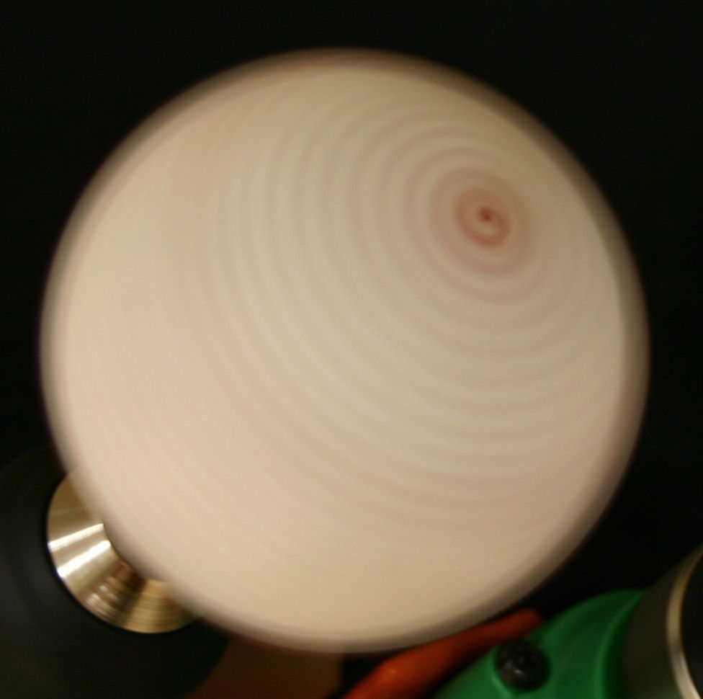
Red dot of the dime slider
Batter’s
view
Notes:
The axis of rotation goes through a seam.
To demonstrate these spin patterns we have simulated the spin on a pitch by setting the ball on a drill and rotating the ball at 250 rpm. This is much slower than the spin on an real baseball. In the photos we will show, the shutter speed was 0.5 seconds and the f-stop was set at 5.6. This is the batter’s view of a right-handed pitcher’s slider.
This is a two-seam slider.

Slide 12
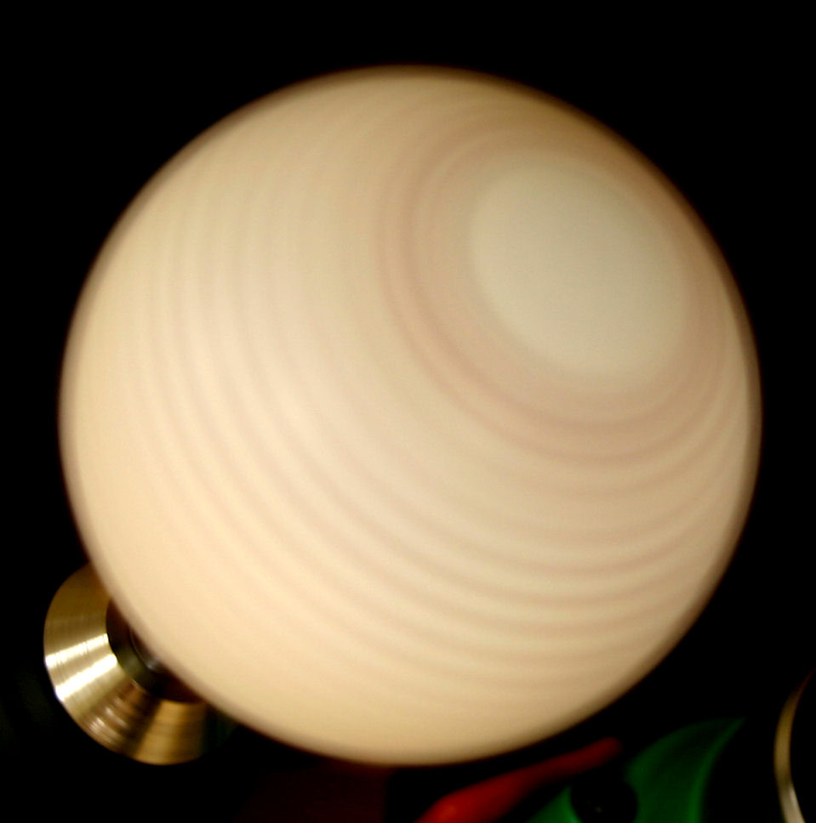
Circle pattern of the nickel slider
Batter’s
view
Notes:
The axis of rotation was in the center of the isthmus.
This is a simulation of the circular “nickel” pattern on a right-hander’s slider. The spin speed is the same as that used to simulate the dot pattern.
This is a four seam slider.

Slide 13
Equatorial bands
Batter’s
view
Notes:
In this simulation we have very faint bands about the equator of the ball. No monetary patterns here.
The axis of rotation was out in the plain.

Slide 14
Spin simulations
We drilled a hole in a regulation baseball and inserted a four inch bolt. The bolt was chucked in a drill and spun at rates up to 25 rps. The bolt is the spin axis, which defines the pole. The shutter speed was 0.5 seconds and the f-stop was 5.6.
Notes:
This picture shows a slider. For a slider, the bolt was shorter and did not go all the way through the ball.

Slide 15
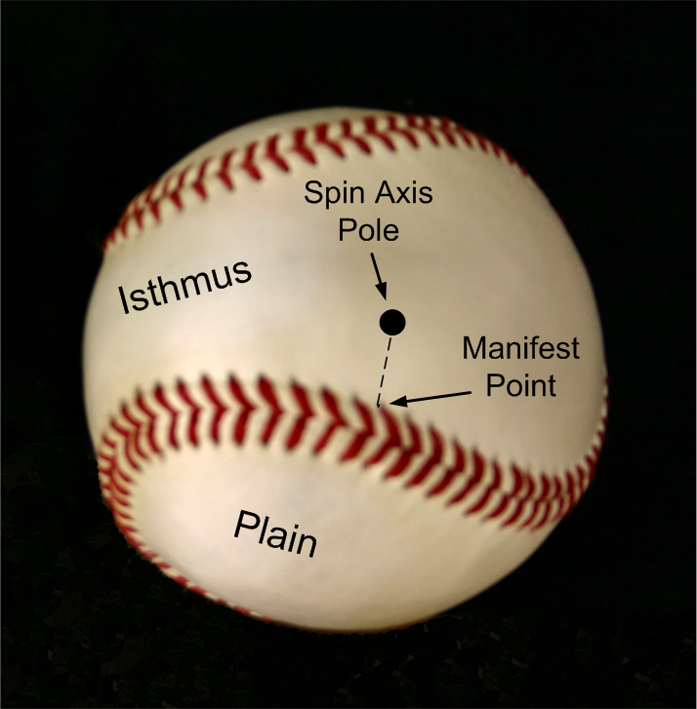
Features of the ball
Notes:
To explain the patterns, we need to describe the features of the ball’s surface. The ball has a single seam that stitches together two dog-bone shaped pieces of leather. The dog-bone configuration is known as Ovals of Cassini – named for a seventeenth century astronomer. This strip consists of two large white plains connected by a narrow isthmus. The spin pattern is a function of the location of the spin axis pole relative to the seam. The point on the seam nearest the axis pole is called the manifest point.

Slide 16
Typical values for major league pitches
Notes:
It is labeled “Initial Speed” because the ball loses about 10% of its speed in route to the plate.
The Radar gun is probably within ±2 mph.

Slide 17
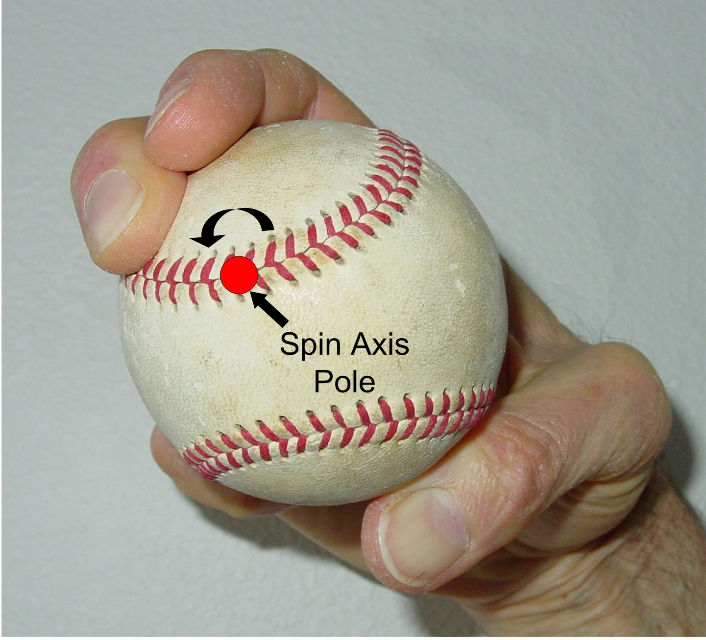
Creation of the red dot
First-base
coach’s view
of the grip
Notes:
This shows a slider grip that would position the axis pole near the seam, producing the dot pattern.
The curved arrow shows that the spin around this pole would be in a counterclockwise direction.
This is a four-seam grip.

Slide 18
Creation of the circle
The fingers
point toward
the isthmus
First-base
coach’s view
of the grip
Notes:
The fingers point toward the isthmus.
This particular “four-seam” grip of the slider will result in a circular spin pattern.
Note that the pole is not positioned on the seam.
The radius of the circle will be equal to the distance of the pole from the manifest point.

Slide 19
Creation of the Fuzzy Bands
Notes:
This is an uncommon slider grip (generally called, “a two-seam grip”). Notice that this places the axis pole out in the middle of one of the plains. The direction and speed of the spin is the same as it was with the previous two grips shown – only the spin pattern has changed.

Slide 20
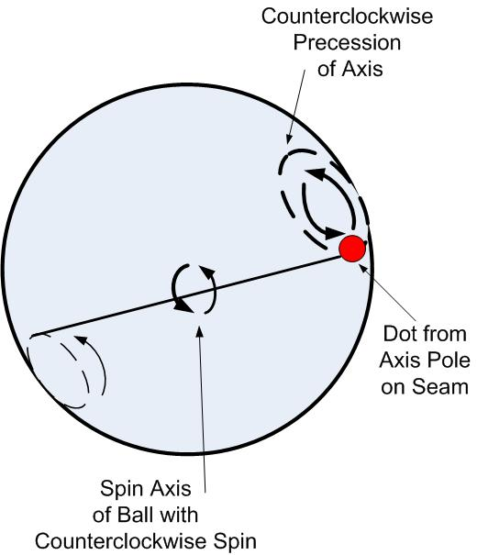
Precession
At first we thought that the circles and dots were due to precession.
Notes:
Our first hypothesis for the cause of the circular patterns was precession. This is a “wobble” or gyration of the spin axis about a secondary axis. If the dot at the end of the spin axis rotates, it circumscribes a small circle. The term was first used by Hipparchus of Nicea in 130 B.C. when he described the effects of the wobble of the earth’s spin axis. Precession is also the basis of the behavior of a toy top, a gyroscope, and a boomerang. In all cases, precession is caused by a secondary force perturbing a spinning body.
After 40 hours of mathematical and physics analysis, we no longer think that precession is a big factor.

Slide 21
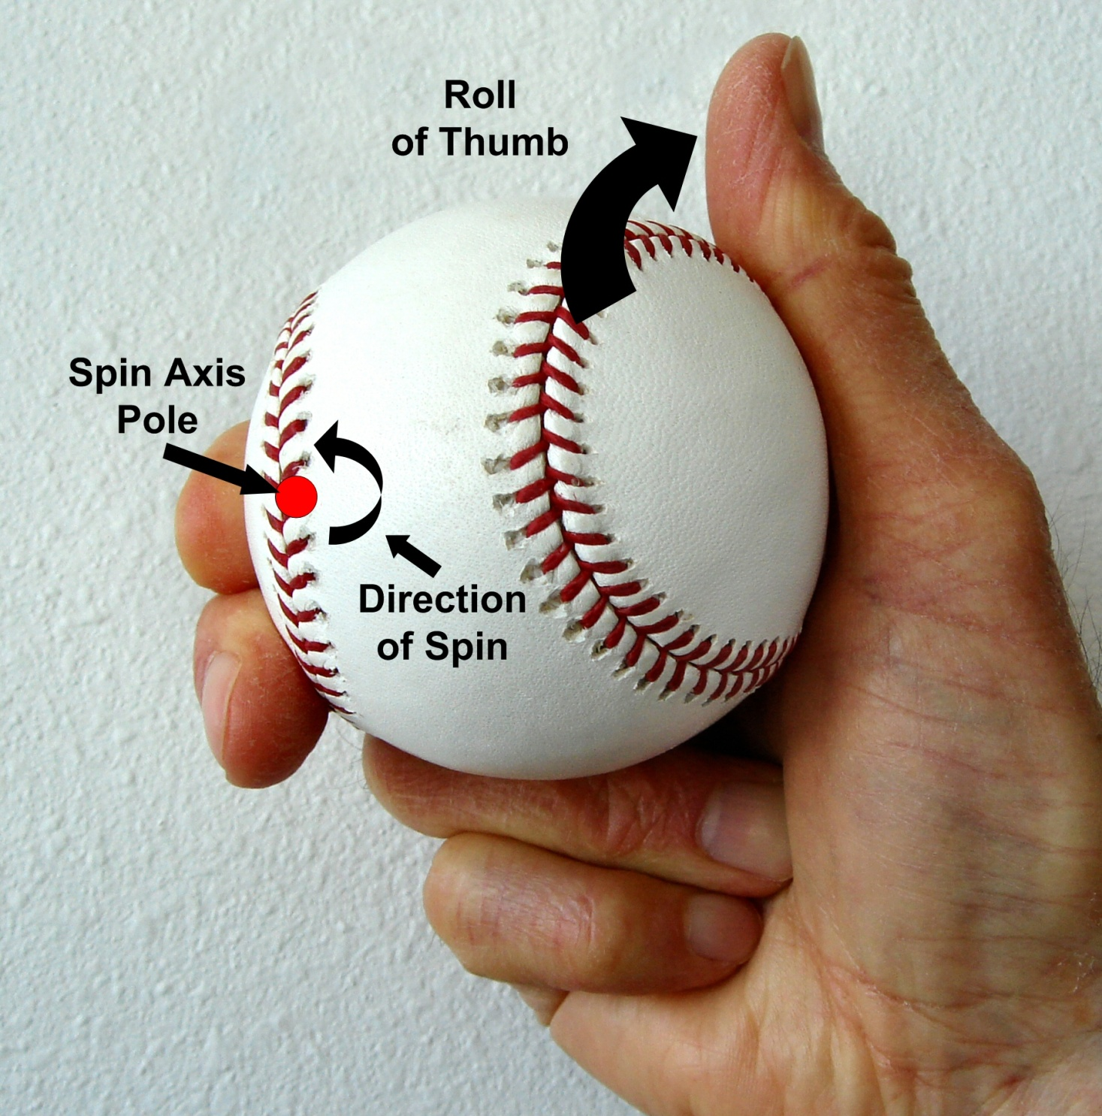
Thumb roll
First-base
coach’s view
of the grip
Notes:
We are now switching from a slider to a curveball.
We asked Sid Hudson (major league pitcher 1940 to 1954, major league pitching coach 1961 to 1978) about the creation of a bad curveball. He cited the roll of the thumb as the ball is released. Note the axis pole is on the seam. The direction of spin is counterclockwise from this angle. The thumb roll could result in a relocation of the axis pole into the isthmus or it could cause precession to occur – in either case a nickel pattern would be seen on the pitch. Also Hudson said thumb roll will reduce the magnitude of the spin.
To ensure proper release concentrate on putting pressure on the right front corner of the ball. As a result of this pressure, the last part of the hand to touch the ball was the thumb-side edge of the index finger's tip. The ball left his hand with the spin axis assuming an oblique angle to the forward direction of the pitch. Three of our interviewees reported that throwing sliders caused blisters or calluses on the thumb side of the index finger's tip.
Hudson thinks that the thumb roll decrease the amount of spin,
Dave thinks that the thumb roll effects the axis of rotation.

Slide 22
Thumb roll
Sid Hudson said that many pitchers roll their thumbs over the ball.
This could relocate the pole into the isthmus or this could cause precession.
This would produce a poor quality, or nickel slider. Of course the batter could not see this nickel sized red circle; only someone perpendicular to the ball’s flight (like the first-base coach) could.

Slide 23
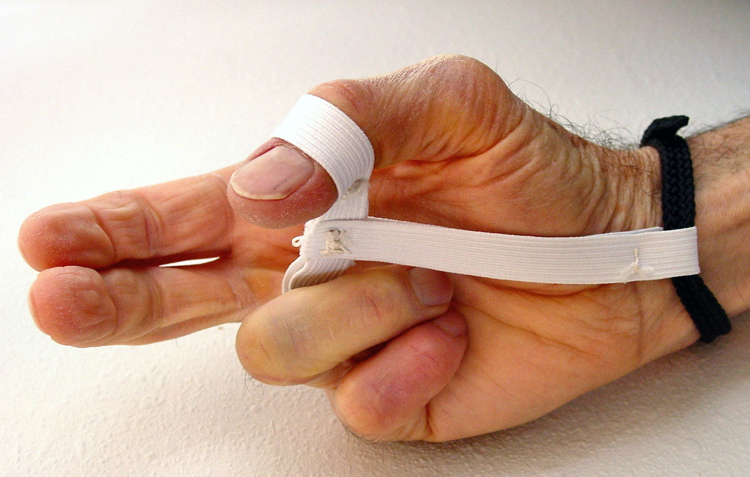
Hudson harness

Slide 24
Hudson harness
Invented by Sid Hudson to train pitchers.
Prevents the thumb from rolling over the top of ball.
Only used during training for a curveball.
Notes:
Rolling the thumb reduces the spin rpm.
It also changes the spin pattern.
This produces an inferior pitch, such as there nickel curveball.
The batters can’t see the red dot, but the coaches can.

Slide 25
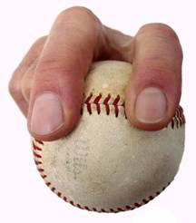
Four seam fastball/slider grip
Batter’s view

Slide 26
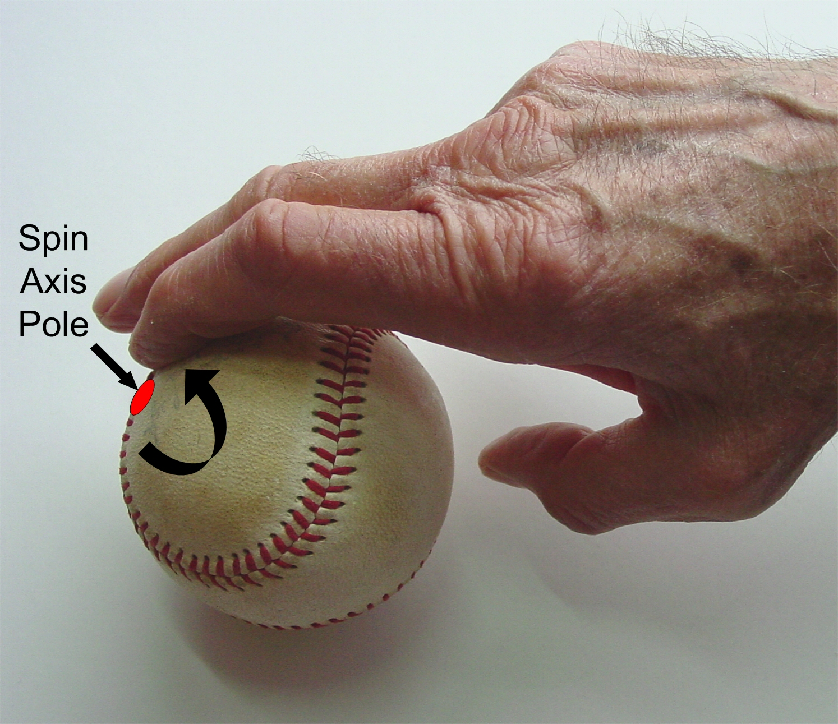
Slider release
Top view

Slide 27
Are the two meanings of the term “nickel” related?
Spin Deflection Quality
Pattern depends on axis pole location relative to seam
Spin rate and deflection is independent of the orientation of seam (from wind tunnel experiments in Watts & Bahill)
Dots and circles can be produced with the same spin rate (e.g., in our simulations)
Notes:
The term “nickel” can refer to a spin pattern or to a poor curve or slider. Are these meanings related in any way? We are defining quality of a curve or slider as a function of the magnitude and direction of deflection, which in turn is a function of the speed and direction of the ball’s spin. The pattern depends on the orientation of the seam and the mode of release. The deflection (and therefore, the quality) does not depend on orientation of the seam (it depends only on the release of the pitch) – this was shown in wind tunnel experiments. Note that the spin rate does not necessarily determine the pattern – all the simulated patterns we have shown you have been produced at the same spin rate.

Slide 28
Two poles
The spin axis has two poles.
Although the two poles must have the same spin rate,
one pole could display a dot pattern, while the opposite pole displays a circle pattern.

Slide 29
Grip and release of the ball
There is apparently no direct cause-and-effect link between quality and pattern.
Grip and release can affect quality and create a specific pattern.
Whatever creates a bad curve or slider might create a nickel pattern.
Notes:
Although there doesn’t appear to be a direct cause and effect link between quality and pattern, there might be an indirect relationship. Suppose a pitcher in throwing a curve or a slider grips and releases the ball in such a way that if done correctly, he produces a dot, and if incorrectly, he produces a circle or even a fuzzy band. With that in mind we asked some major league pitchers and coaches how one would go about throwing a bad curve or slider.

Slide 30
Bad sliders
These pitchers told us what can go wrong with a slider: Dick Bosman, Jim Kaat, Ken Sanders, and Bob Humphreys.
Bad sliders result from a rolling of the wrist (like turning a door knob).
With some grips, wrist roll might shift the pole into the isthmus or plain.
Notes:
With two of the most popular slider grips the pole is located on a seam if the pitch is thrown correctly. If the wrist rolls the pole is shifted and it’s likely it will relocate to whiteness, producing a circle or bands.

Slide 31
The slider
The finger-seam orientation in the pitcher’s grip might also effect the batter’s perception of the slider.

Slide 32
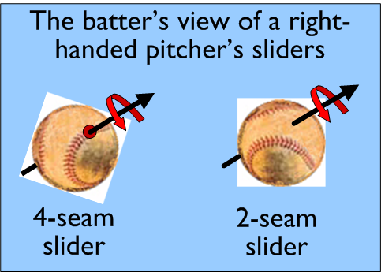

Slide 33
Photos of 4-seam and 2-seam slider models
© 2012 Bahill

Slide 34
But the difference in appearance of these four-seam and two-seam slider models is more dramatic in this video than in the previous still photographs. (These balls are being rotated at 20 rps.)

Slide 35
Baseball sounds
You can hear a bat-ball collision
Can you hear the difference between a fastball and a curveball?
They have different speeds and spin rates so they sound different.
Perhaps batters and umpires could be trained to use this auditory clue.
© 2012 Bahill

Slide 36
Summary
Nickel pattern not necessarily indicative of poor pitch.
Pattern is associated with orientation of seam relative to axis pole.
Pitcher’s grip and release might produce a pitch of poor quality that has a nickel pattern.
Notes:
In summary, the nickel pattern does not necessarily indicate a reduced magnitude of spin or deflection. We conclude that the circular pattern seen on a nickel pitch results from certain orientations of the seam relative to the spin axis. Whether or not this pattern is associated with a pitch of poor quality depends on the pitcher's grip and release of the ball.

Slide 37
Dog Pack Attacks Alligator

Slide 38
At times nature can be cruel,
but there is also a raw beauty, and even a certain justice manifested within that cruelty. The alligator, one of the oldest and ultimate predators, normally considered the apex predator, can still fall victim to implemented team work strategy, made possible due to the tight knit social structure and survival of the pack mentality bred into the canines.

Slide 39
As shown in the following remarkable photograph courtesy of Nature Magazine.
Note that the Alpha dog has a muzzle hold on the gator preventing it from breathing, while another dog has a hold on the tail to keep it from thrashing. The third dog attacks the soft underbelly of the gator. The following picture is not for the squeamish!

Slide 42
Karen’s puppy, Gus

Slide 43
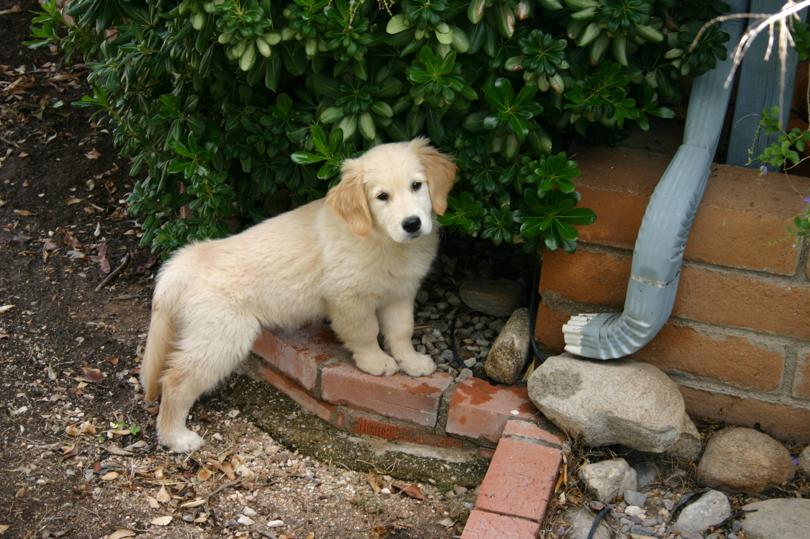
Proof that not all puppies are alligator killers

Slide 45
Custom colors
background: H= 172 S=244 L=70, 0% transparency
emphasis text: G=255
title: H=35, S=255, L=130
standard yellow, R=255, G=255, B=0
footer: H=42, S=255, L=100
Visio backgrounds R=153, G=204, B=255

