Slide 1
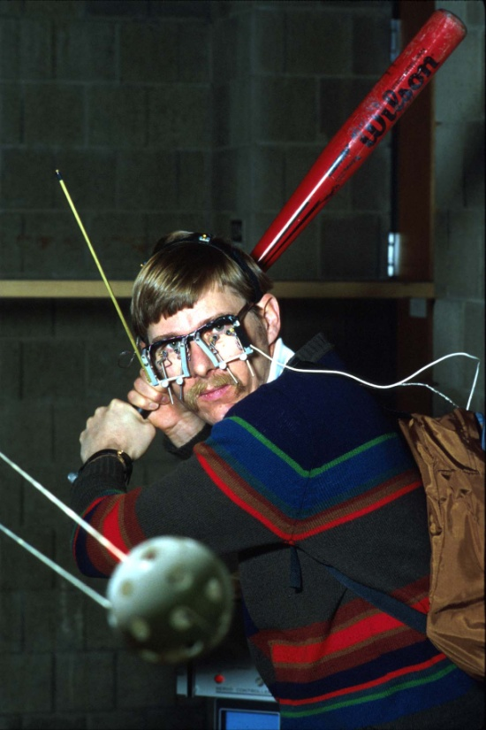

Ancient Mysteries: Portolan Charts
Part 4 The Bird Claw in Africa
A. Terry Bahill
Emeritus Professor of
Systems Engineering
University of Arizona
terry@sie.arizona.edu
©, 2019, Bahill

Slide 2
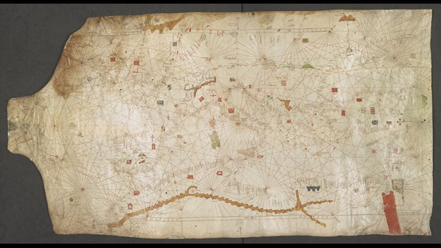
Dulceto, 1339
Notes:
This is the first portolan chart with the bird claw in Africa (that I have found).
The claw is brown in color. (Like sandy hills)
The hook is in between Corsica and Majorca
The Red Sea is, as always, red.
Angelino Dulceto, Latin and Italian
G70124-75 in the British Library

Slide 3

Bumps in the claw look like brown desert mountains

Slide 4
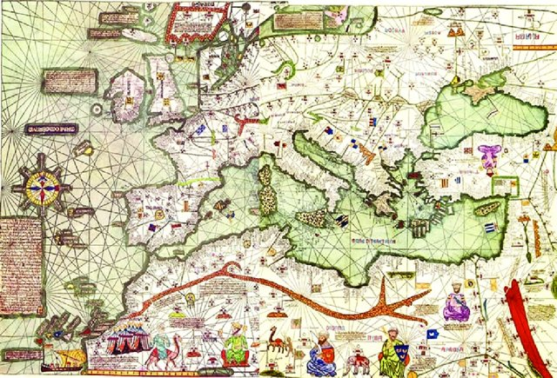
Cresques 1375
All of my portolan charts either have or maybe have this mountain pass
Notes:
The red sea is usually painted red
Abraham Cresques (Catalan pronunciation: [əβɾəˈam ˈkɾeskəs], 1325–1387), whose real name was Cresques (son of) Abraham, was a 14th-century Jewish cartographer from Palma, Majorca (then part of the Crown of Aragon). In collaboration with his son, Jehuda Cresques, Cresques is credited with the authorship of the celebrated Catalan Atlas of 1375.

Slide 5
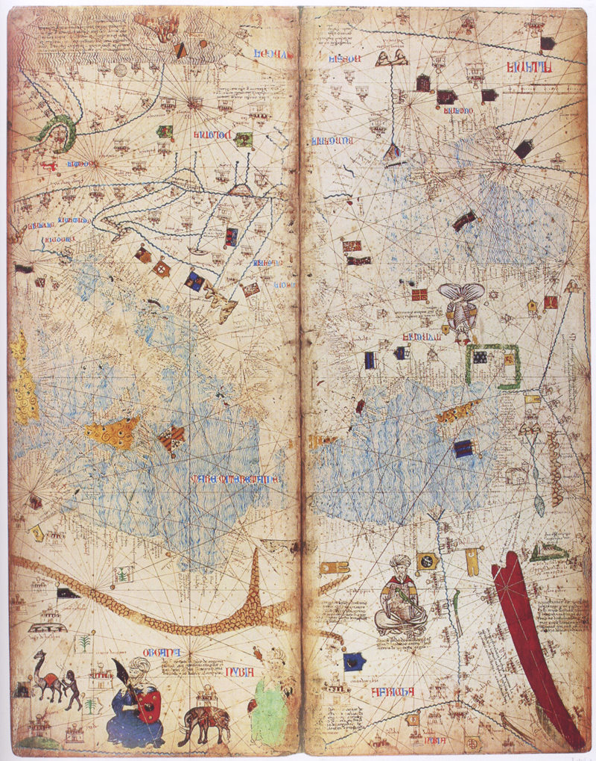
Catalan Atlas
(Cresques) 1375

Slide 6
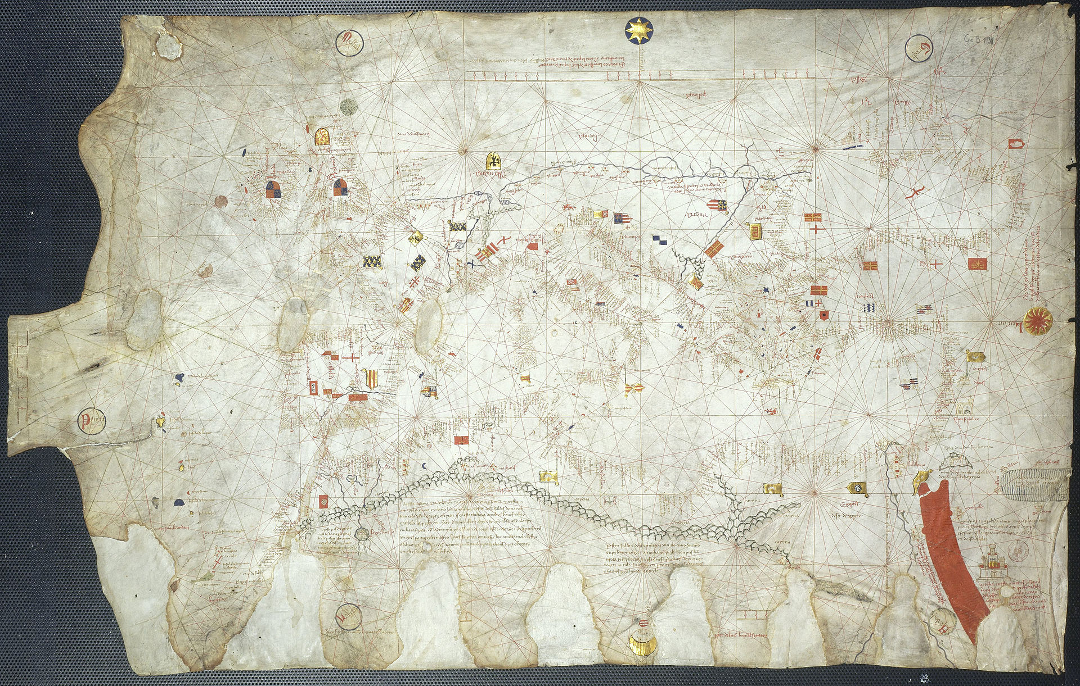
Soler 1380
Notes:
The claw lost its color but not its shape

Slide 7
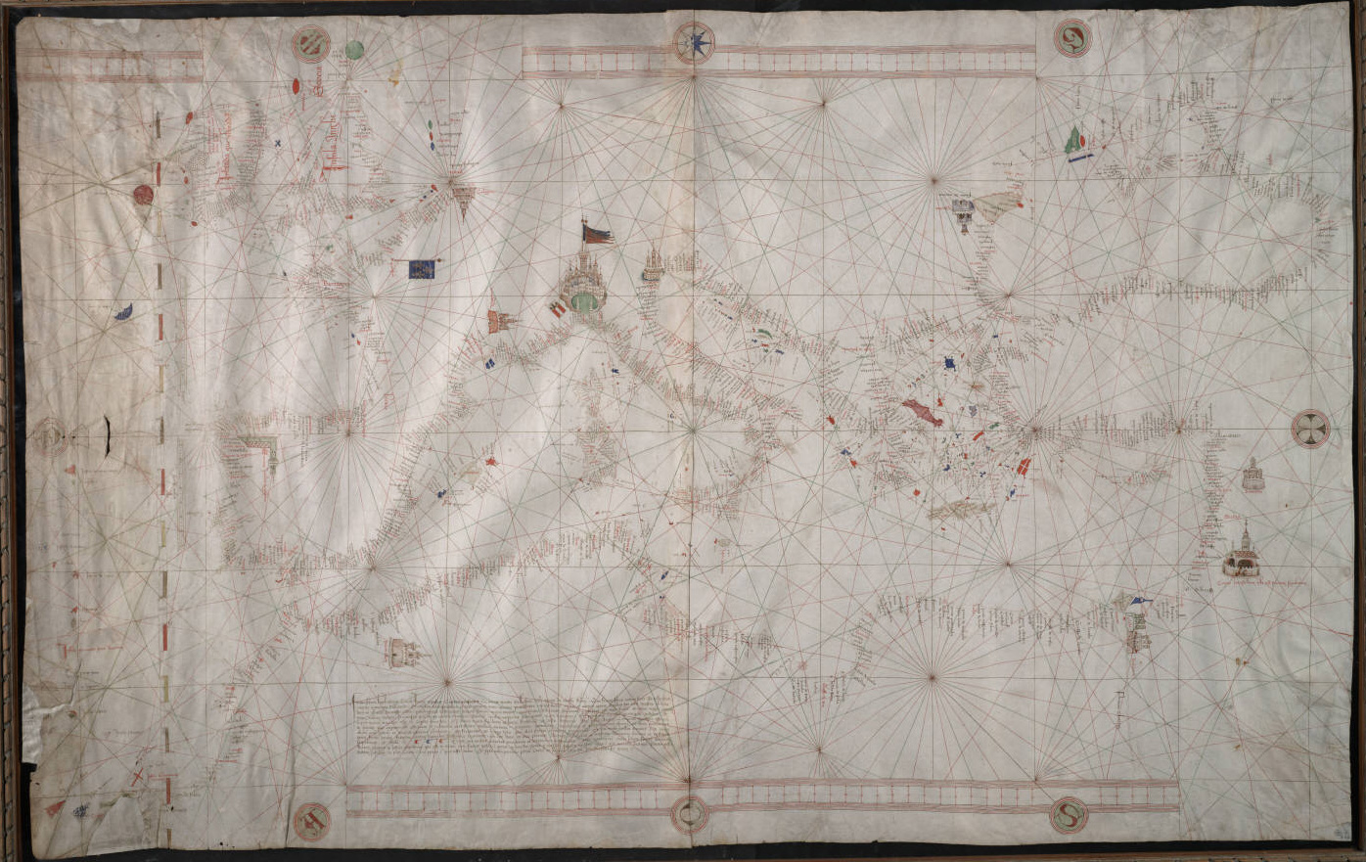
Becharius, 1403
There is no bird claw in Africa!

Slide 8
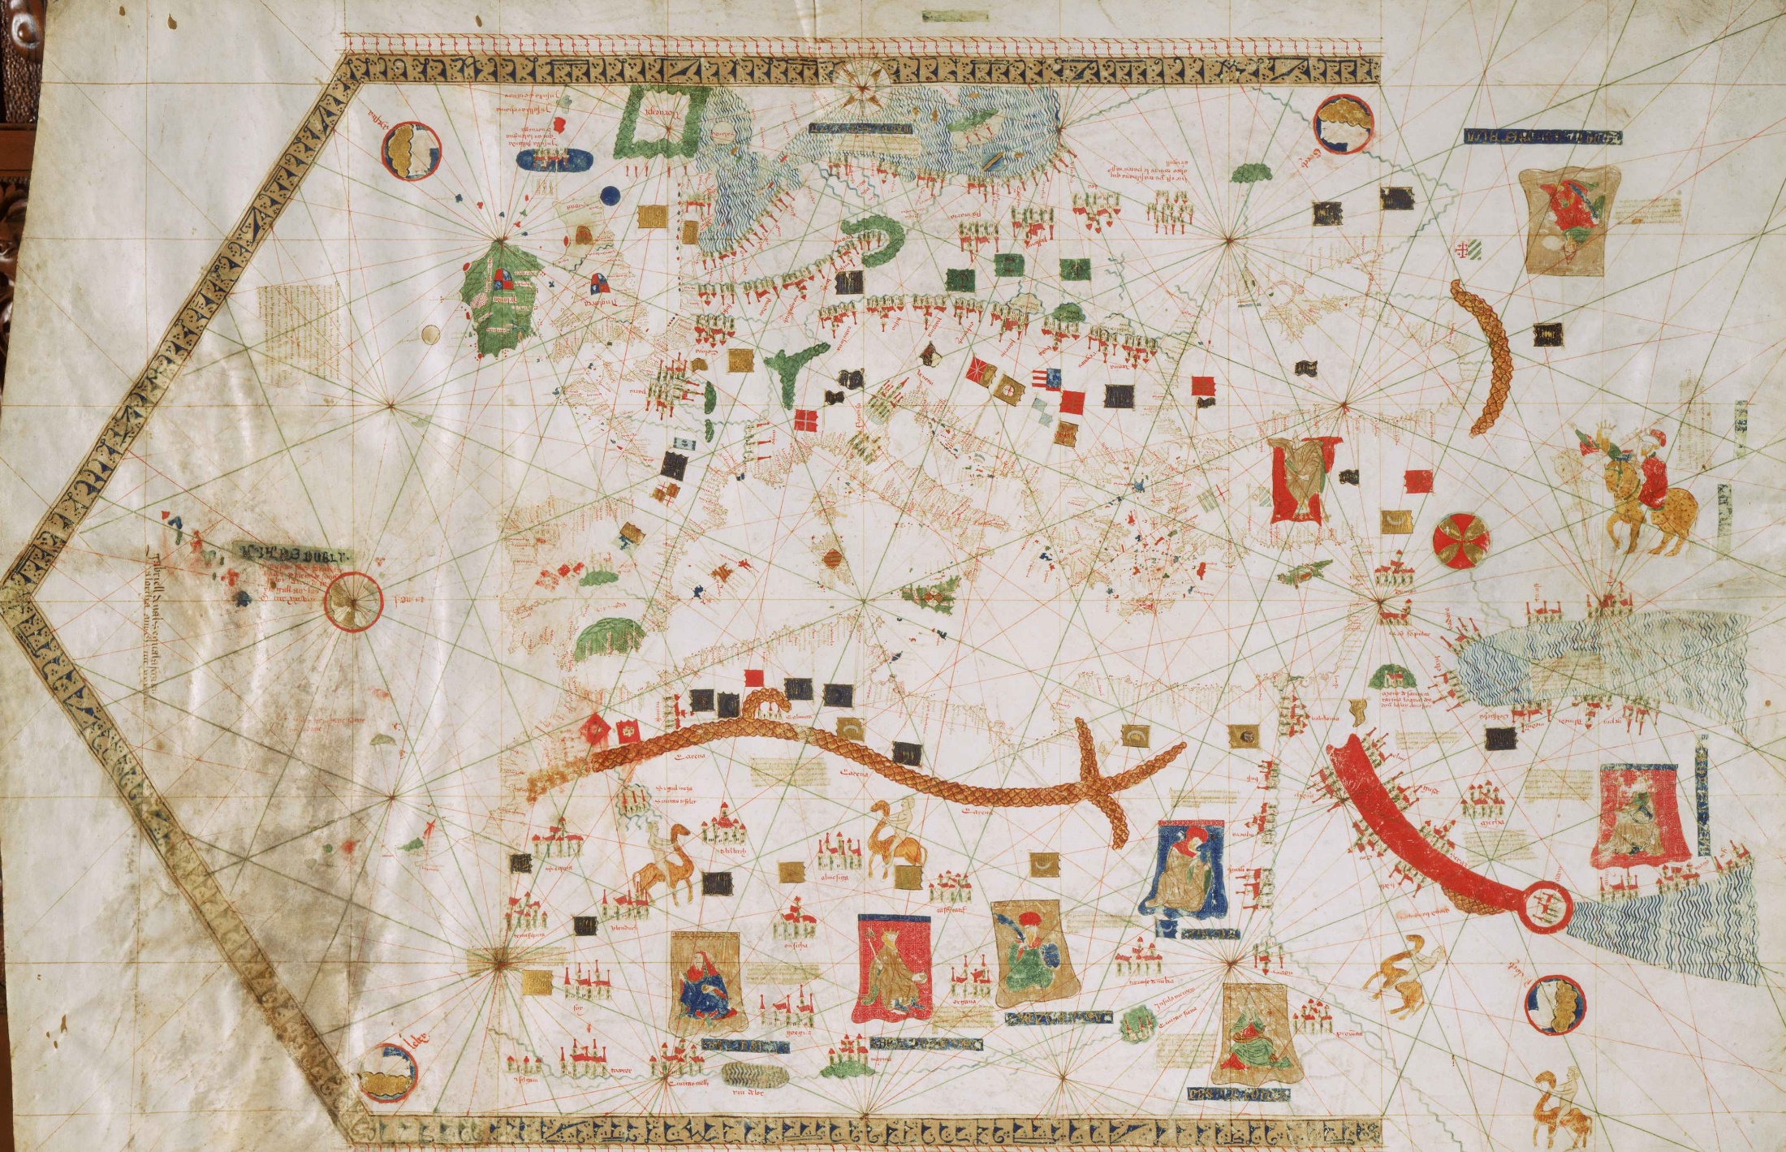
Vallseca 1439
Is this bird claw pushed up with the hook pushed left?
Notes:
1439 portolan chart by Gabriel de Vallseca
A Catalan cartographer of Jewish descent connected to the Majorcan cartographic center.
The red sea is painted red
The Alps are in green
What is the red crescent in the upper-right? Caucasus mountains?
The Azores in the middle left are new.

Slide 9
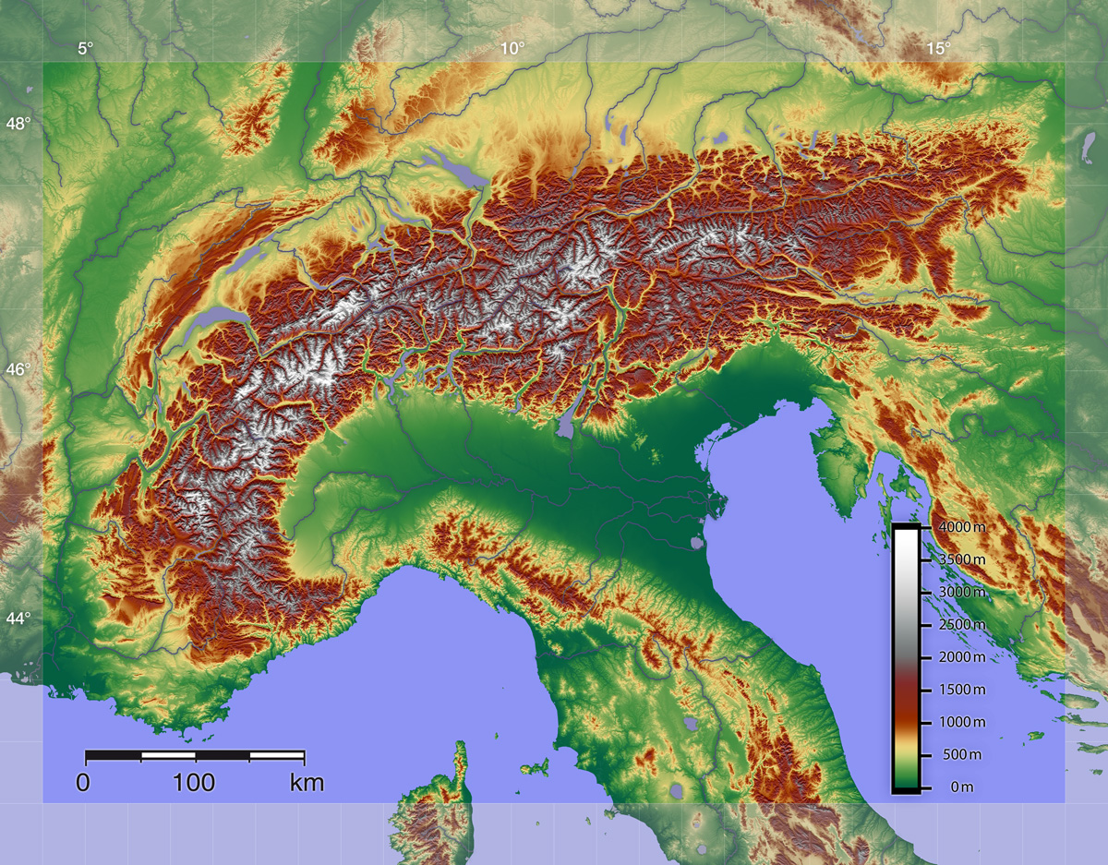
Alps

Slide 10
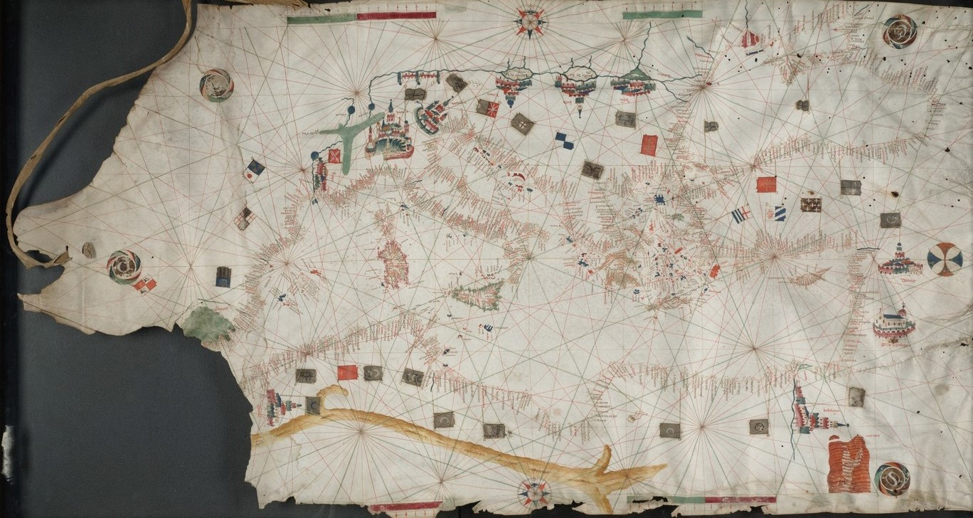
Petrus Roselli, 1450
Notes:
The Alps are bigger. The hook in Africa has moved left. 56 by 104 cm.

Slide 11
Roselli, 1465
“This mountain range is called Carena by the Saracens and by the Christians the white mountains. Note that in these mountains are many good cities and castles which make war against the others. Note that in the said mountains there is an abundance of all goods of the world”

Slide 12
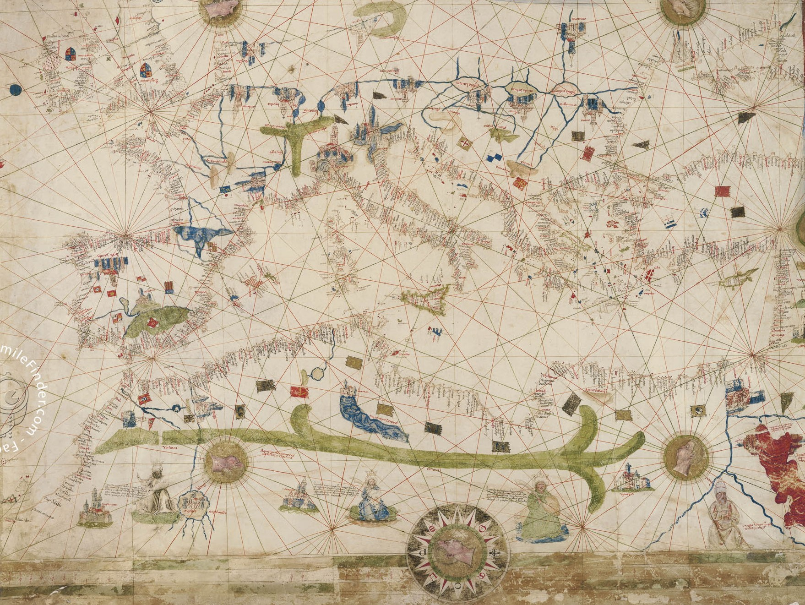
CGA5d 1450
Notes:
Alps copied
Pyrenees in blue
Red Sea shows Moses’ path through it
The claw is green, like the Alps

Slide 13
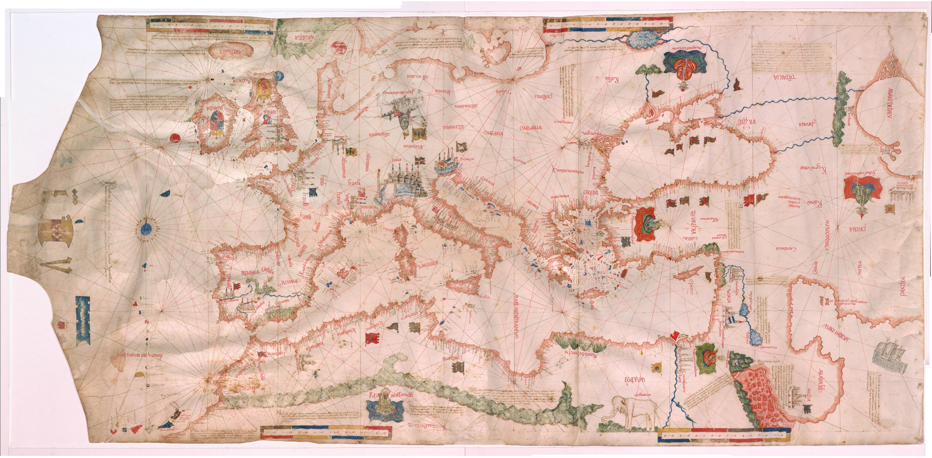
Pareto 1455
Notes:
Caucasus?

Slide 14
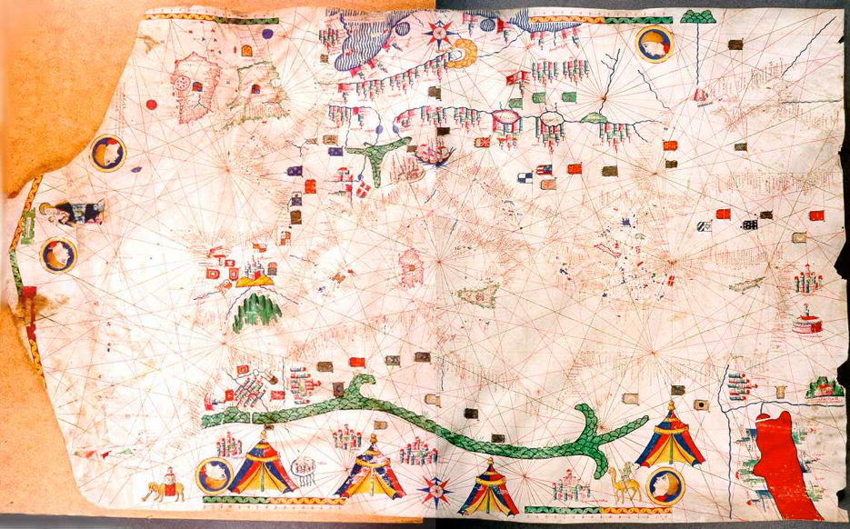
Roselli 1466
Notes:
Majorca this example dates from 1465, the Catalan tradition
Alps copied
Red Sea copied

Slide 15
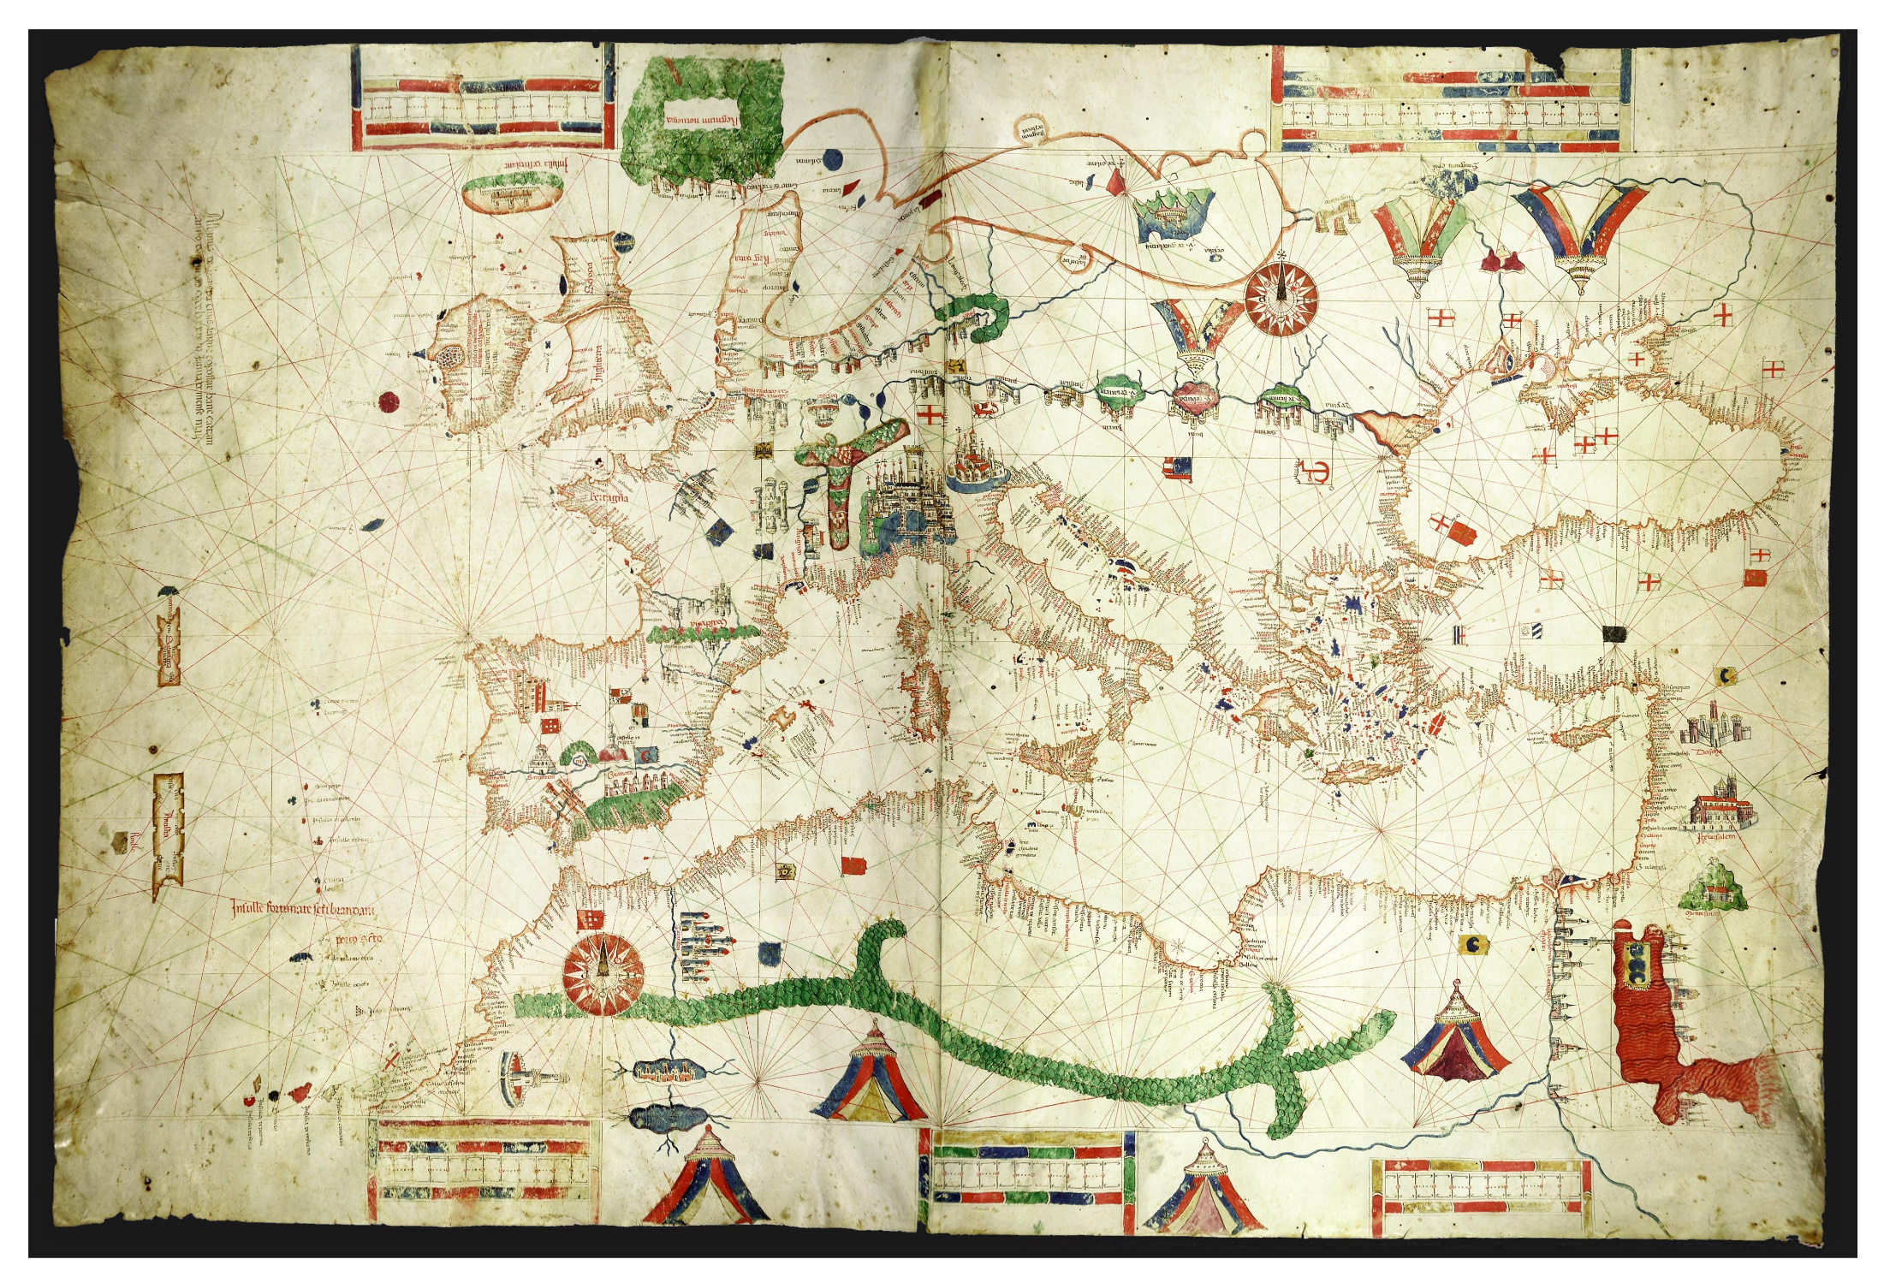
Canepa 1489
Notes:
Alps and Pyrenees in green
de Canepa trained as an apprentice in Roselli’s atelier.

Slide 16
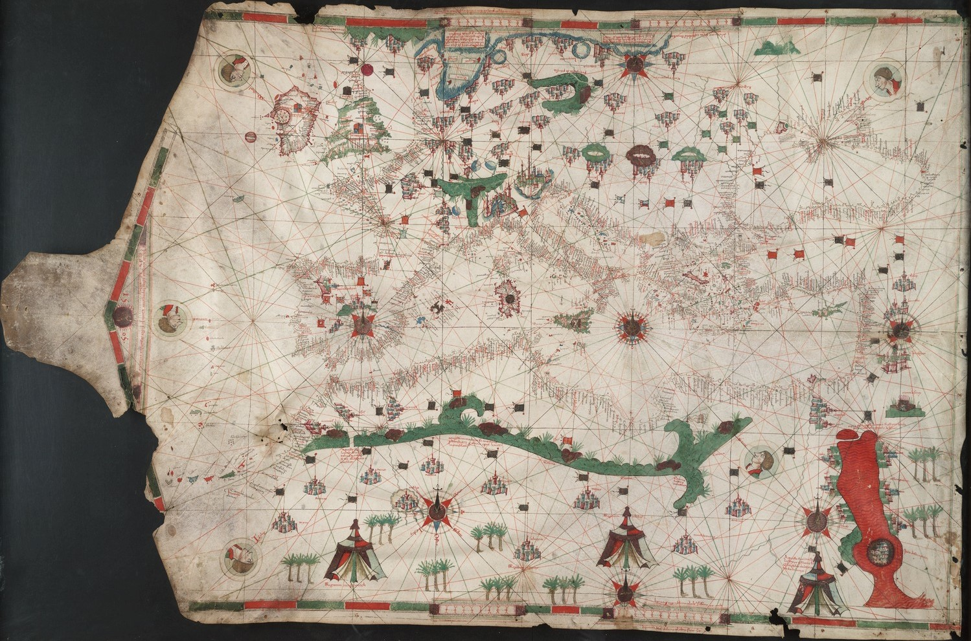
ben Zara 1497
Notes:
Alps
Red Sea copied

Slide 17
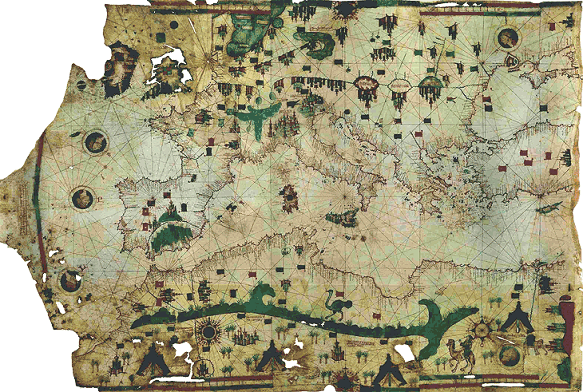
ben Zara 1500
Notes:
Alps

Slide 18
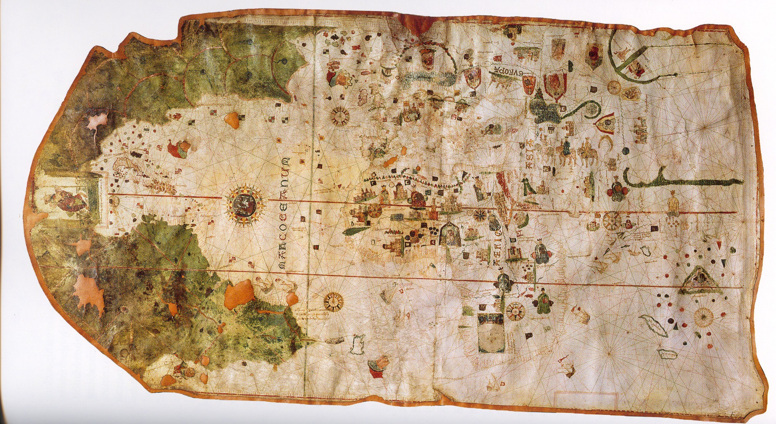
Juan de la Casa, 1500, second bird claw

Slide 19
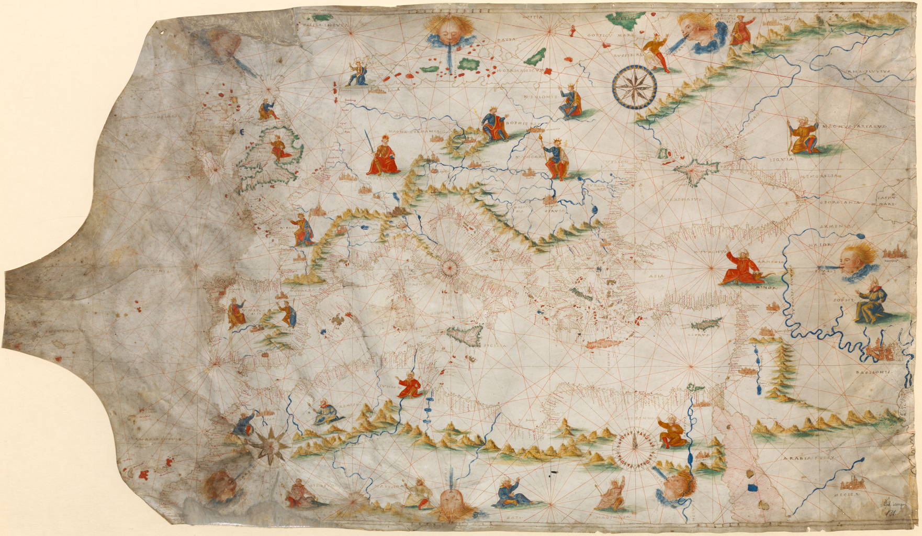
Unknown 1505
Notes:
These really look like mountains

Slide 20
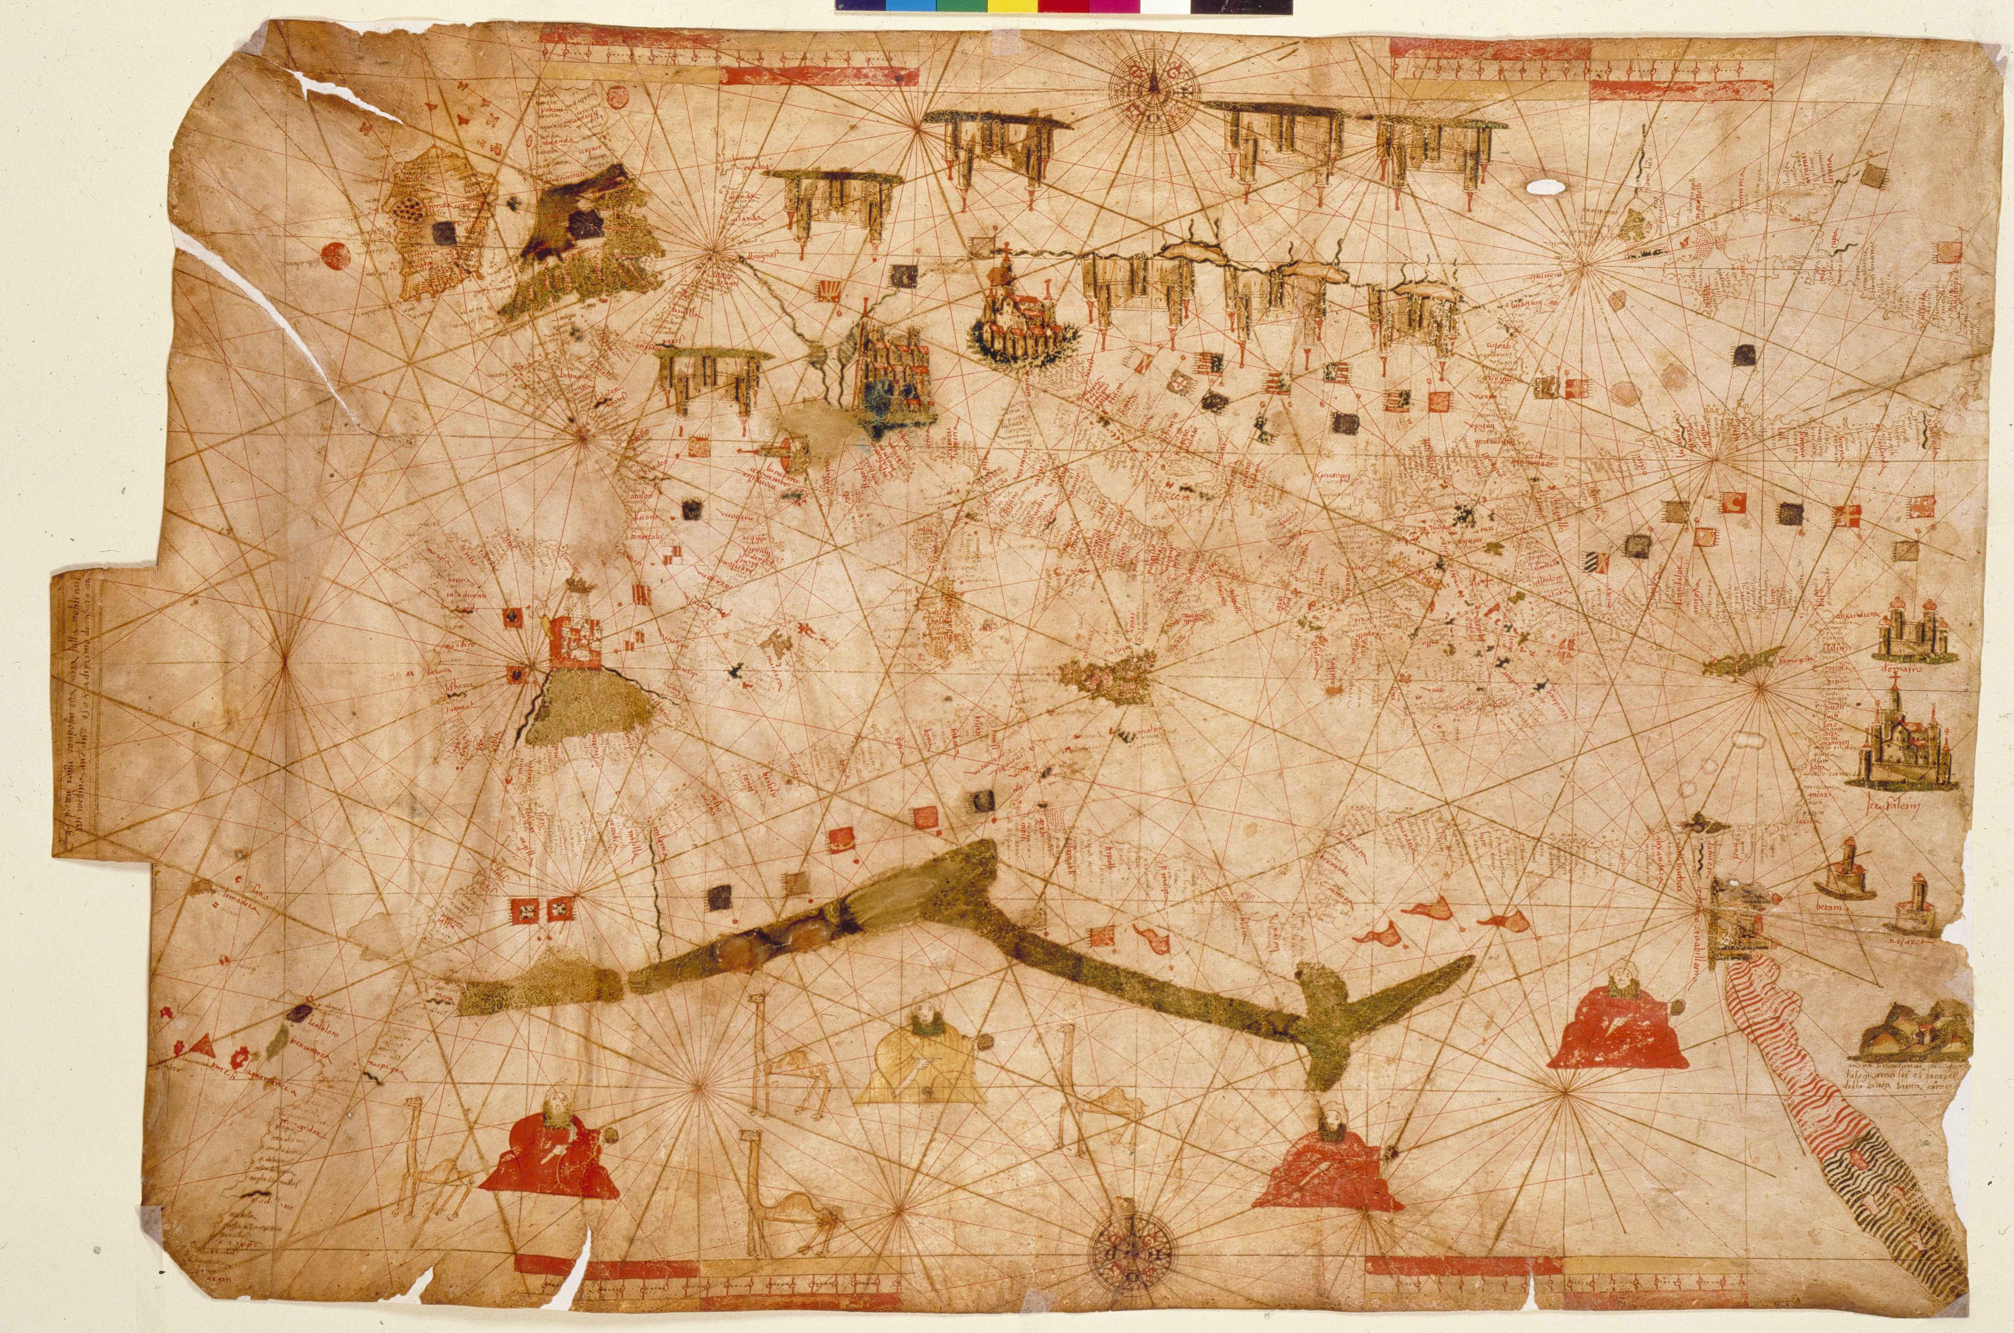
Russo 1508

Slide 21
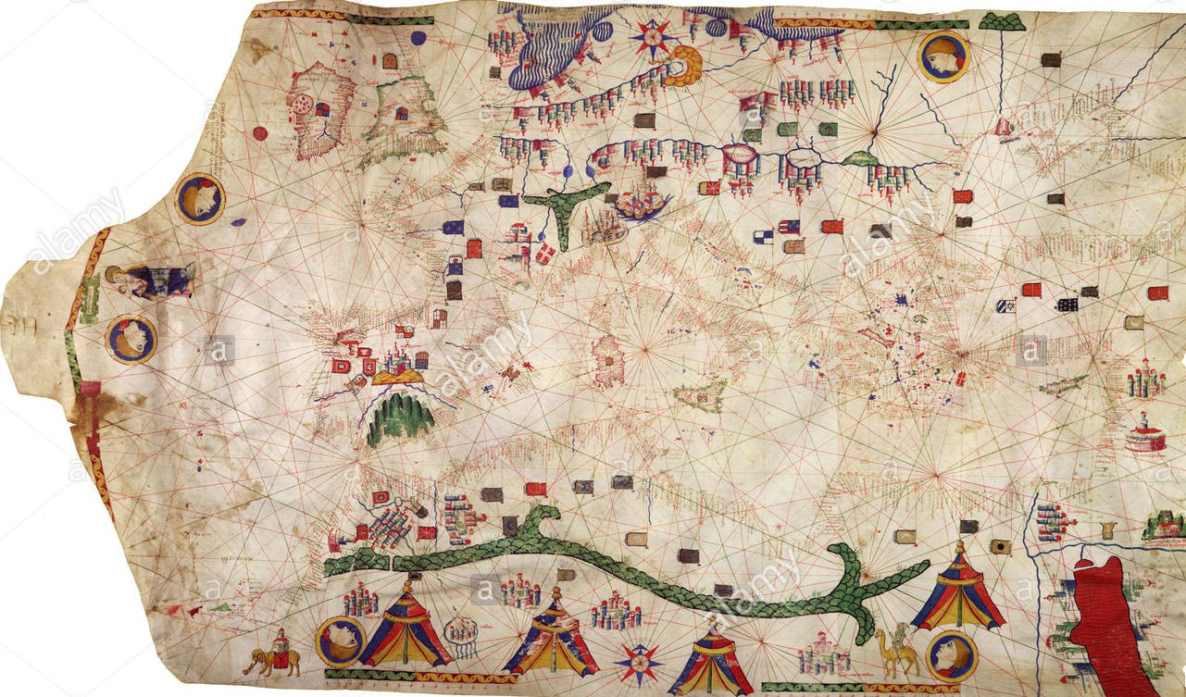
Jacobus
Russus, 1533
Notes:
Very much like Roselli 1466, but Tin Eye says it is not the same
The flags at the middle right are different
Jacobus Russus of Messina Sicily, aka Giacoma Russo

Slide 22
Roselli 1466
Notes:
Majorca this example dates from 1465, the Catalan tradition
Alps copied
Red Sea copied

Slide 23
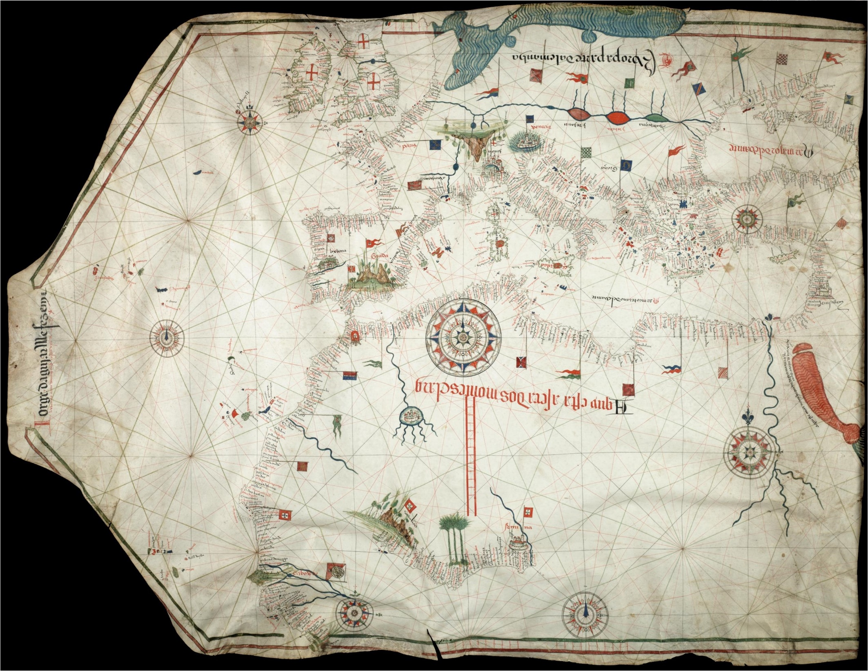
Agular 1492
No bird claw in Africa

Slide 24
They stopped putting the bird claw in Africa around 1530 AD

Slide 25
Mountains on non portolan charts

Slide 26
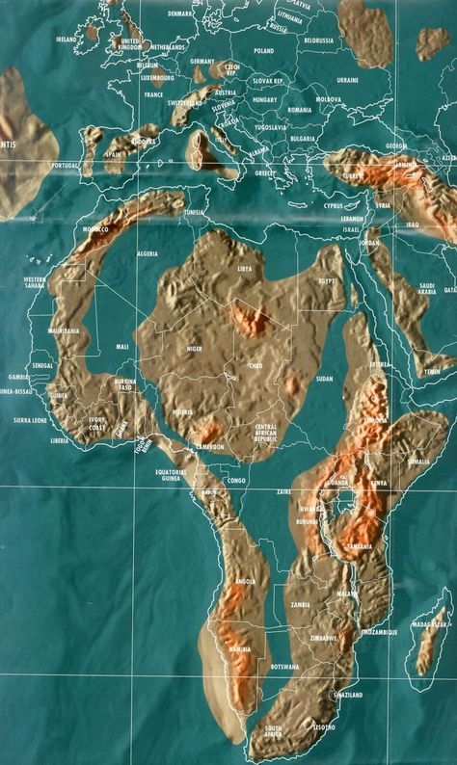
Global warming
Notes:
There are no mountains that go right across north Africa

Slide 27
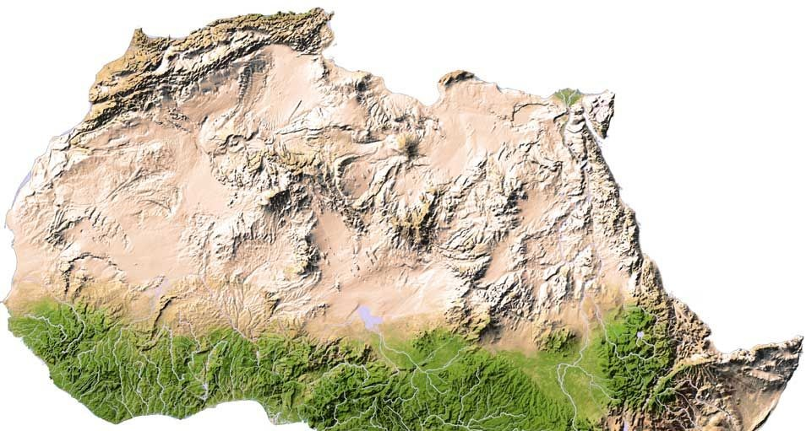
North Africa
Atlas Mountains
Tibesti Mountains
Notes:
The crescent shape may be the Tibesti Mountains, 20 deg North 18 deg East
Highest point is 19 deg N, 20 deg E

Slide 28
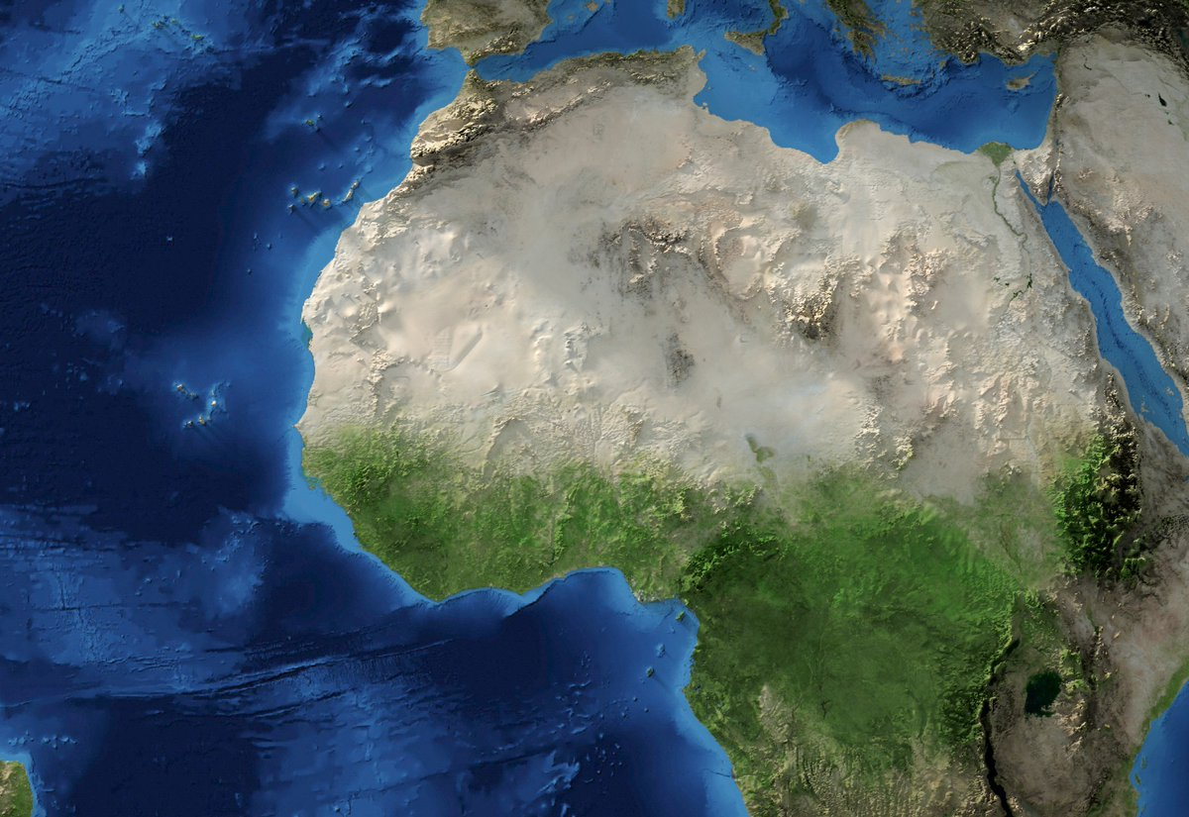

Slide 29
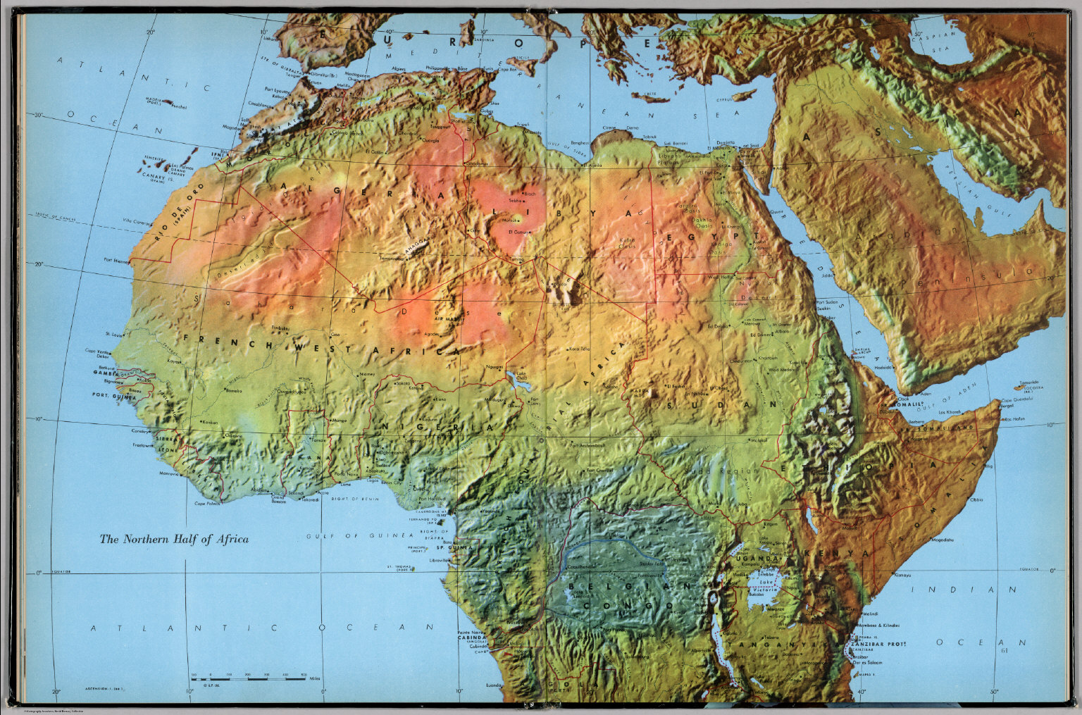
Africa
Tibesti Mountains
Notes:
25 deg N and 12 deg E

Slide 30
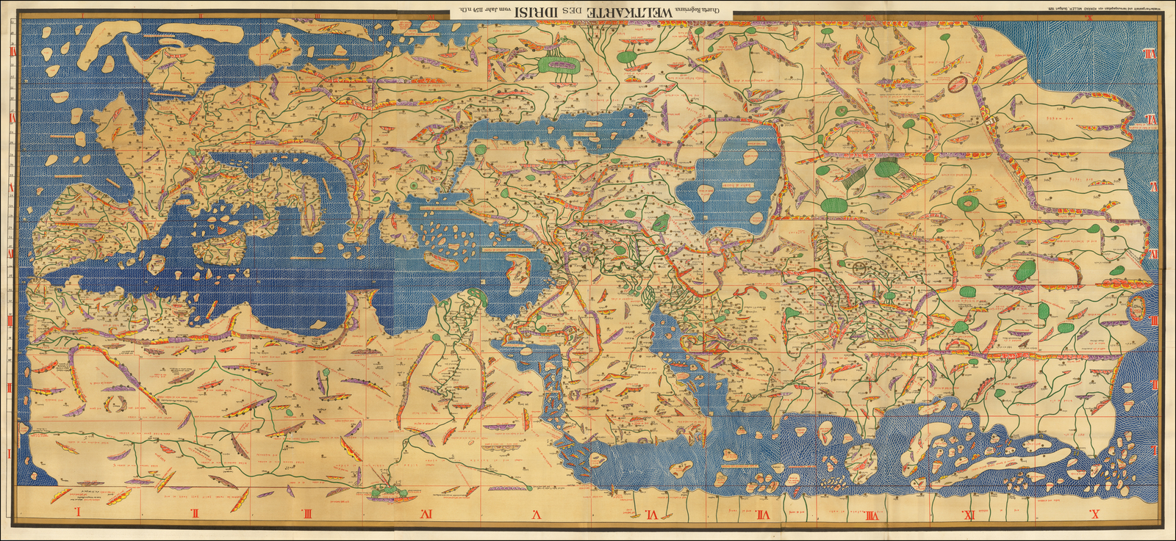
Ptolemy 150 AD, reconstructed by al-Idrisi in 1154
Notes:
This has the claw in Africa, the Alps and the Pyrenees. But it does not have the “mountain pass” in Morocco

Slide 31
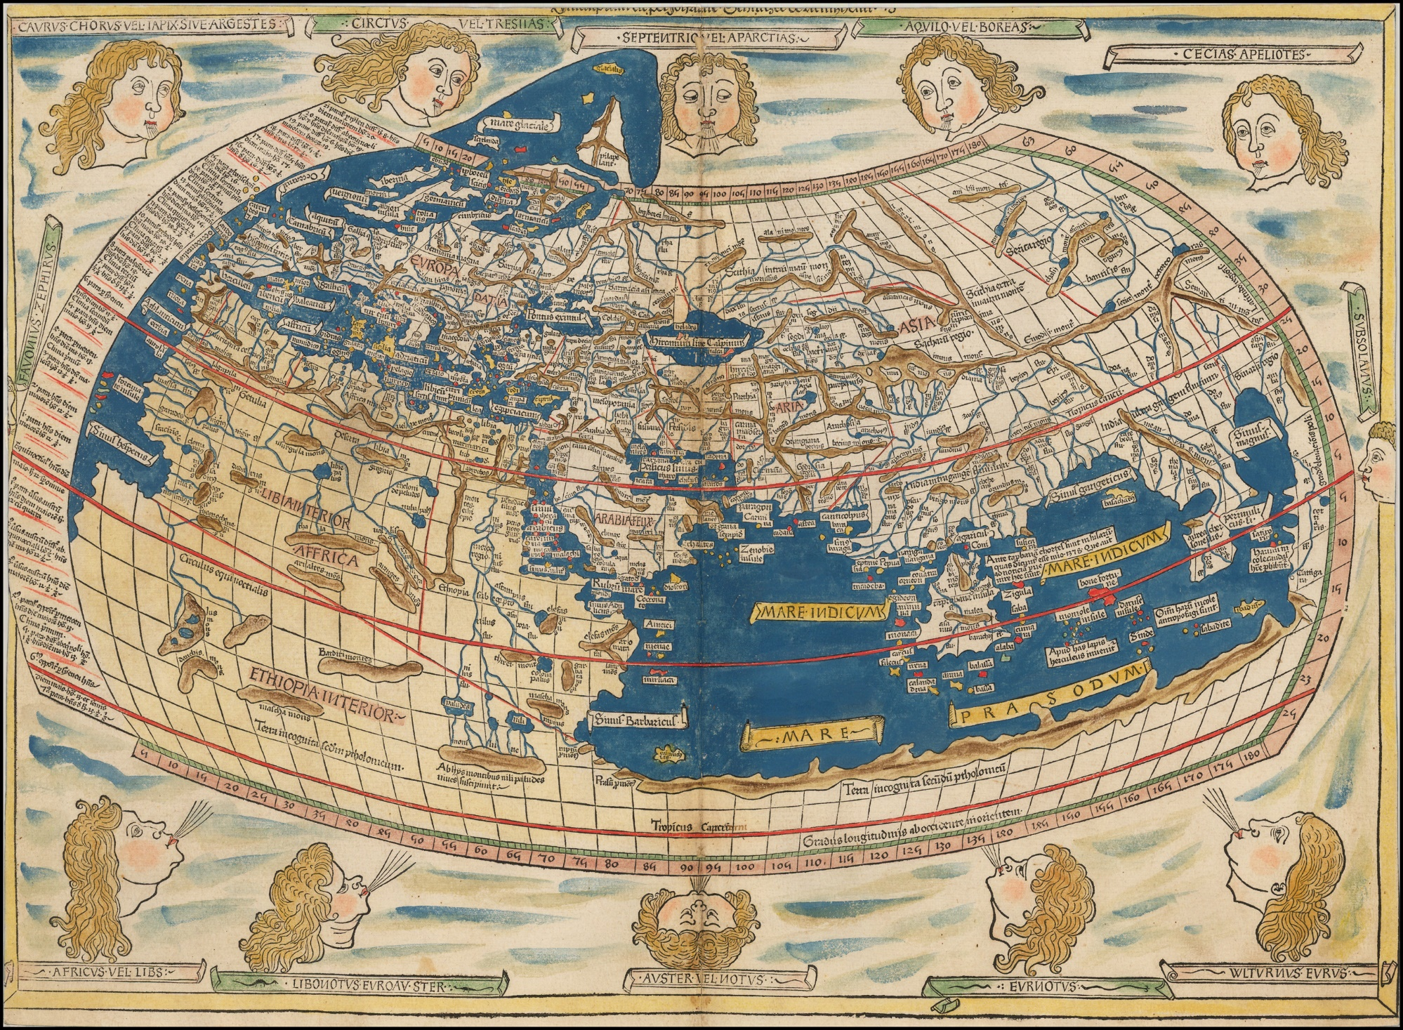
Ptolemy 150 AD, reconstructed in 1482, note the sixteen winds
Notes:
It has the claw in Africa

Slide 32
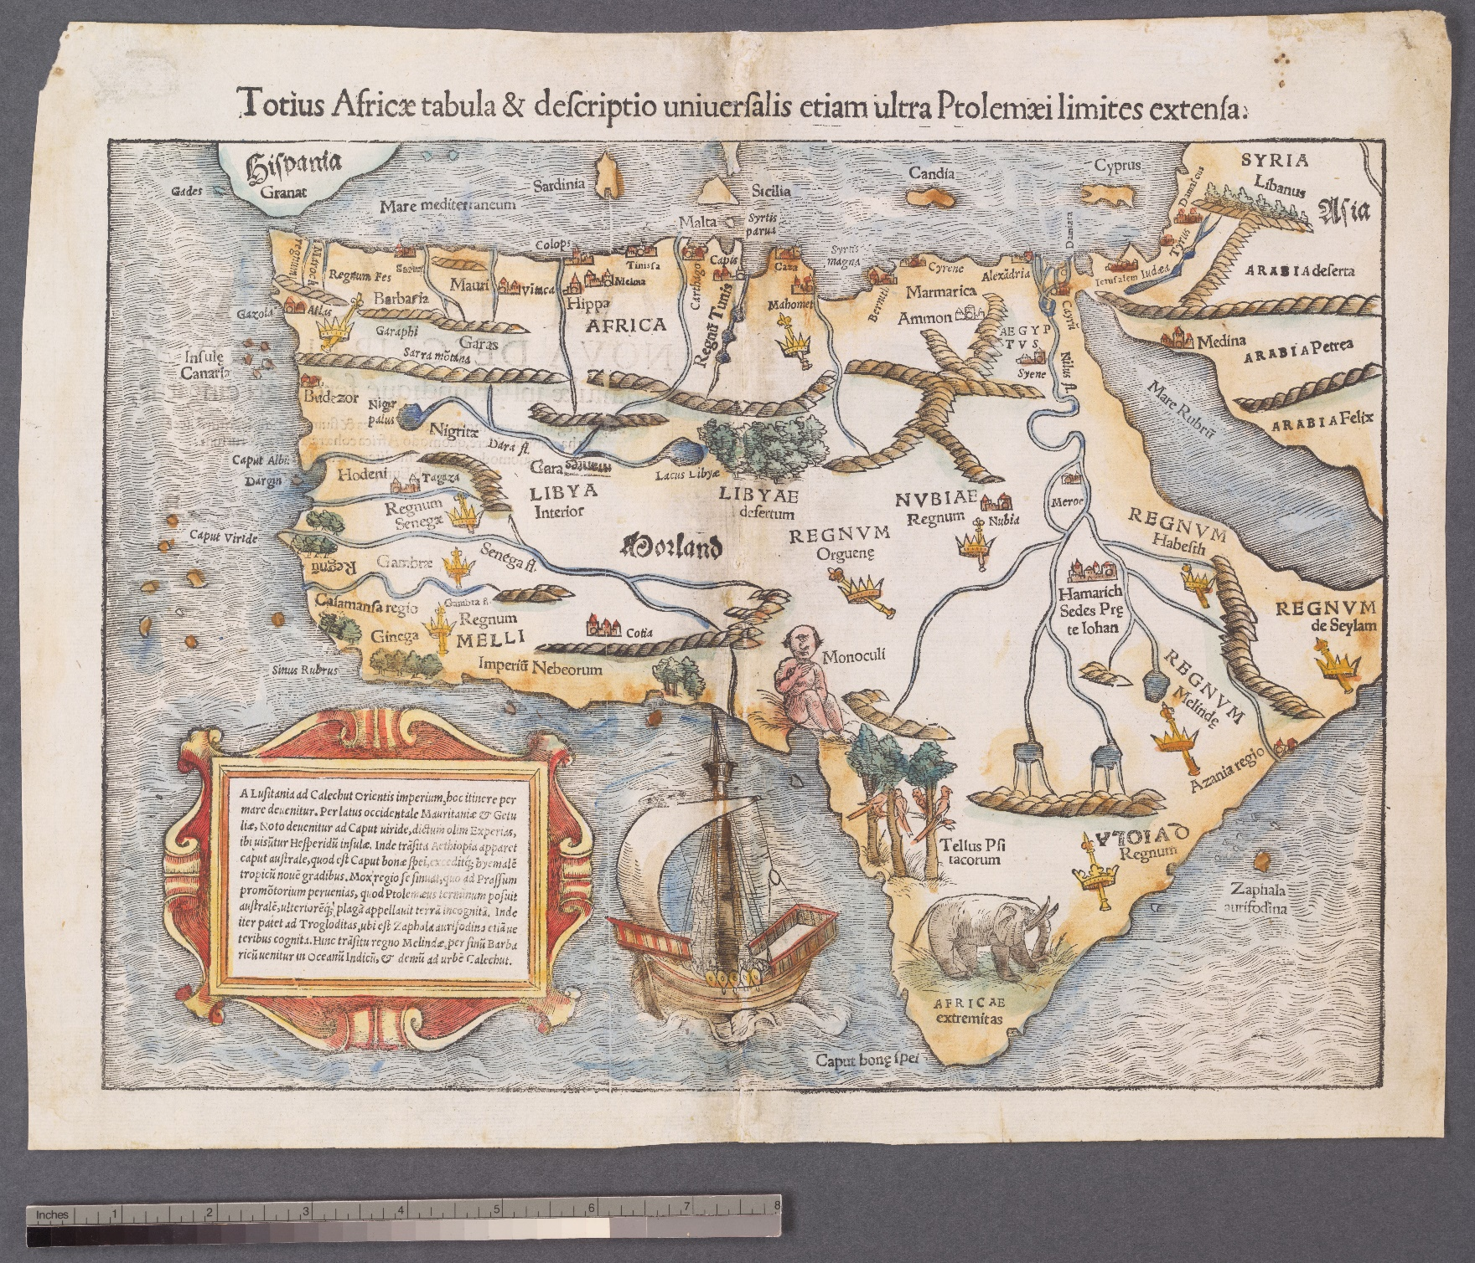
Munster 1542
Notes:
It has the claw in Africa

Slide 33
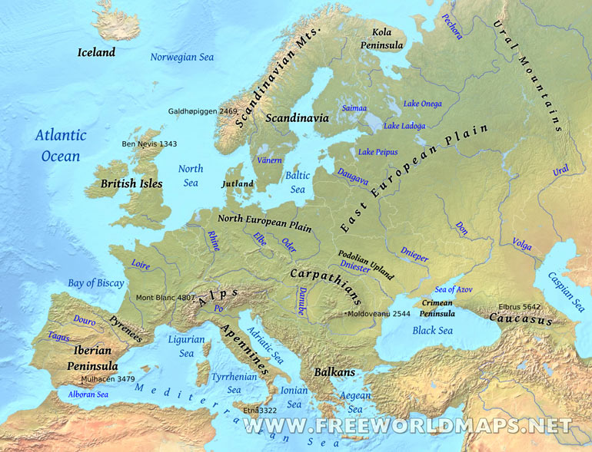
The bird claw in Africa

Slide 34
