Slide 1
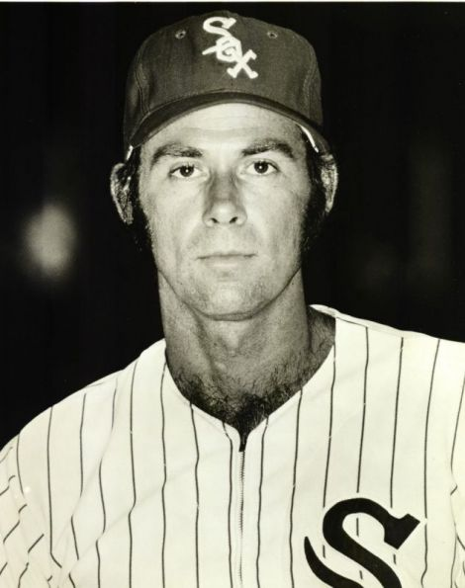

Depth Perception
Terry Bahill
Emeritus Professor of Systems Engineering
University of Arizona
terry@sie.arizona.edu
http://www.sie.arizona.edu/sysengr/
Dave Baldwin
Relief Pitcher Emeritus
Chicago White Sox Baseball Organization
SnakeJazz_37@brainpip.com
http://www.alkydair.com/index.html
Copyright © 2005-2012, Bahill and Baldwin
Notes:
The old title was Engineering the Sport of Baseball.

Slide 3
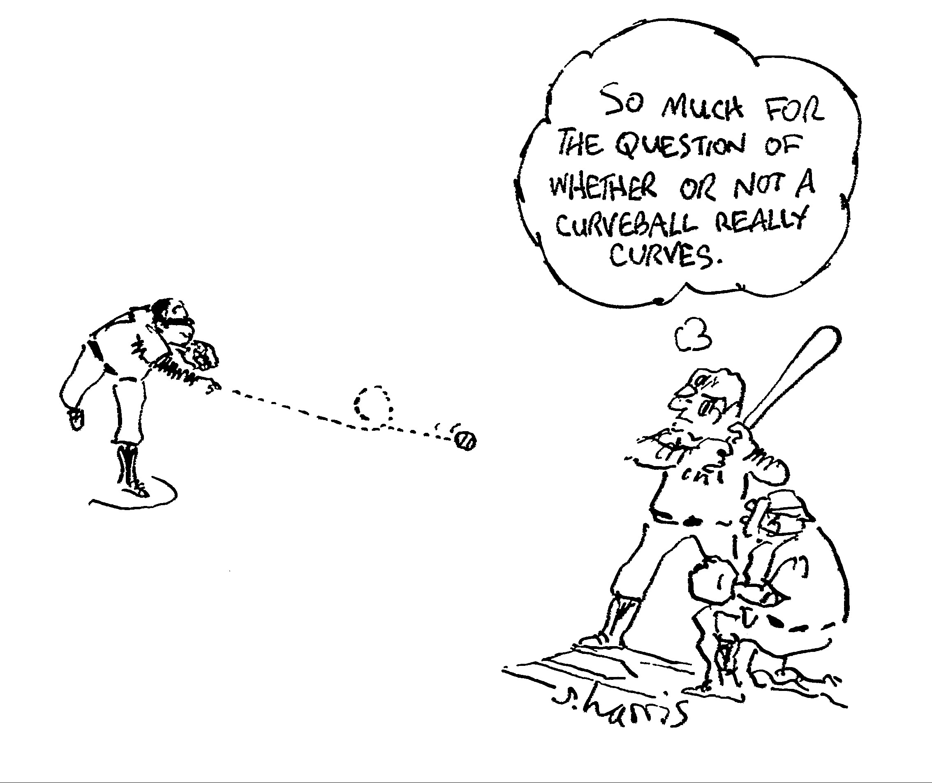
Notes:
With some more forces, maybe we could get this trajectory.

Slide 4
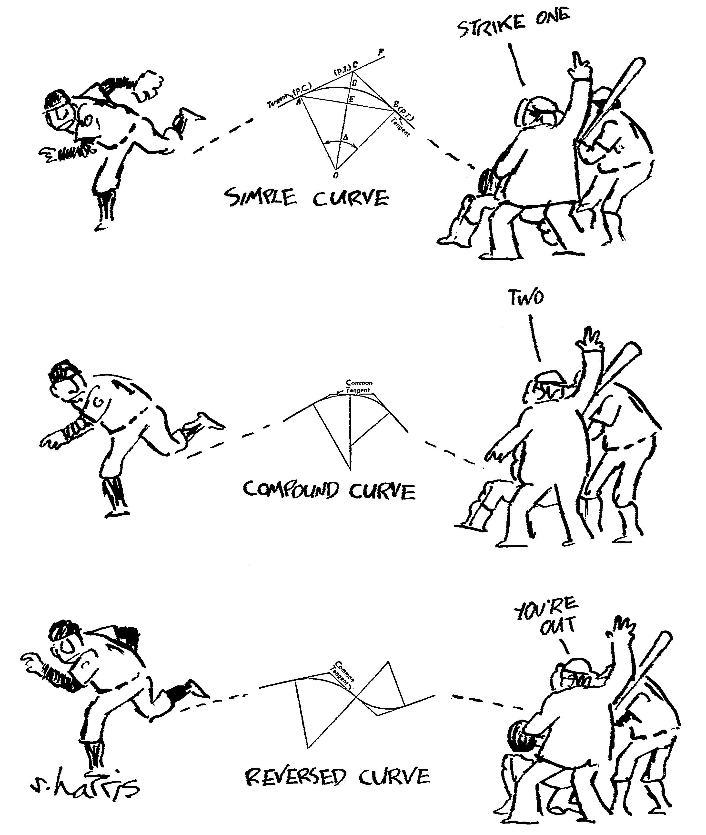
Notes:
This cartoon shows some of the variation.

Slide 5
Velocity and spin
Once the ball is in the air, its motion depends only on gravity, velocity and spin, which are vectors with magnitude and direction.*
These pitch characteristics are described by a linear velocity vector and an angular velocity vector, each with magnitude and direction.
The magnitude of the linear velocity vector is called pitch speed and the magnitude of the angular velocity vector is called spin rate.
Notes:
Air density and ball parameters (size, weight, smoothness) have second order effects.
The Magnus force is proportional to air density, which is inversely proportional to temperature, altitude and humidity.

Slide 6
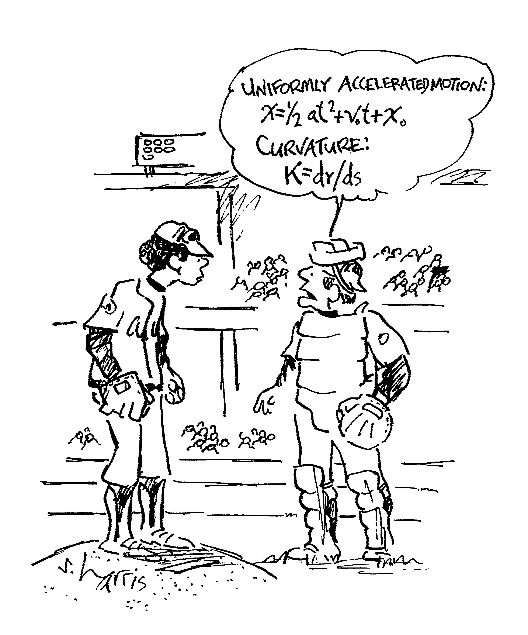
We need to simplify this
Notes:
I think that I can make this a bit simpler.

Slide 7
Dave Baldwin said,
“If a major league baseball pitcher* describes the flight of one of his pitches; he usually illustrates the trajectory using his pitching hand, much like a kid or a pilot demonstrating the yaw, pitch and roll of an airplane.
The hand used as an analog in this way is a gestural example of a somatic metaphor.”
Notes:
Most of the pictures and comments in this section are from the perspective of the pitcher, usually a right-handed pitcher.

Slide 8
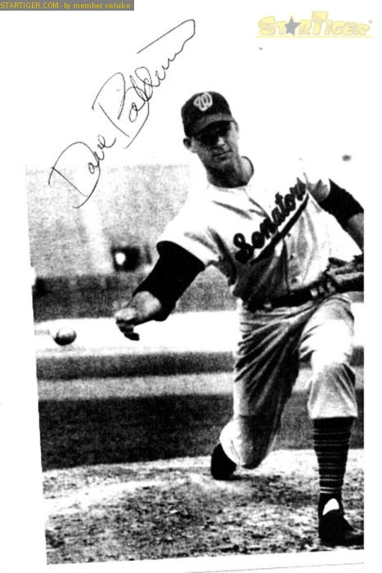
Pitcher’s perspective
The first half of this presentation is about physics and how the pitcher can make the ball move.
So, with the exception of that last slide, all slides with spinning balls will be from the pitcher’s perspective.
Specifically a right-handed pitcher, because Dave Baldwin was a right-handed relief pitcher. Dave threw a submarine pitch.

Slide 9
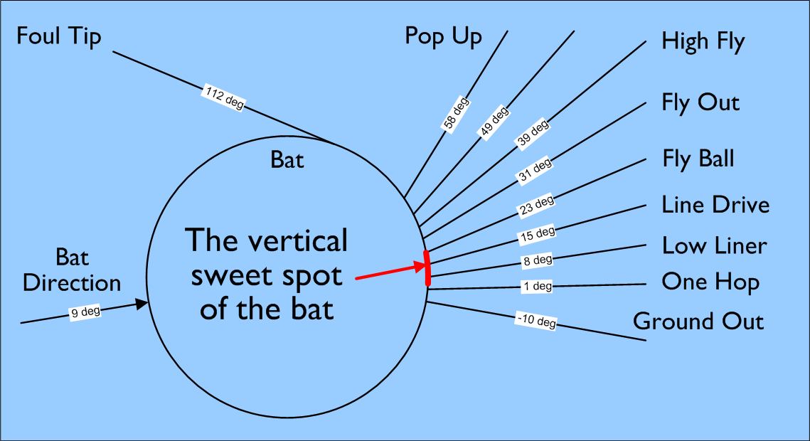
Vertical sweet spot

Slide 10
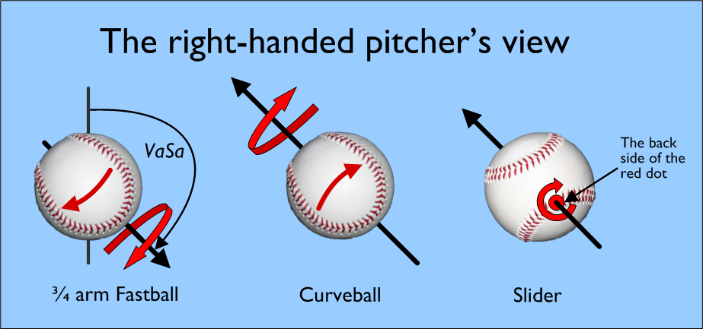
Spin axis for common pitches

Slide 11
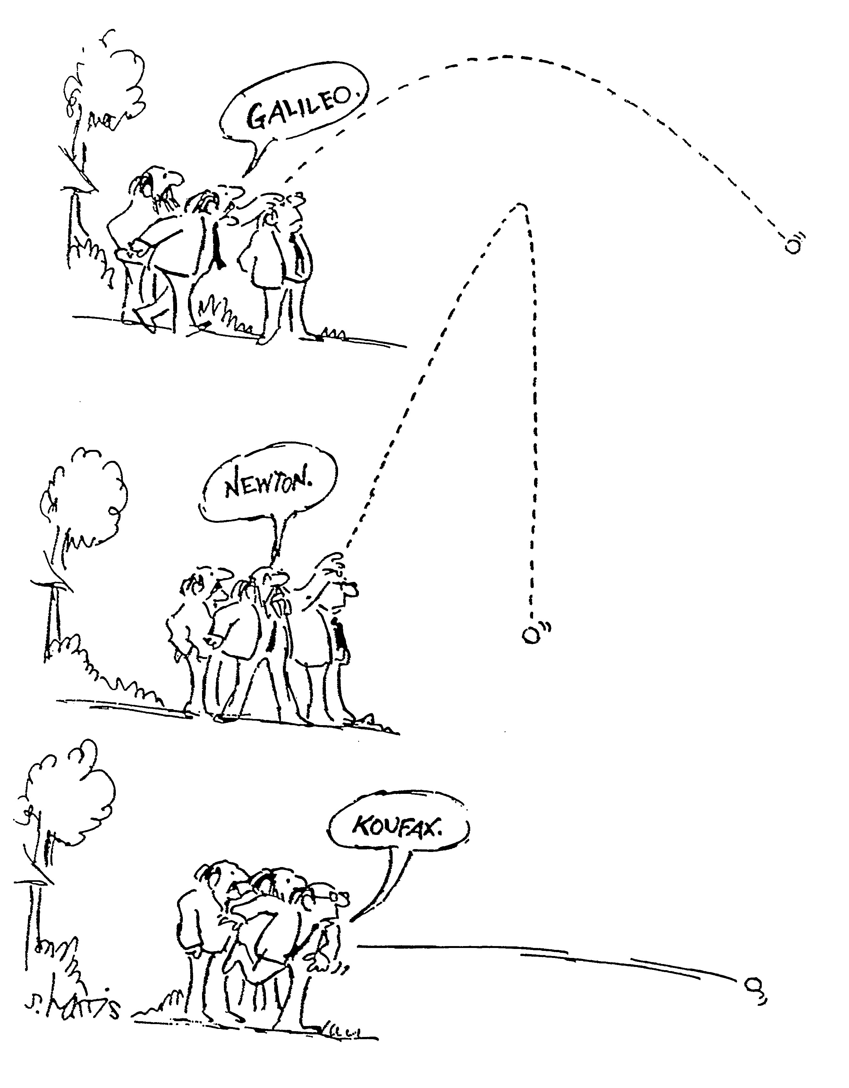
Notes:
Three famous demonstrations of the physics of the ball’s flight.

Slide 12
Bahill’s model for a spinning ball in a moving airflow
VaSa is the angle from the Vertical axis to the Spin axis.
SaD is the angle from the Spin axis to the Direction of motion
Notes:
We use Cd = 0.5.
Al Nathan has a different set of equations for his model.
But his model produces results just like my model.

Slide 13
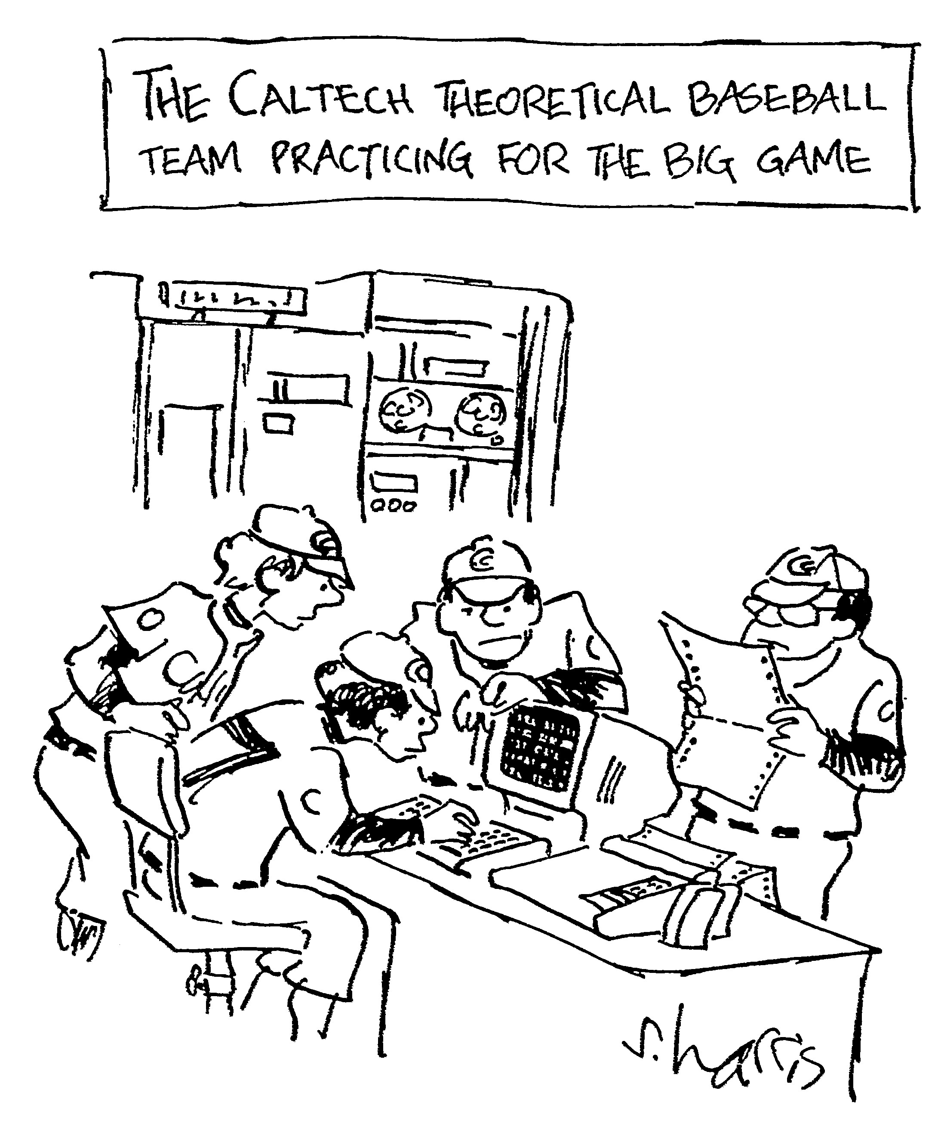
Notes:
It will take our best people to answer these questions.

Slide 14
To simplify, use models
A model is a simplified representation of a particular aspect of a real-world system.
This is a good model for the vertical aspect of a major league fastball.
Notes:
Bahill drops a baseball here.

Slide 15
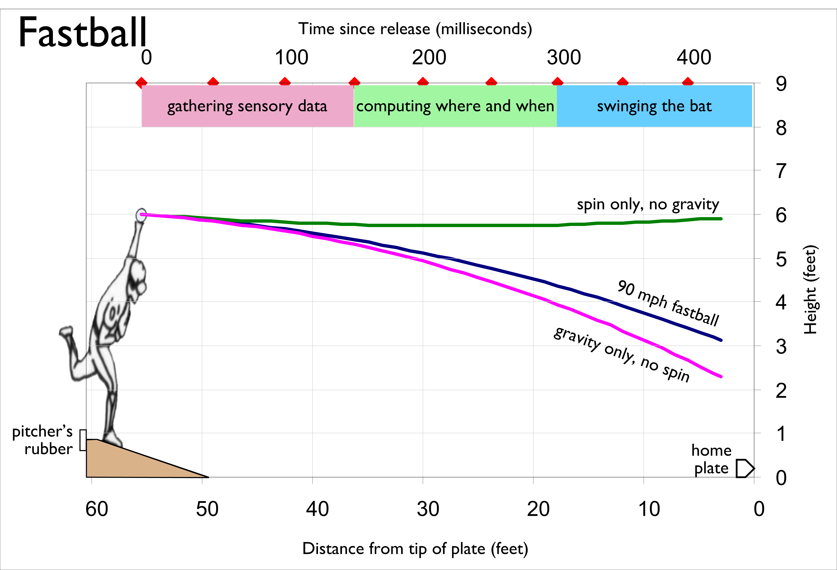
Notes:
launched one-degree downward with 1200 rpm of back spin.

Slide 17
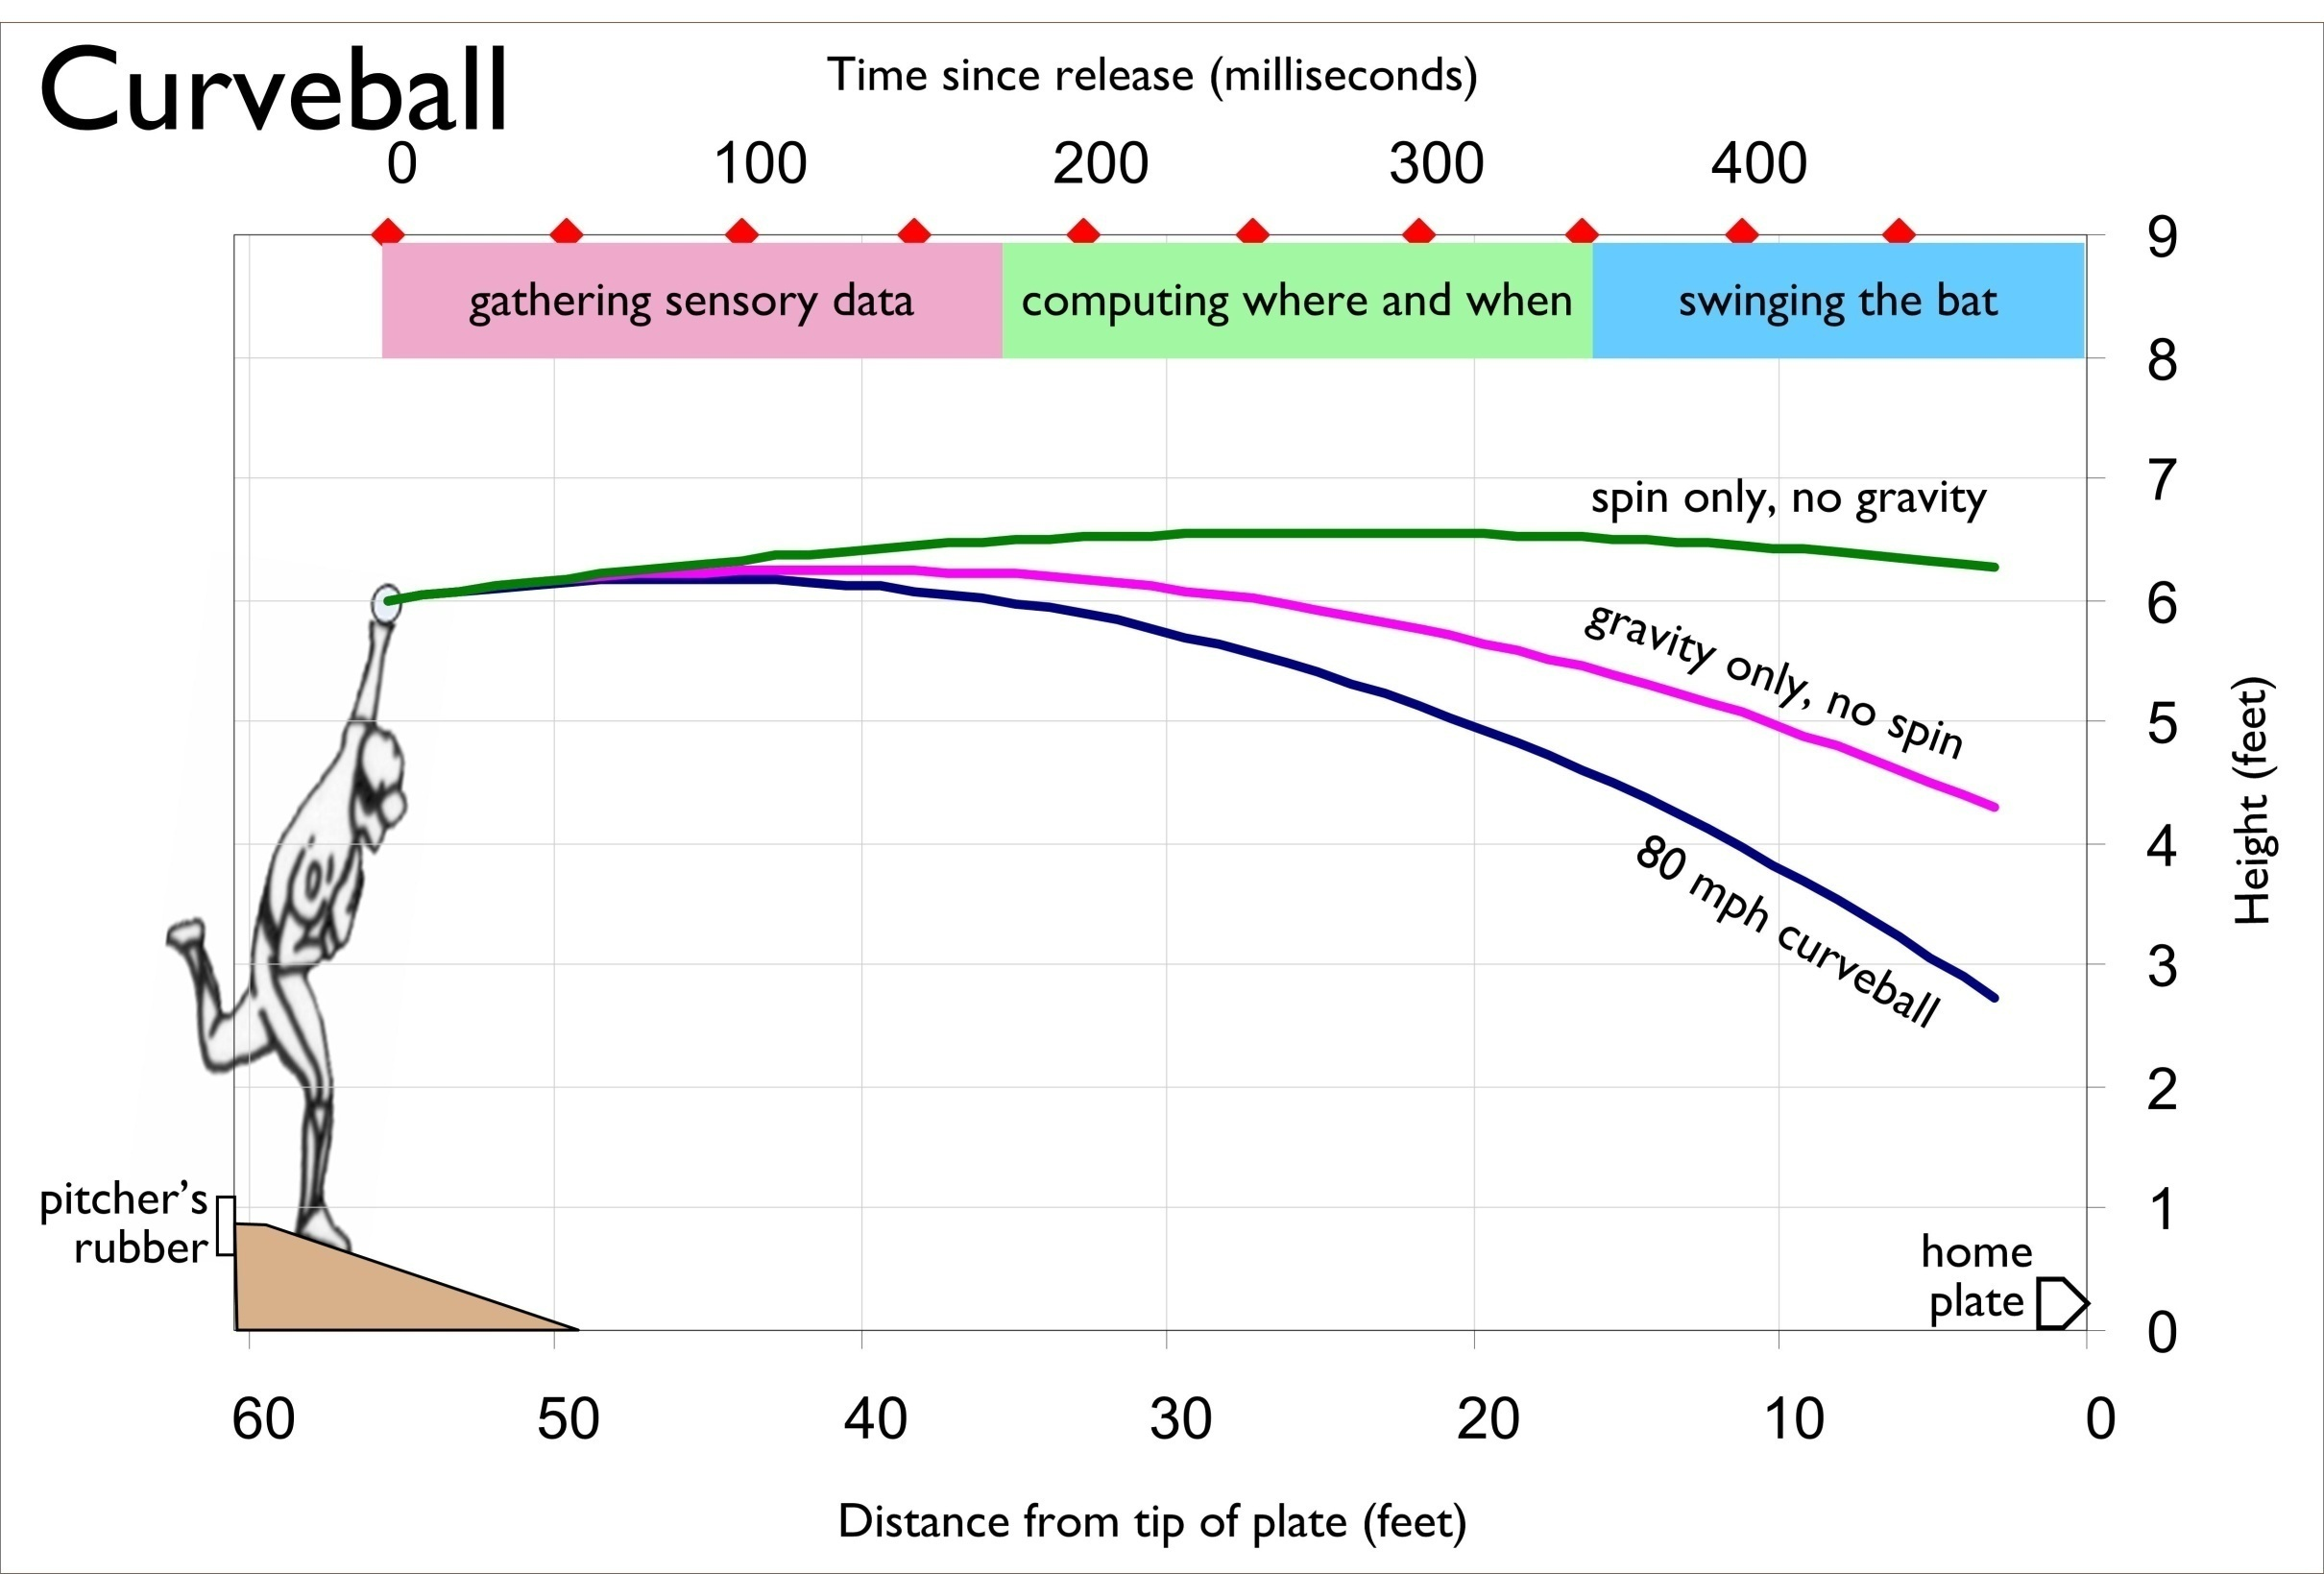
Notes:
launched two degrees upward with 2000 rpm of top spin.

Slide 18
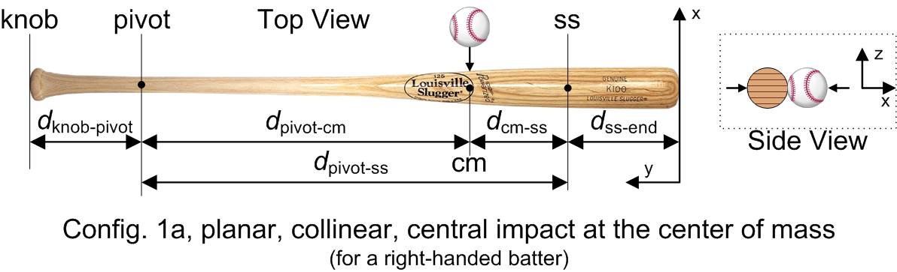
These right-hand rules also apply to the batted-ball*
Notes:
The right-hand rules also apply to soccer, cricket, tennis, Nerf and golf balls. But not to footballs or basketballs.
Footballs and basketballs are heavy and they do not have high spin rates.

Slide 19
That was the physics of the pitch. Now let us answer the question of, “What does the batter’s eye tell the batter’s brain?”

Slide 20
Batter’s perspective
The second half of this presentation is about psychology and how the batter can predict where the ball will be when it collides with the bat.
So all balls will be shown from the batter’s perspective for a right-handed pitcher.

Slide 21
What clues does the batter have?
Pitcher’s arm angle
Pitcher’s hand and fingers
Launch angle
Ball’s visual appearance
Ball’s spin
Ball’s speed*
Notes:
The batter has no direct measure of ball speed.
He must estimate the speed.

Slide 22
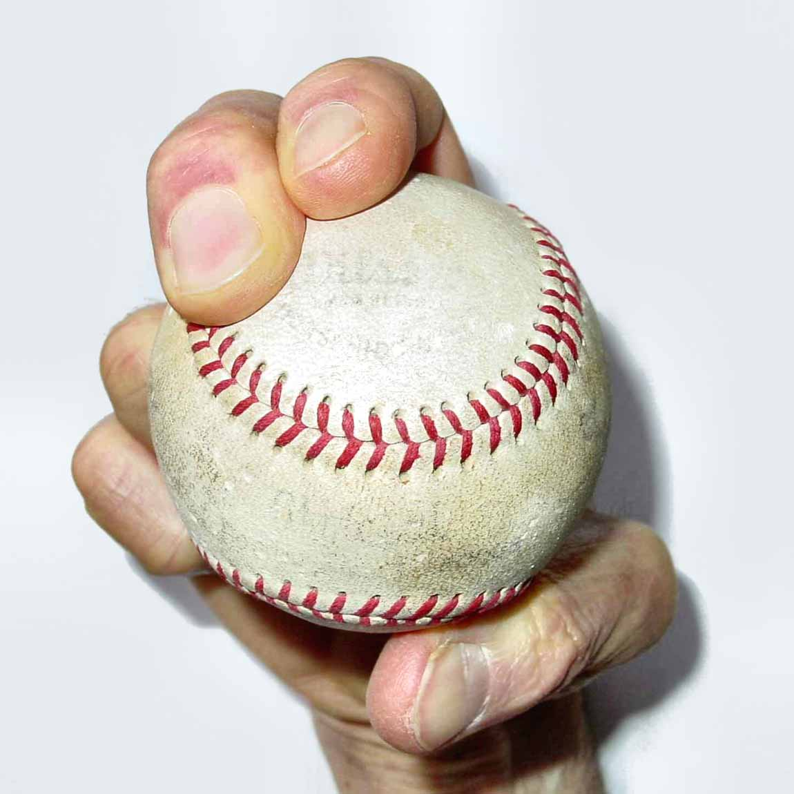
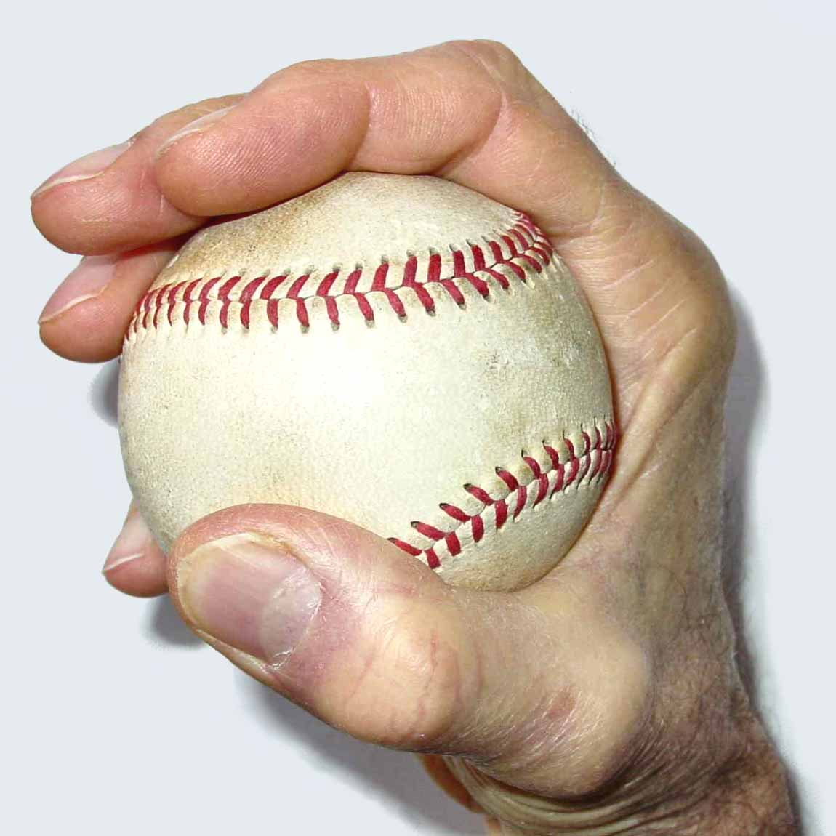
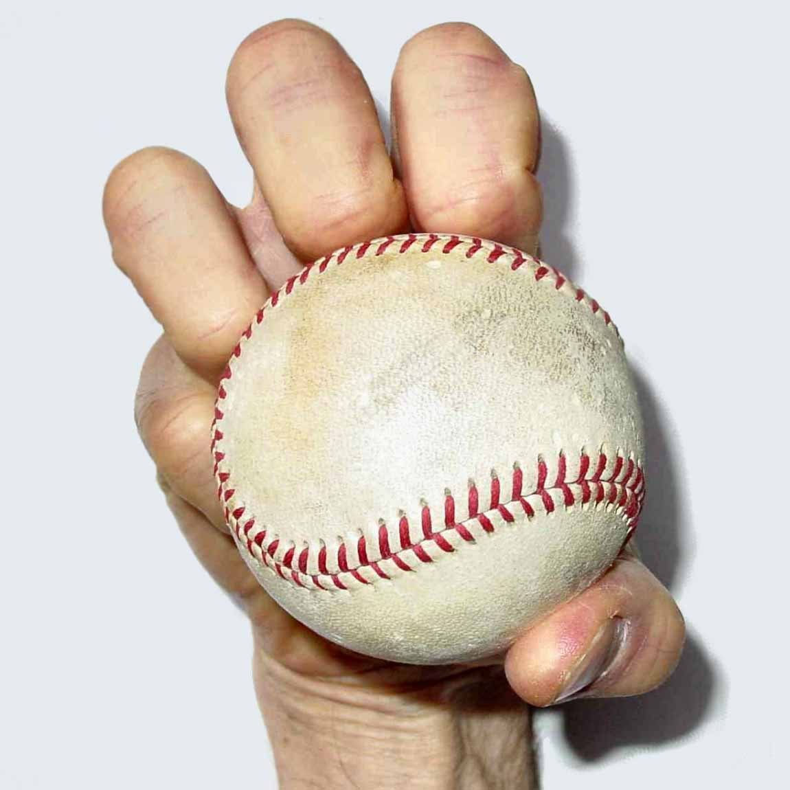
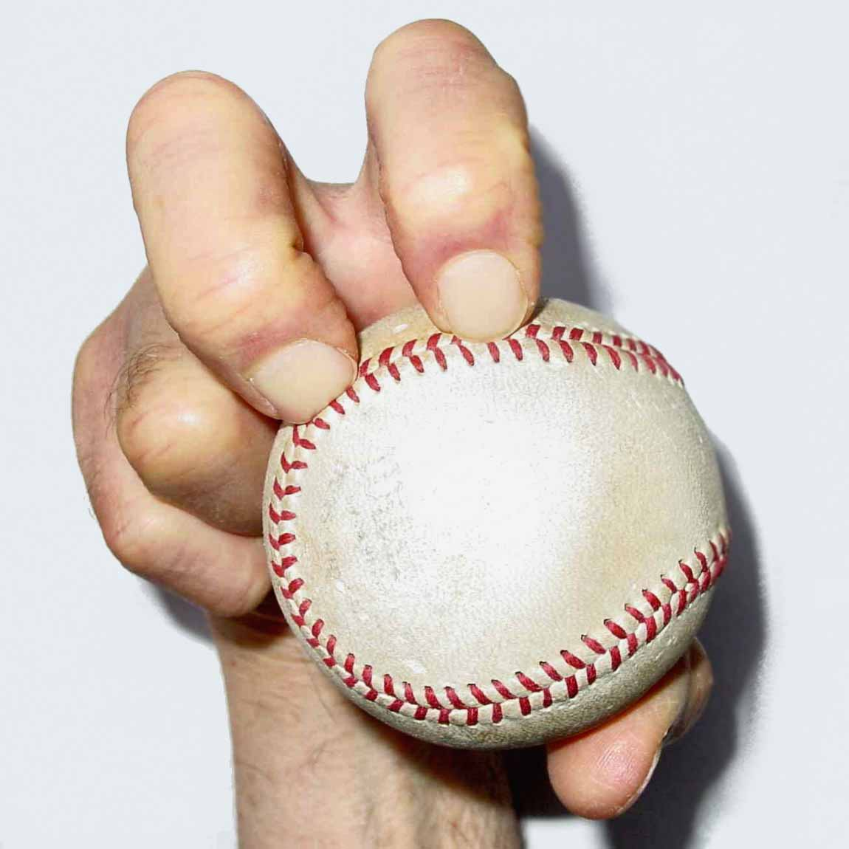
Dave Baldwin’s grips*
Curveball
Palmball
Knuckleball
Knuckleball variant
Notes:
The palmball is slower because it "locks" the wrist (reducing the whipping
motion) and because the arm's energy is imparted to the ball over a much
greater area - from the palm and all the fingers rather than from the
fingertips of just two fingers.

Slide 23
Launch angle
Notes:
95 mph fastball was launched downward at 2.3 degrees
60 mph palmball was launched upward at 2.4 degrees.

Slide 24
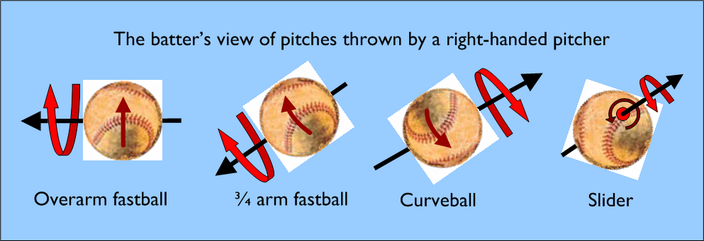
Spin that the batter might see

Slide 25
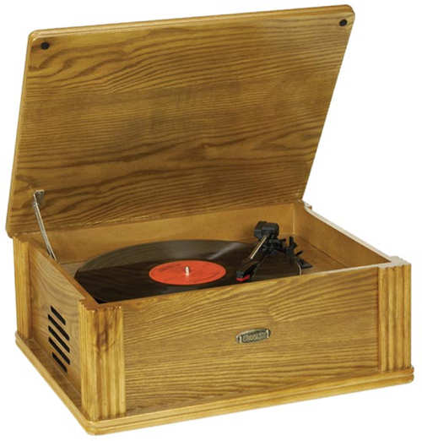
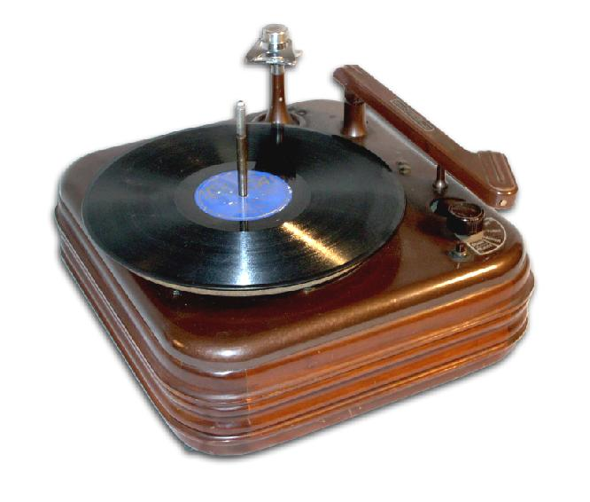
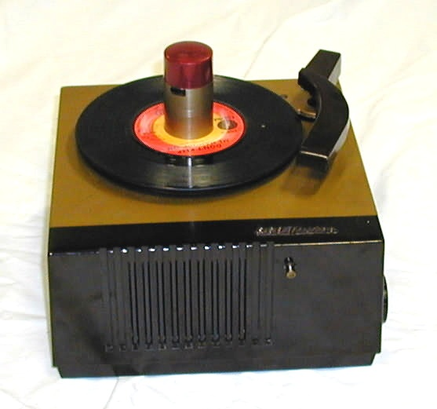
Visual acuity
Static
Dynamic
Ted Williams
Notes:
Ricardo Castro’s research is suggesting that a lot of this perception is foveal.
That means that peripheral processes are less important.
So if motion perception and dynamic visual acuity are peripheral, then they are less important.
Ted Williams might have also had tremendous contrast sensitivity.

Slide 26
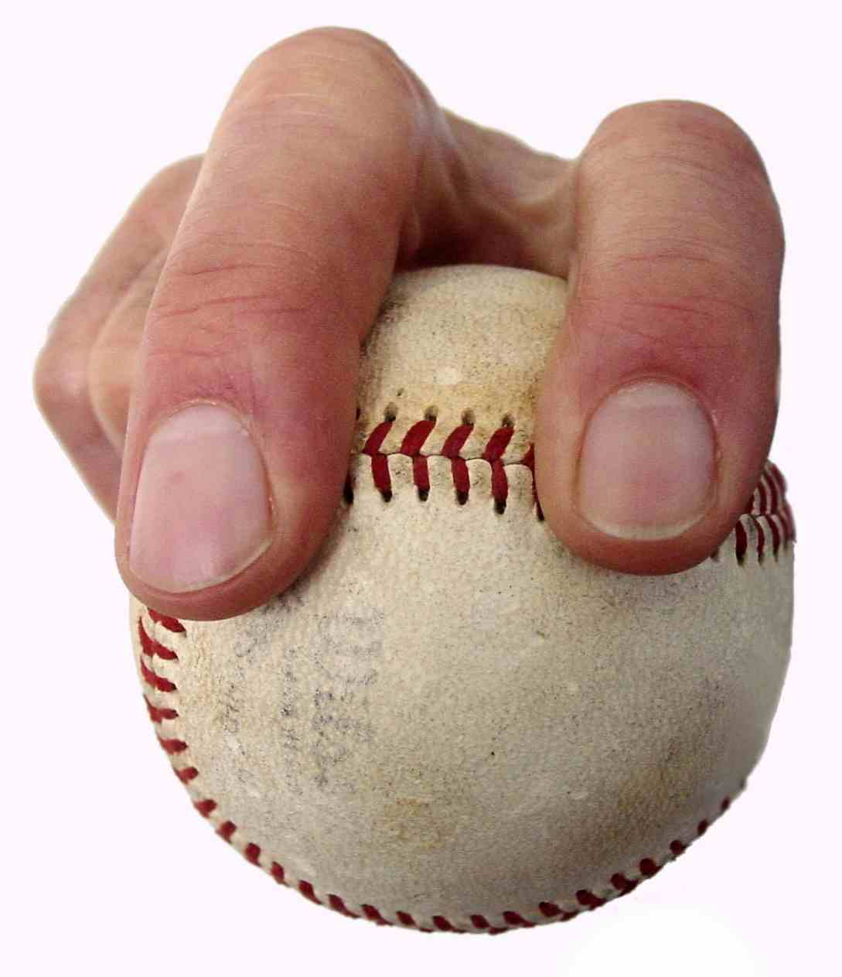
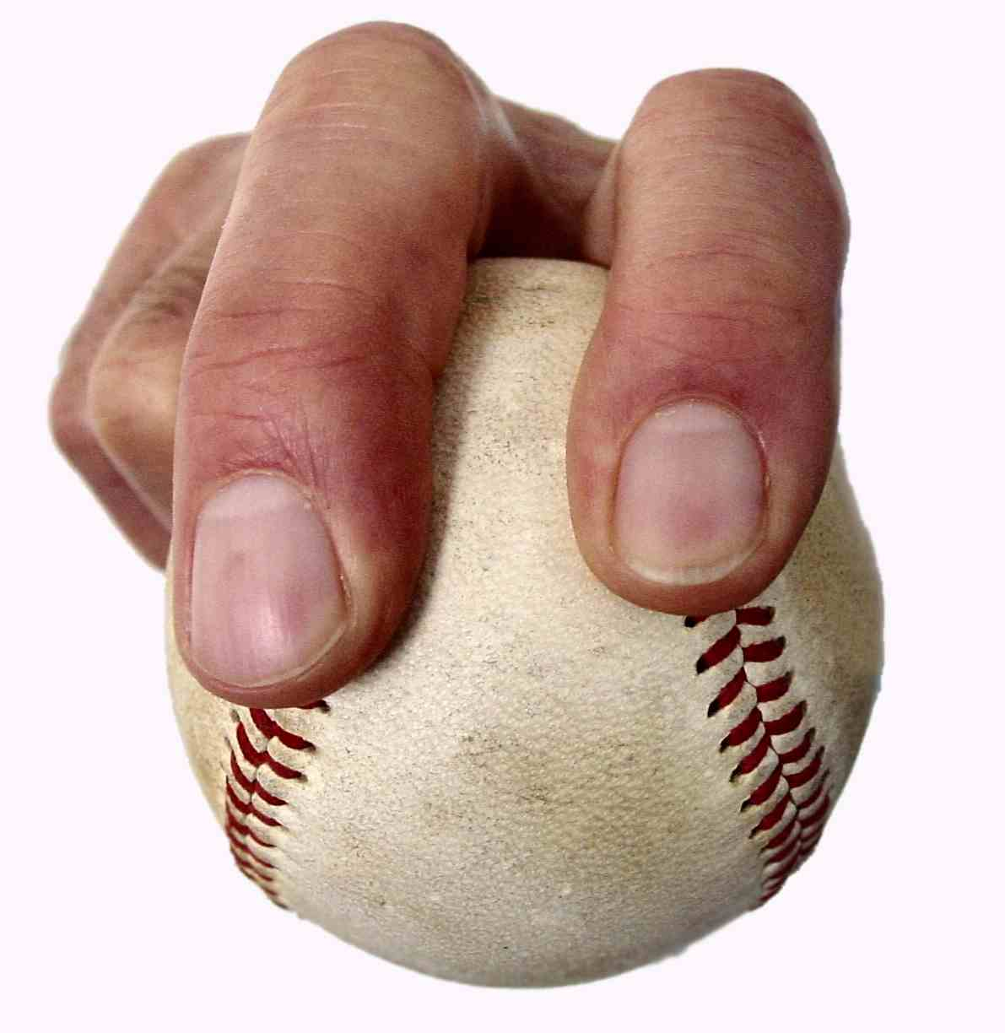
Grip of 4-seam and 2-seam fastballs*
Notes:
The ball is not gripped tightly, however, and the ball rolls off the two pitching
fingers to create the back spin. The energy that the hand is delivering to
the ball results in two kinds of ball velocities - linear and
angular. Whatever energy is expended in creating angular velocity is lost
to the creation of linear velocity. The back spin reduces forward
velocity. Because the arm is being used as a whip, the greatest total velocity (linear and spin) is generated
when the arm's energy is transferred to the relatively tiny contact area of
the fingertips with the ball. In other words, the pitcher throws in such a
way as to maximize forward velocity and it just happens that method also
creates a hard back spin and sacrifices some energy to it.
If a TV announcer tells you that a pitch was a 2-seam or a 4-seam fastball, he is bull shitting you.
He can’t tell.

Slide 27
The baseball player says
The four-seam fastball is gripped across four seams.
Each seam provides high impedance to the airflow around the ball.
Back spin with four seams perpendicular to the trajectory gives the ball maximum “lift.”
Pitchers believe that this lift accounts for the rise experienced by batters.

Slide 28
The engineer says
For puzzling things like this
try Physics models first
then try Physiology models
finally try Psychology models

Slide 29
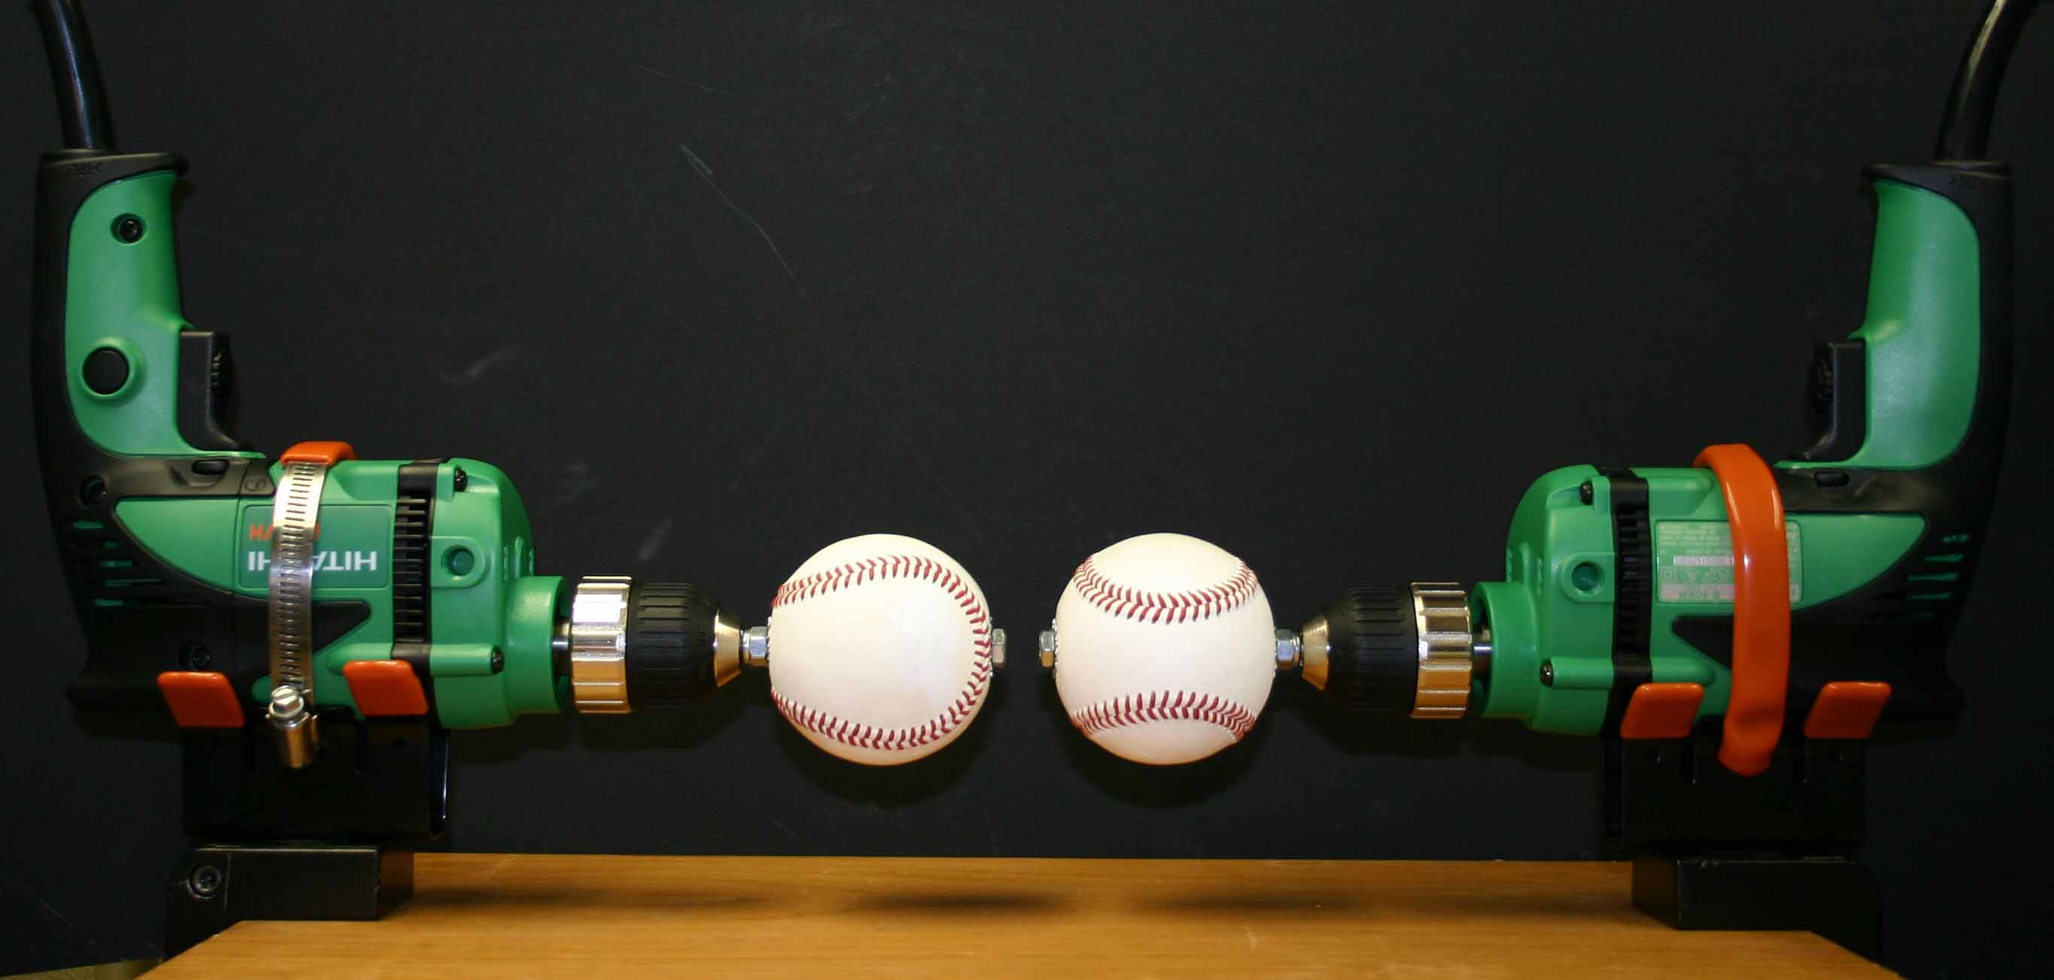
4-seam and 2-seam fastball models

Slide 30
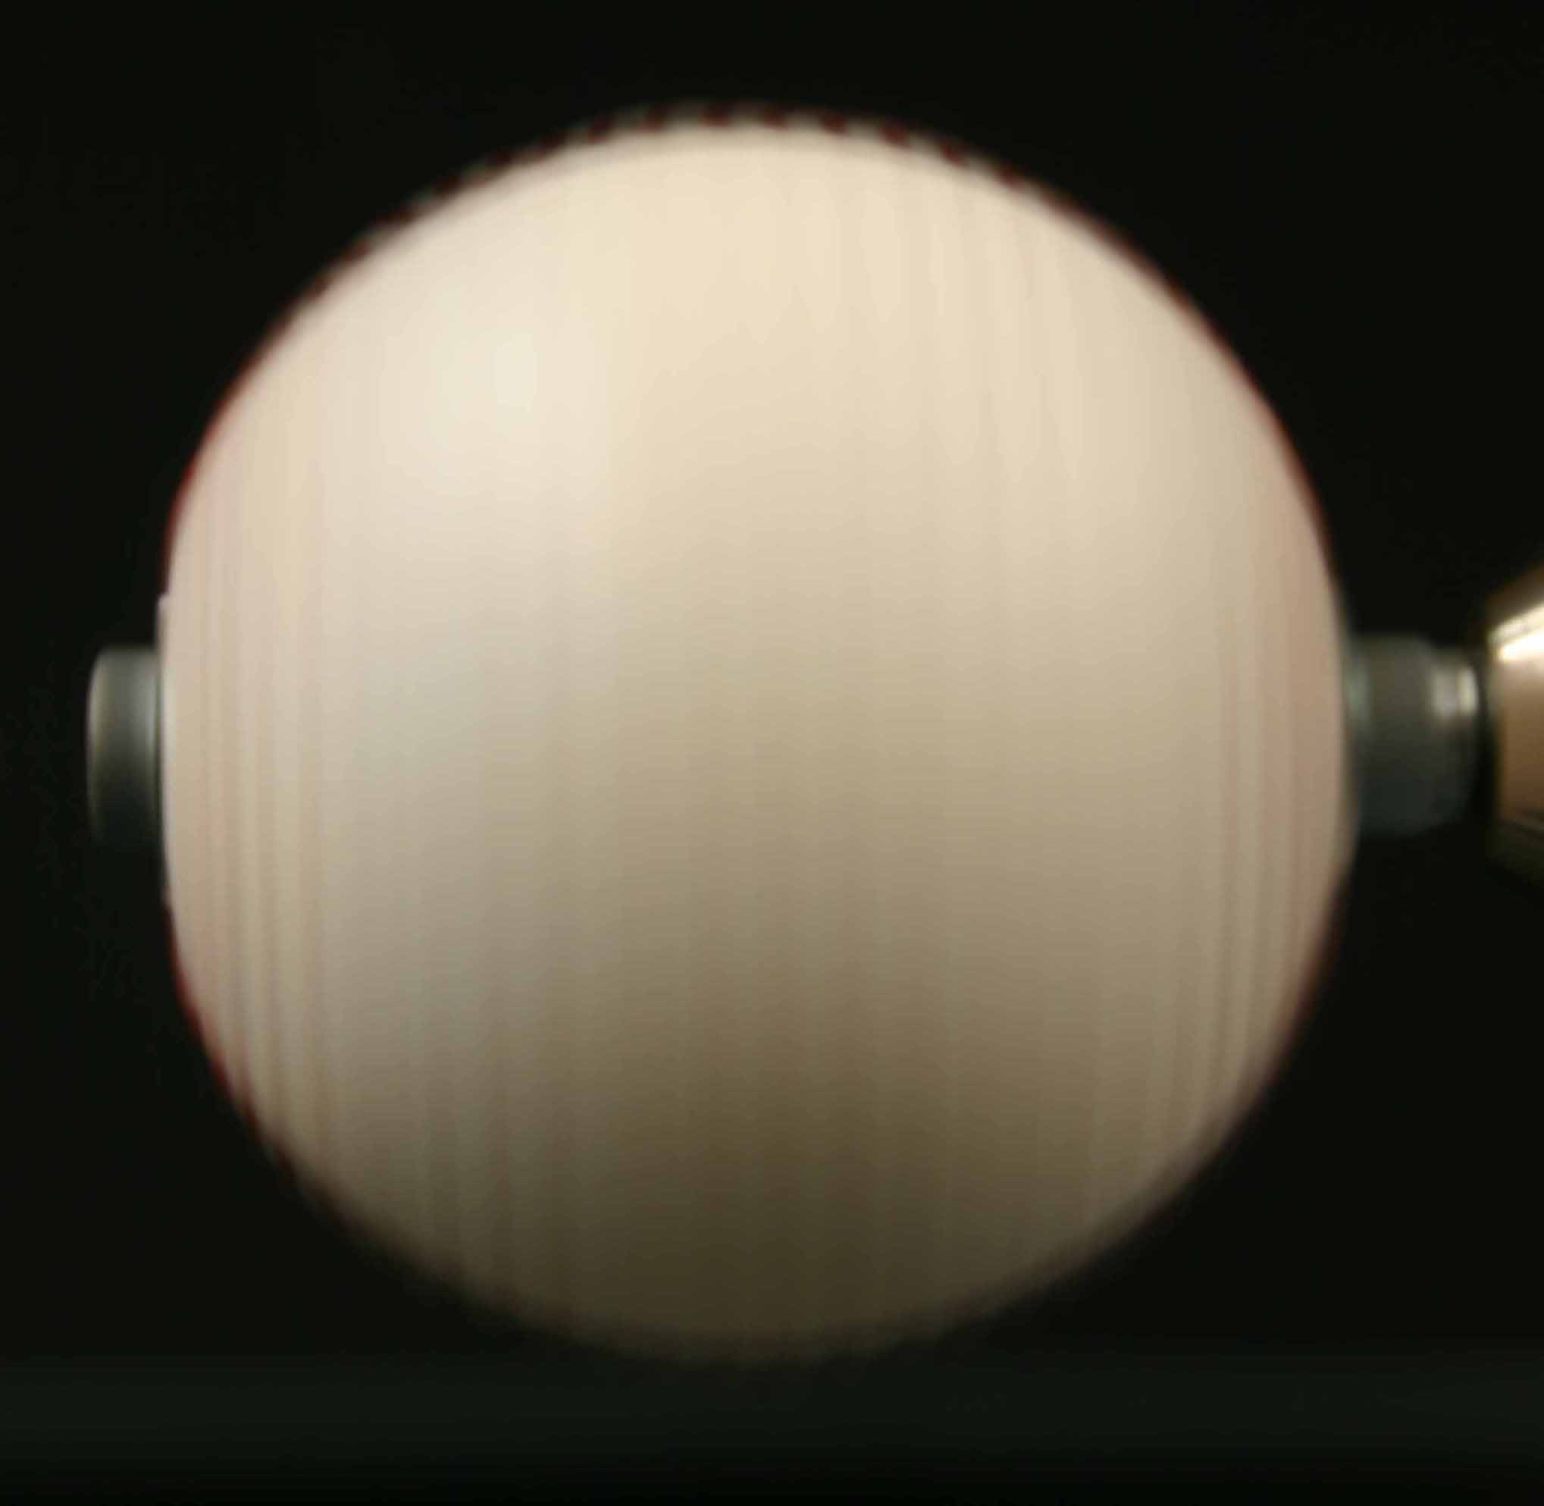
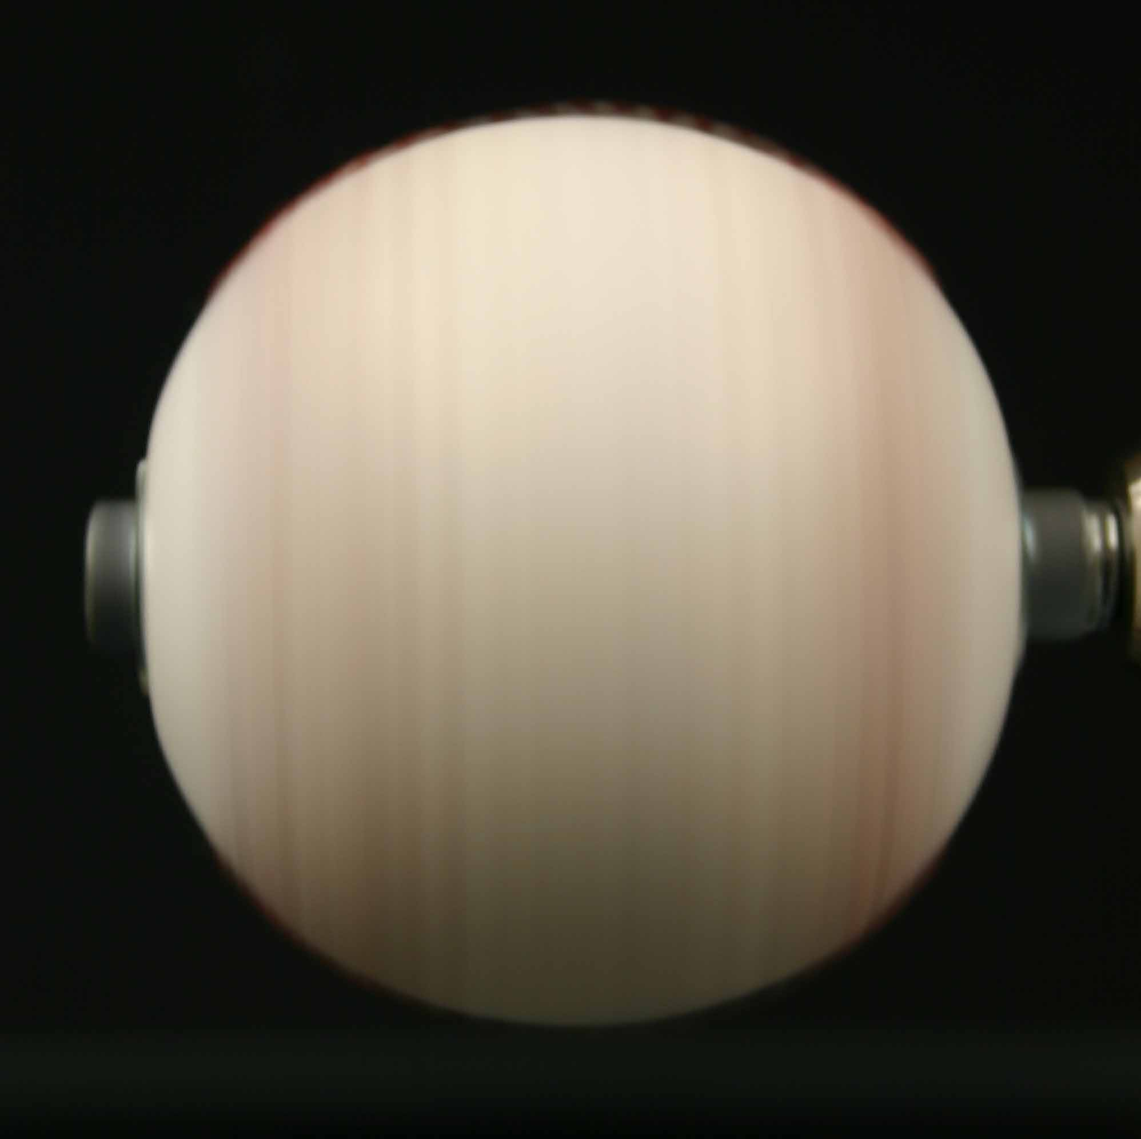
Photos of 4-seam and 2-seam fastball models
Notes:
The four-seam looks somewhat like a sine wave grating.

Slide 31
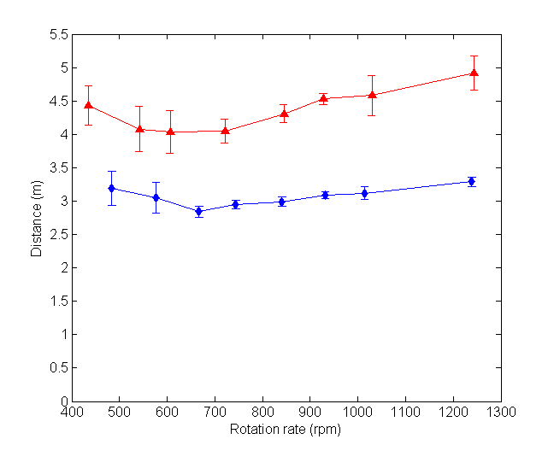
Distance at which the stripes and lines were seen*
Two-seam
Four-seam
Notes:
Red line is the for the two red stripes of the two-seam simulated fastball.
Blue line is for the thin red lines of the simulated four-seam fastball.

Slide 32
Notes:
launched one-degree downward with 1200 rpm of back spin.

Slide 33
Visual acuity
This graduate student picked up the spin on the 2-seam fastball when it was 16 feet away,
but he didn’t see the spin on the 4-seam fastball until it was 10 feet away.
The swing starts when the ball is 19 feet from the batter’s eye.
So million dollar per year batters must have better dynamic visual acuity than this graduate student.

Slide 34
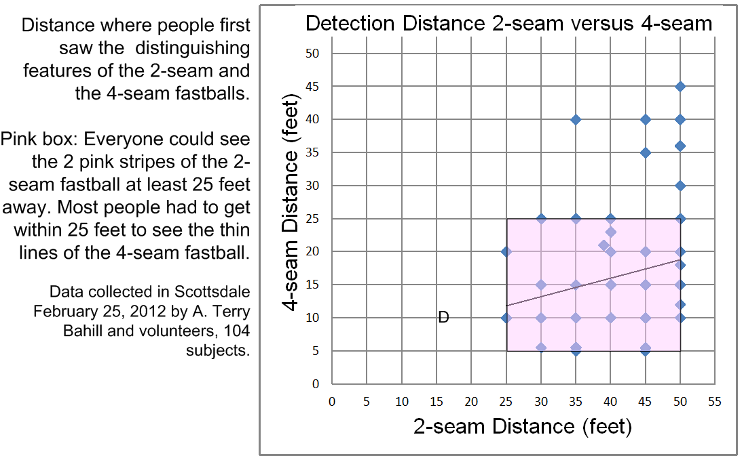
New data
Notes:
The data points in the upper-right corner are for ten year olds.
That is the region of peak acuity.
I think the capital D is Castro.

Slide 35
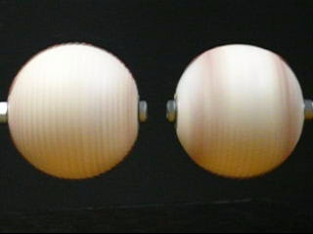
Also the difference in appearance of the four-seam and two-seam fastball models is more dramatic in this video than in the previous still photographs. (These balls are being rotated at 20 rps.)

Slide 36
Real life
Moreover, the difference in appearance of the four-seam and two-seam fastball models is more dramatic in our laboratory than in that video.

Slide 37
The engineer says
For puzzling things like this
try Physics first
then try Physiology
finally try Psychology
The last few slides showed the difference in appearance of spinning balls.
The next few slides will discuss Critical Flicker Fusion Frequency* which is between 40 and 50 Hz.
If anyone in the room has photosensitive epilepsy, please leave the room now.
Notes:
The lights on a police car flash at about 3 Hz. They appear to be blinking, not continuous.
At the beginning of the 20th century movies were called the flicks, because their 24 Hz frame rate produced flickering images.
How many of you are so bothered by the 60 Hz refresh rate of the CRT monitor that you changed it to 75 Hz?

Slide 38
The fastball
The fastball rotates at 20 revolutions per second.

Slide 39
The
4-seam
fastball

Slide 40
The 4-seam fastball
The four-seam fastball will present 80 seams per second.
There will be no flicker.
The batter will have no clues from flicker about the spin.
Hence he will predict less accurately, and may perceive more rising fastballs.

Slide 41
The
2-seam
fastball

Slide 42
The 2-seam fastball may flicker
The two-seam fastball might flicker between 20 and 40 Hz.
The batter may be able to perceive this flicker.
This would tell him that the pitch is a fastball.
Then he could tune his mental model and predict more accurately.

Slide 43
The 2-seam curveball
If a pitcher always used the two-seam grip,
then his 20 rps fastball would flicker between 20 and 40 Hz,
but his 33 rps curveball would be at 33 to 66 Hz and might not flicker.
Thus the flicker would tell the batter if the pitch were a fastball or a curveball.
Most pitchers use a four-seam grip.

Slide 44
The slider
The finger-seam orientation in the pitcher’s grip might also effect the batter’s perception of the slider.

Slide 45
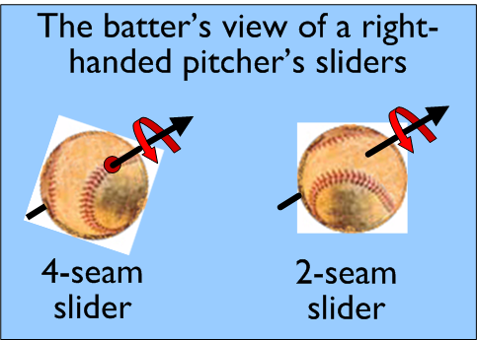

Slide 46
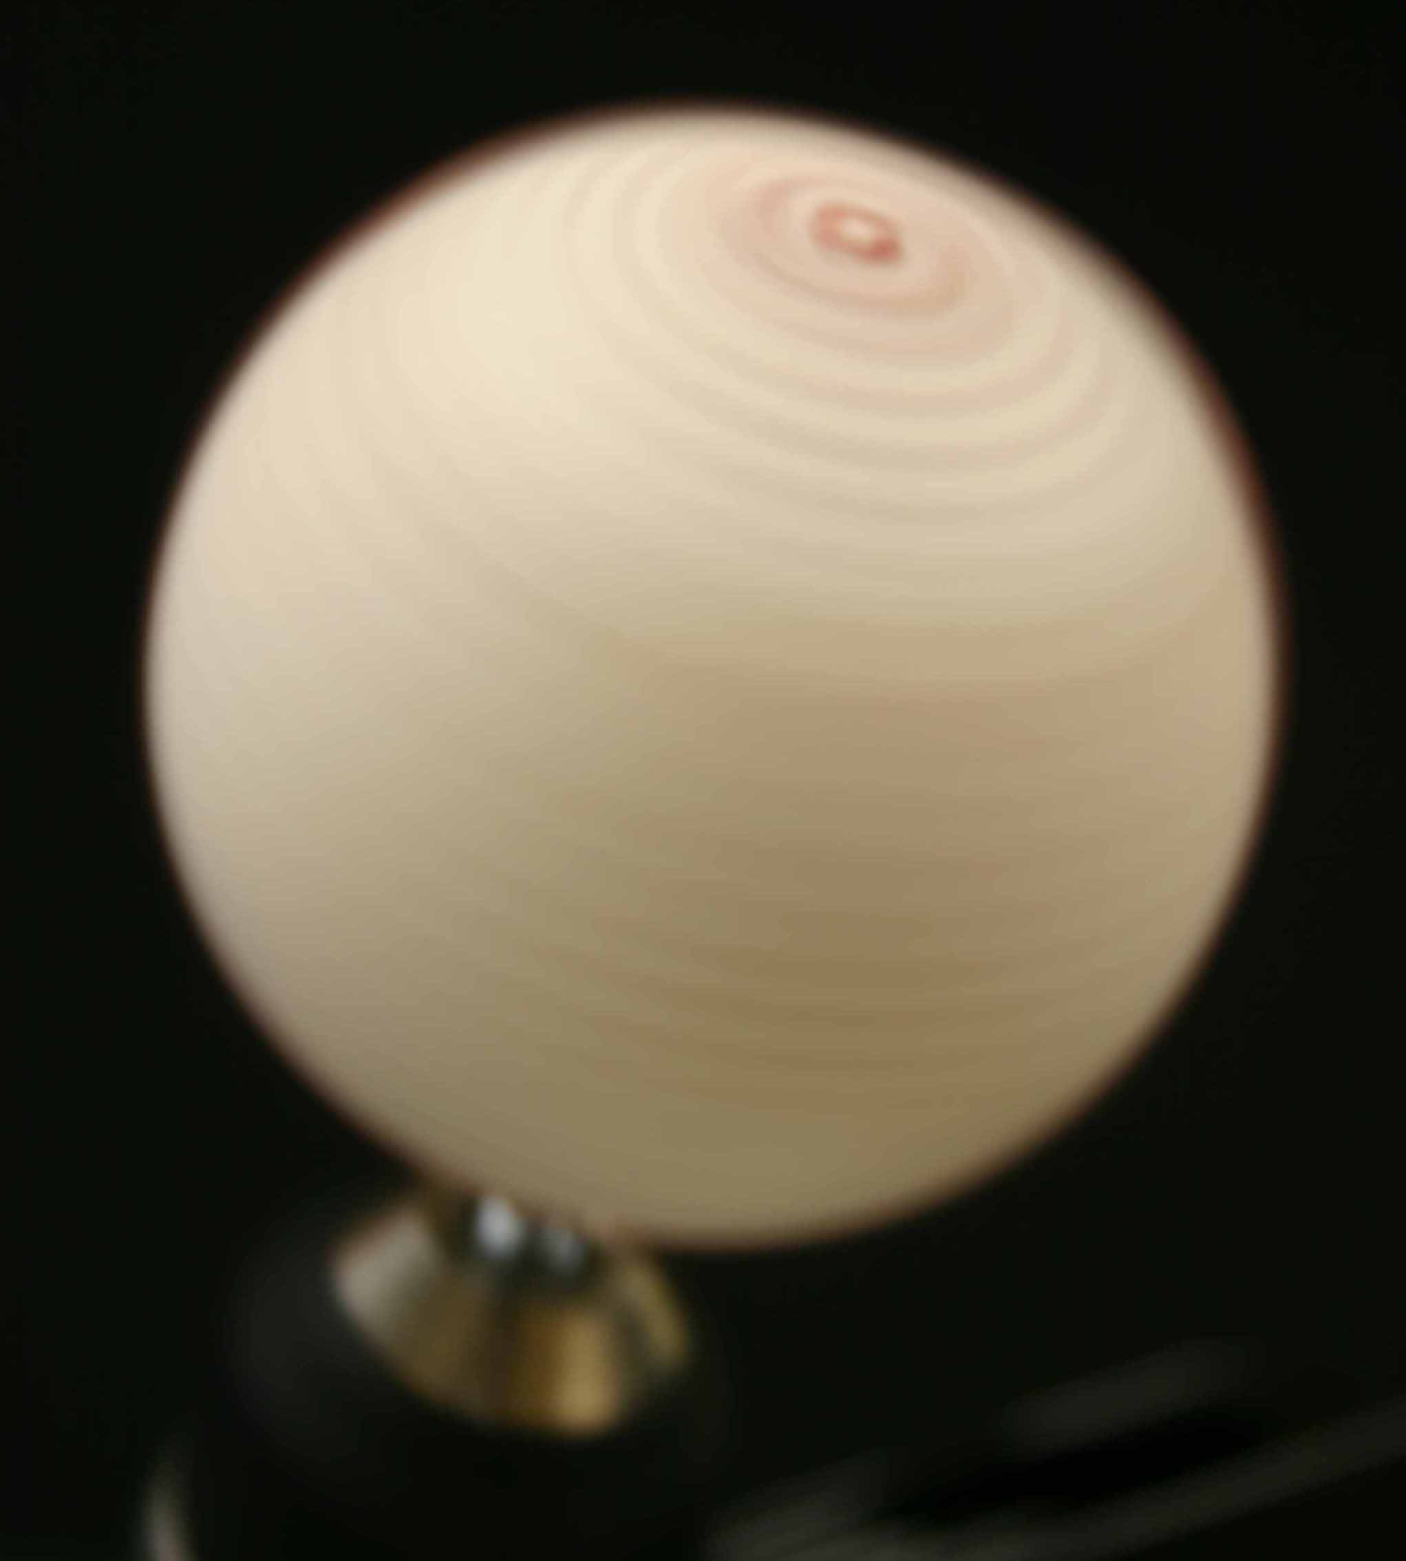
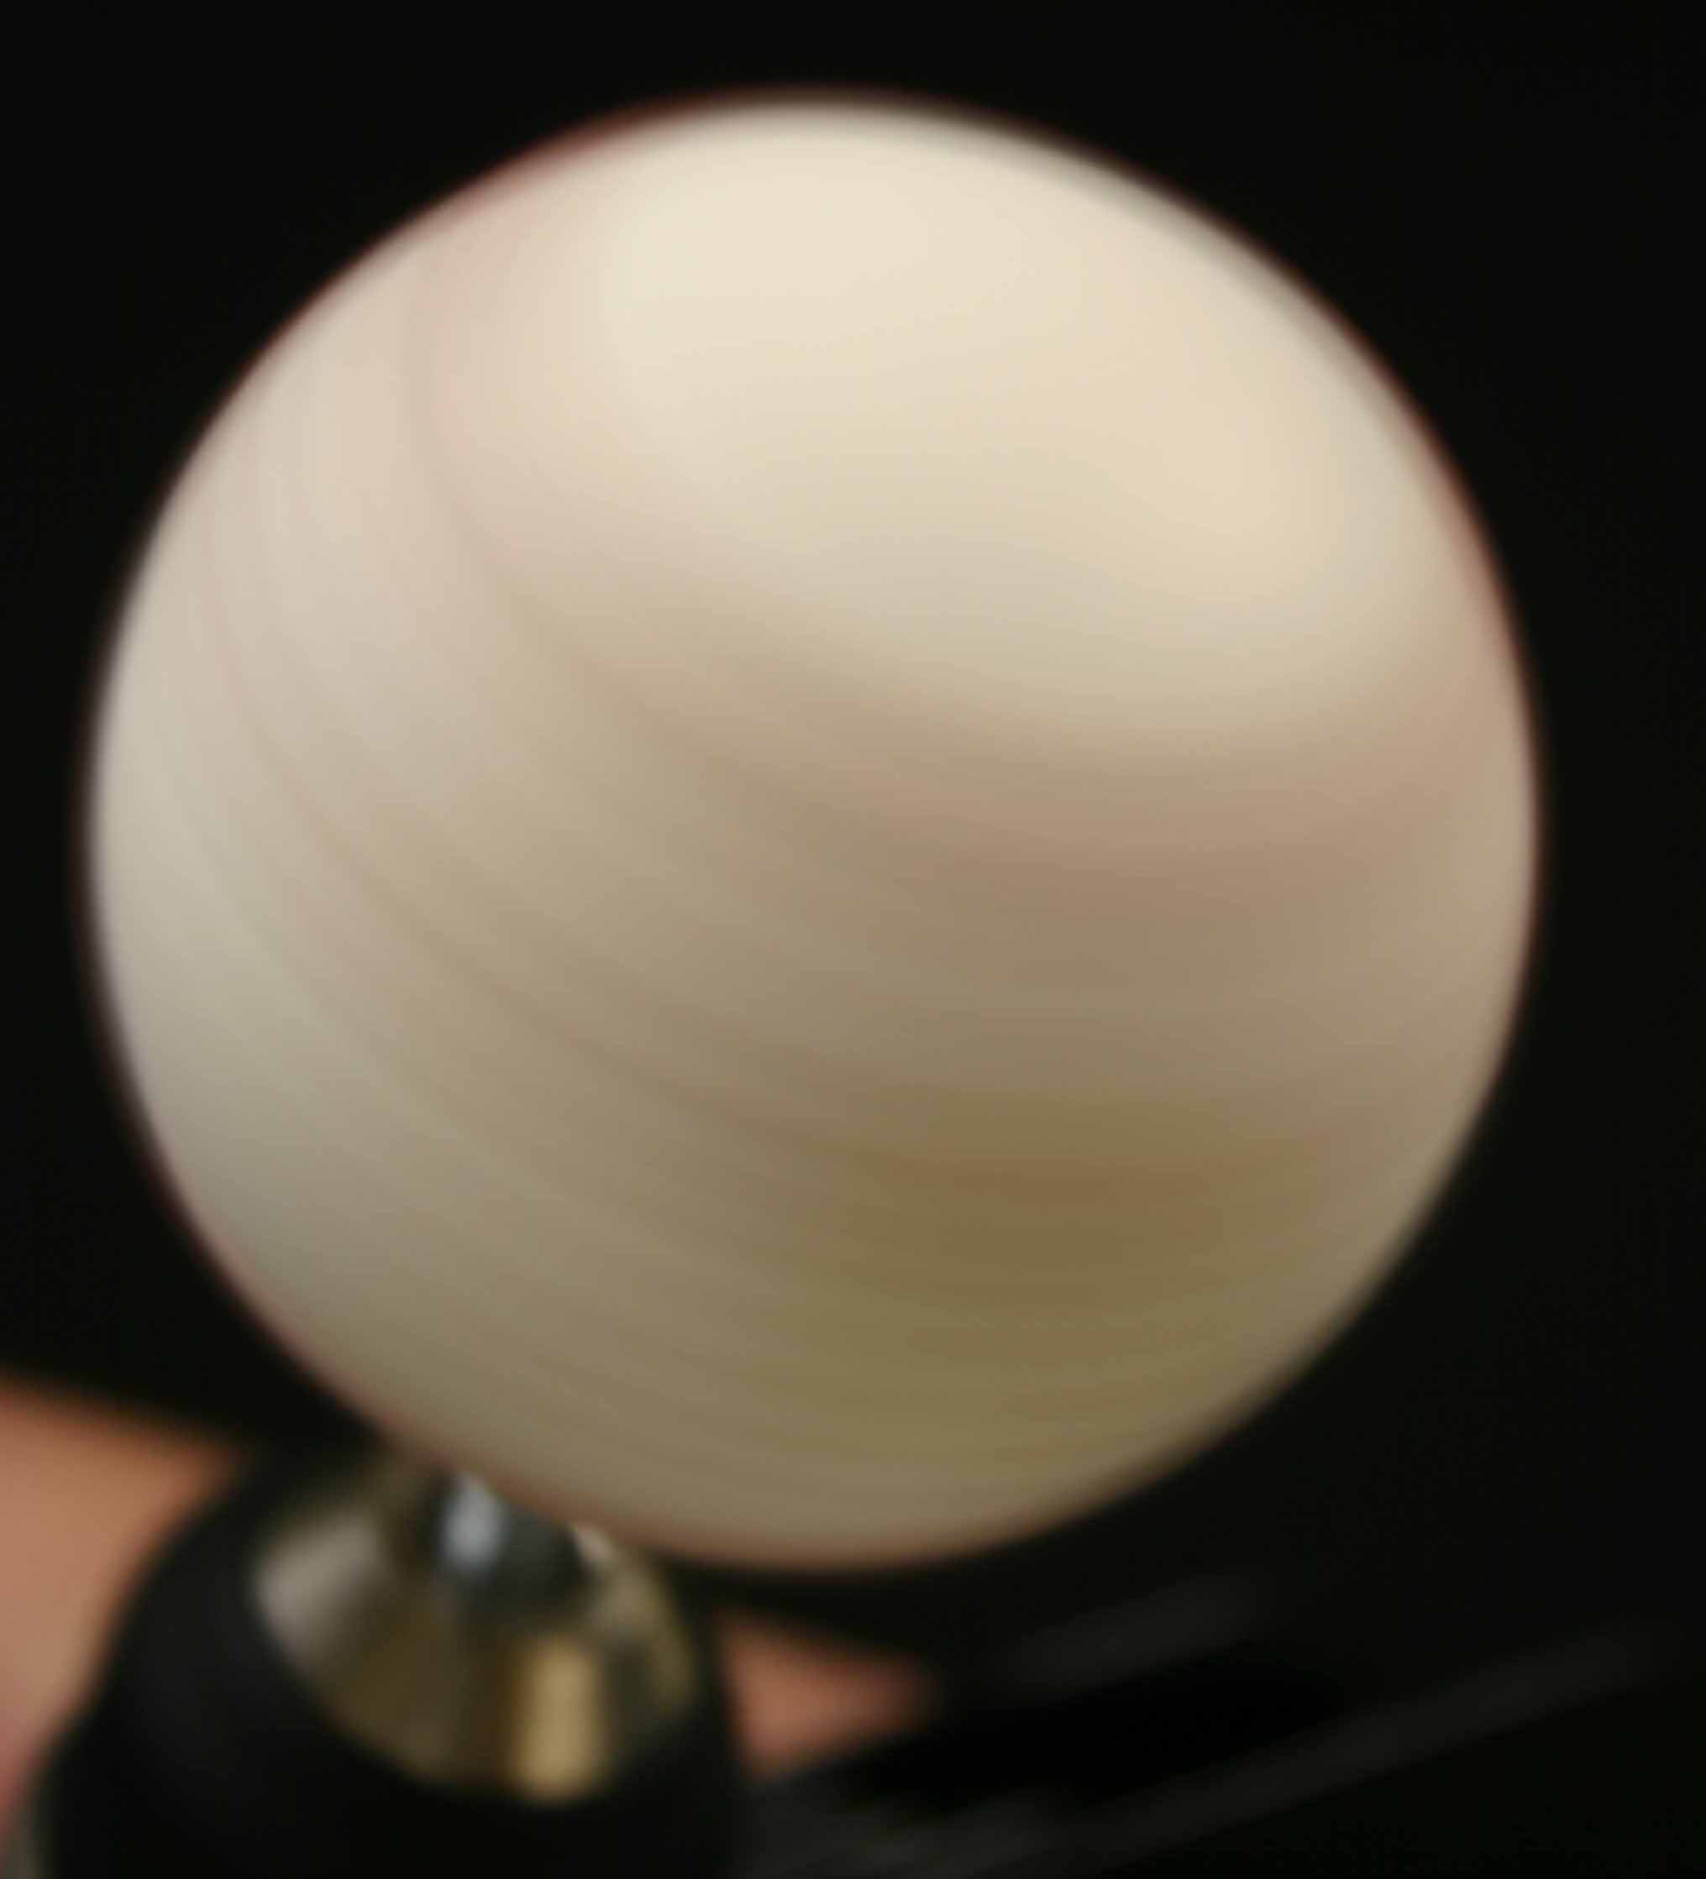
Photos of 4-seam and 2-seam slider models

Slide 47
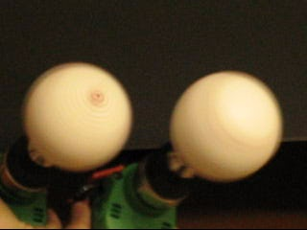
But the difference in appearance of these four-seam and two-seam slider models is more dramatic in this video than in the previous still photographs. (These balls are being rotated at 20 rps.)

Slide 48
Baseball sounds
You can hear a bat-ball collision
Can you hear the difference between a fastball and a curveball?
They have different speeds and spin rates so they sound different.
Perhaps batters and umpires could be trained to use this auditory clue.
Due to their different spin rates, the fastball and the curve ball sound different.
A curveball with a spin rate of 2600 rpm (43 Hz) would sound like F1 on a piano. Whereas a fastball with a spin rate of 2250 rpm (37.5 Hz) would sound like D1.

Slide 49
Modeling philosophy
Models are ephemeral: they are created, they explain a phenomenon, they stimulate discussion, they foment alternatives and then they are replaced by new models.
Our equations will be updated.
But our right-hand rules showing the direction of the spin-induced deflections, will have permanence: they will not be superseded.

Slide 50
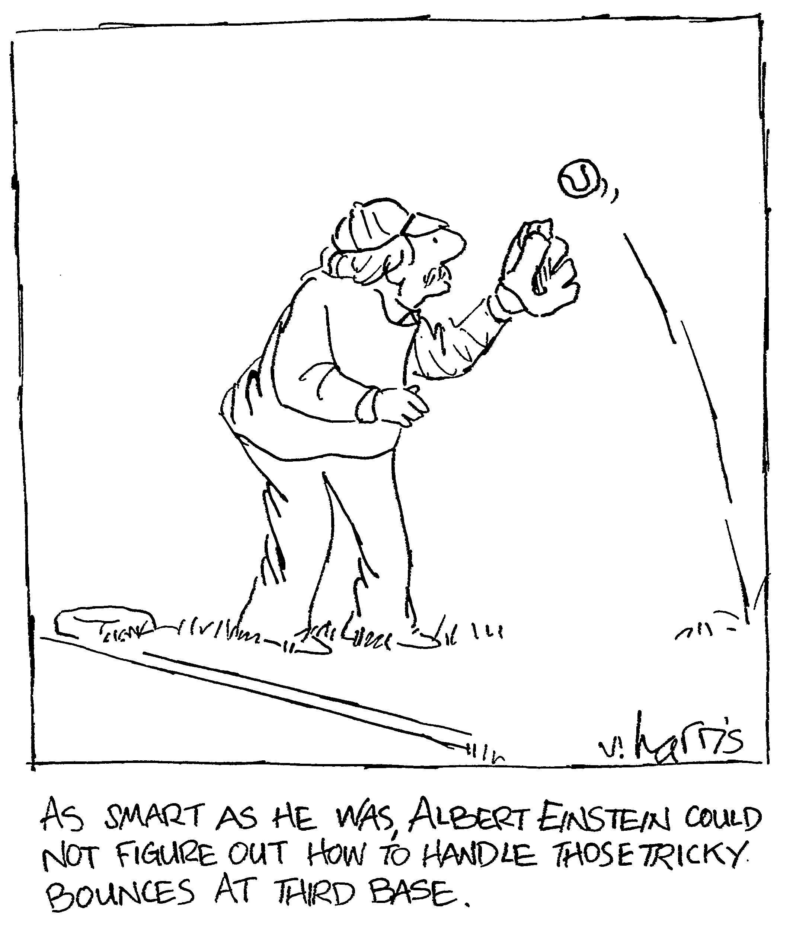
Concerning engineering the sport of baseball, you people are now Einsteins

Slide 51
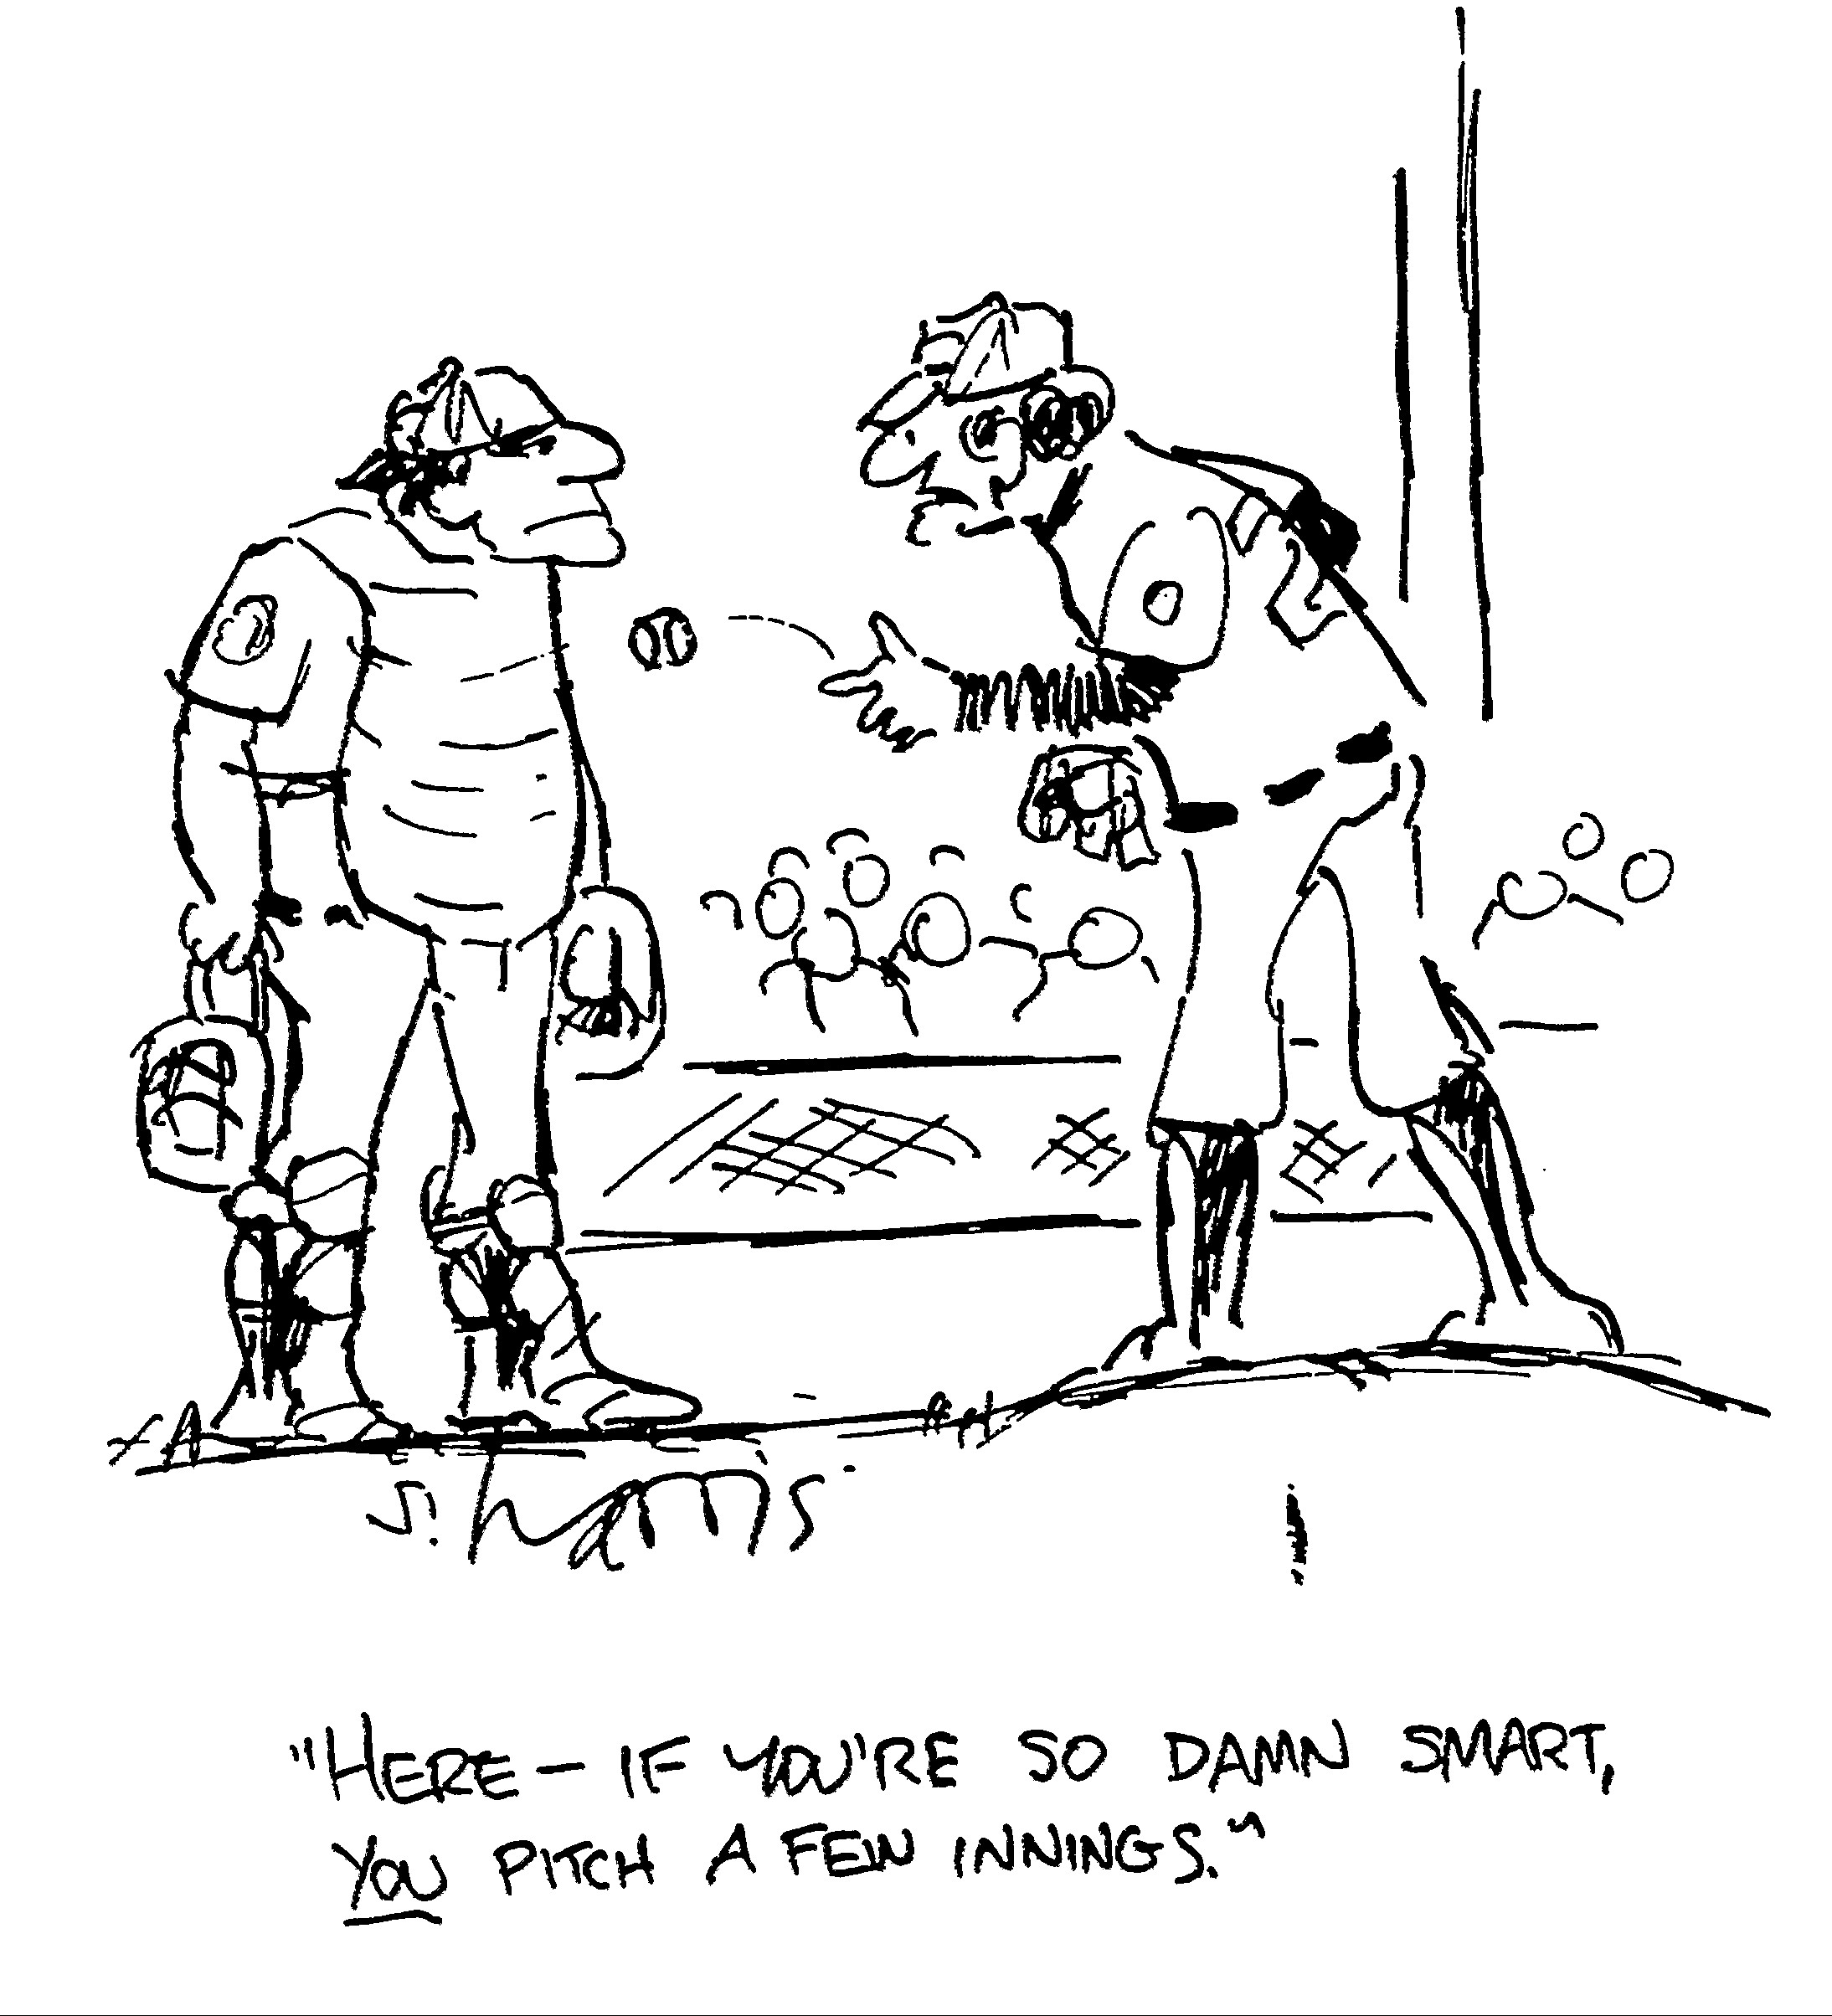
However, there may be a difference between knowledge and execution

Slide 52
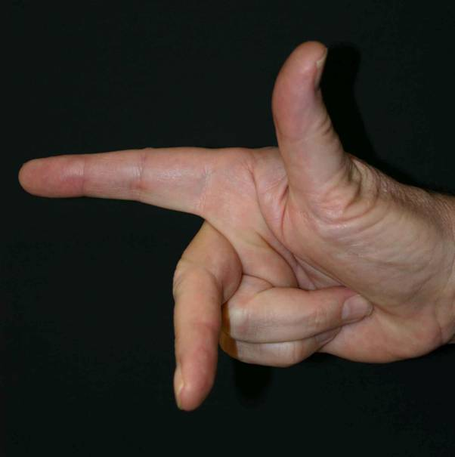
Summary₄
To determine the direction of deflection of the pitched or batted-ball, point the thumb of your
right hand in the direction of the Spin axis and your index finger in the Direction of motion of the ball; your middle finger will indicate the direction of the Spin induced deflection (SaD Sid).

Slide 53
SaD Sid*
Thumb → Spin axis
Index finger → Direction of motion
Middle finger → Spin induced deflection
Notes:
This is the take-home message of the whole talk.

Slide 54
Summary₁
The big differences seem to be psychological, specifically perceptual.

Slide 55
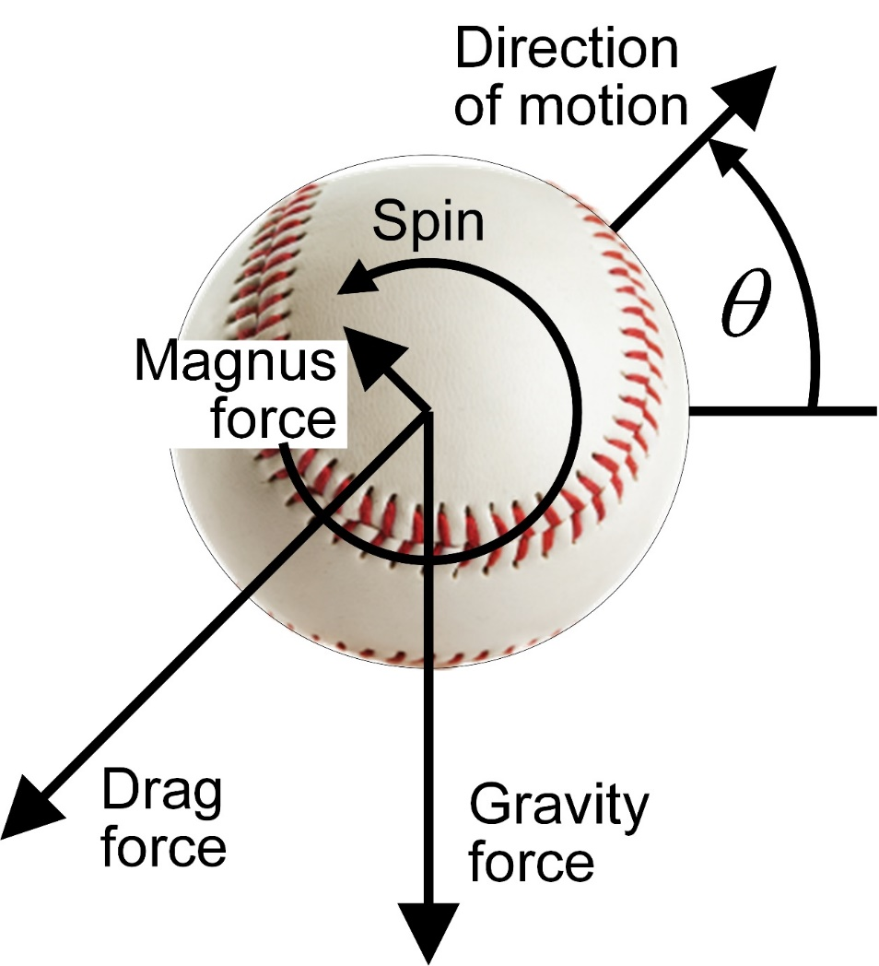

Slide 56
Summary₂
The batter can see
the two red stripes and the flicker of the two-seam fastball,
the two red stripes of the two-seam curveball, and
the red dot on a four-seam slider.
All of these clues alert the batter to the type of spin on the ball and help him to predict its motion.
So the pitcher should prevent them.

Slide 57
Summary₃
The pitcher should use a four-seam grip for fastballs, curveballs and palmballs to remove the perceptual clue of the two red stripes and the flicker,
but he should use the two-seam grip for the slider, to remove the clue of the red dot.

Slide 58
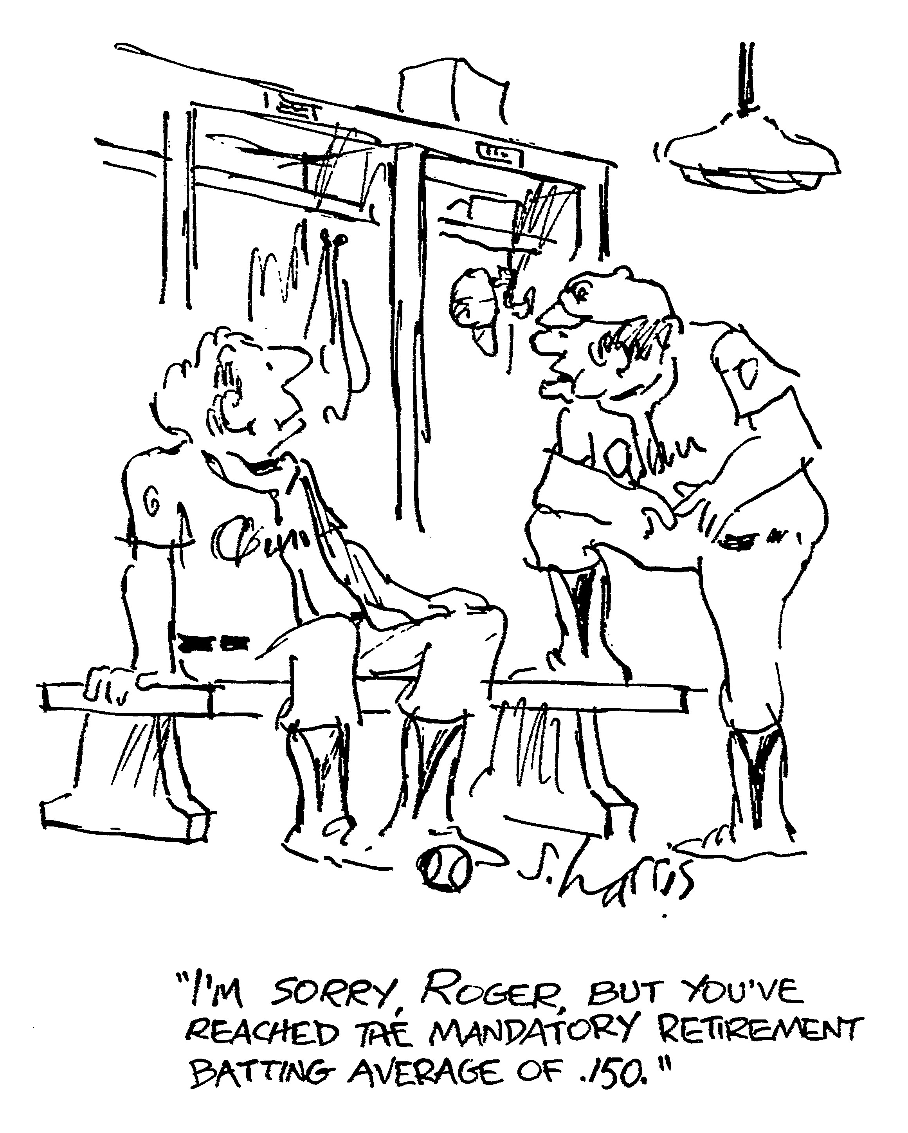
Our seminar is over

Slide 59
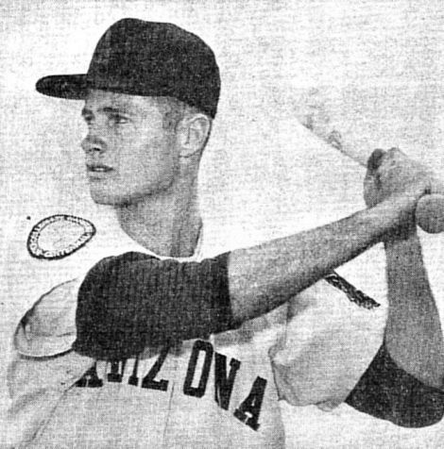

Dave Baldwin
1958 2007

Slide 60
Limitations of the model
Our lift and drag coefficients are constant
Air flow is laminar in front and turbulent behind, for the whole pitch
Our equations ignored the shifting wake of turbulent air behind the ball
The ball loses 10% of its linear velocity in route to the plate: it also loses 2% of its angular velocity, which we ignored
We ignored precession of the spin axis
We ignored differences in moments of inertia of different balls

