Slide 1
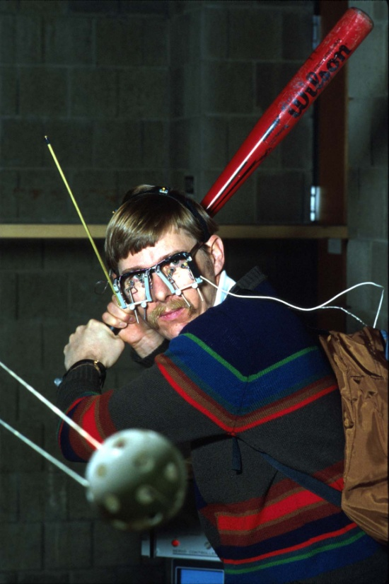

Batters use Depth Perception to Track Baseballs and Softballs
A. Terry Bahill
Emeritus Professor of
Systems Engineering
University of Arizona
terry@sie.arizona.edu
©, 2024, Bahill

Slide 2
Movement of the
Ball in Flight

Slide 3
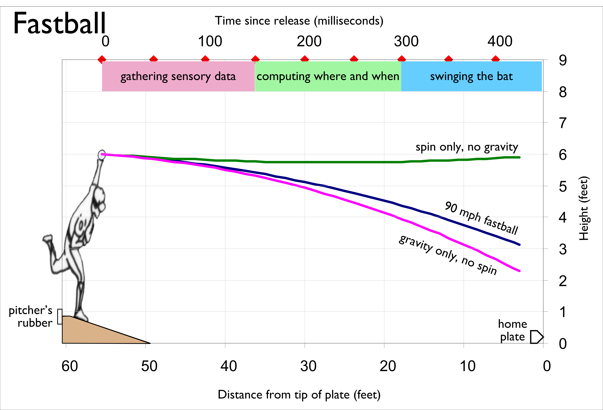
Notes:
During the swing, he could close his eyes and it would not affect the flight of the batted ball.
launched one-degree downward with 1200 rpm of back spin.

Slide 4
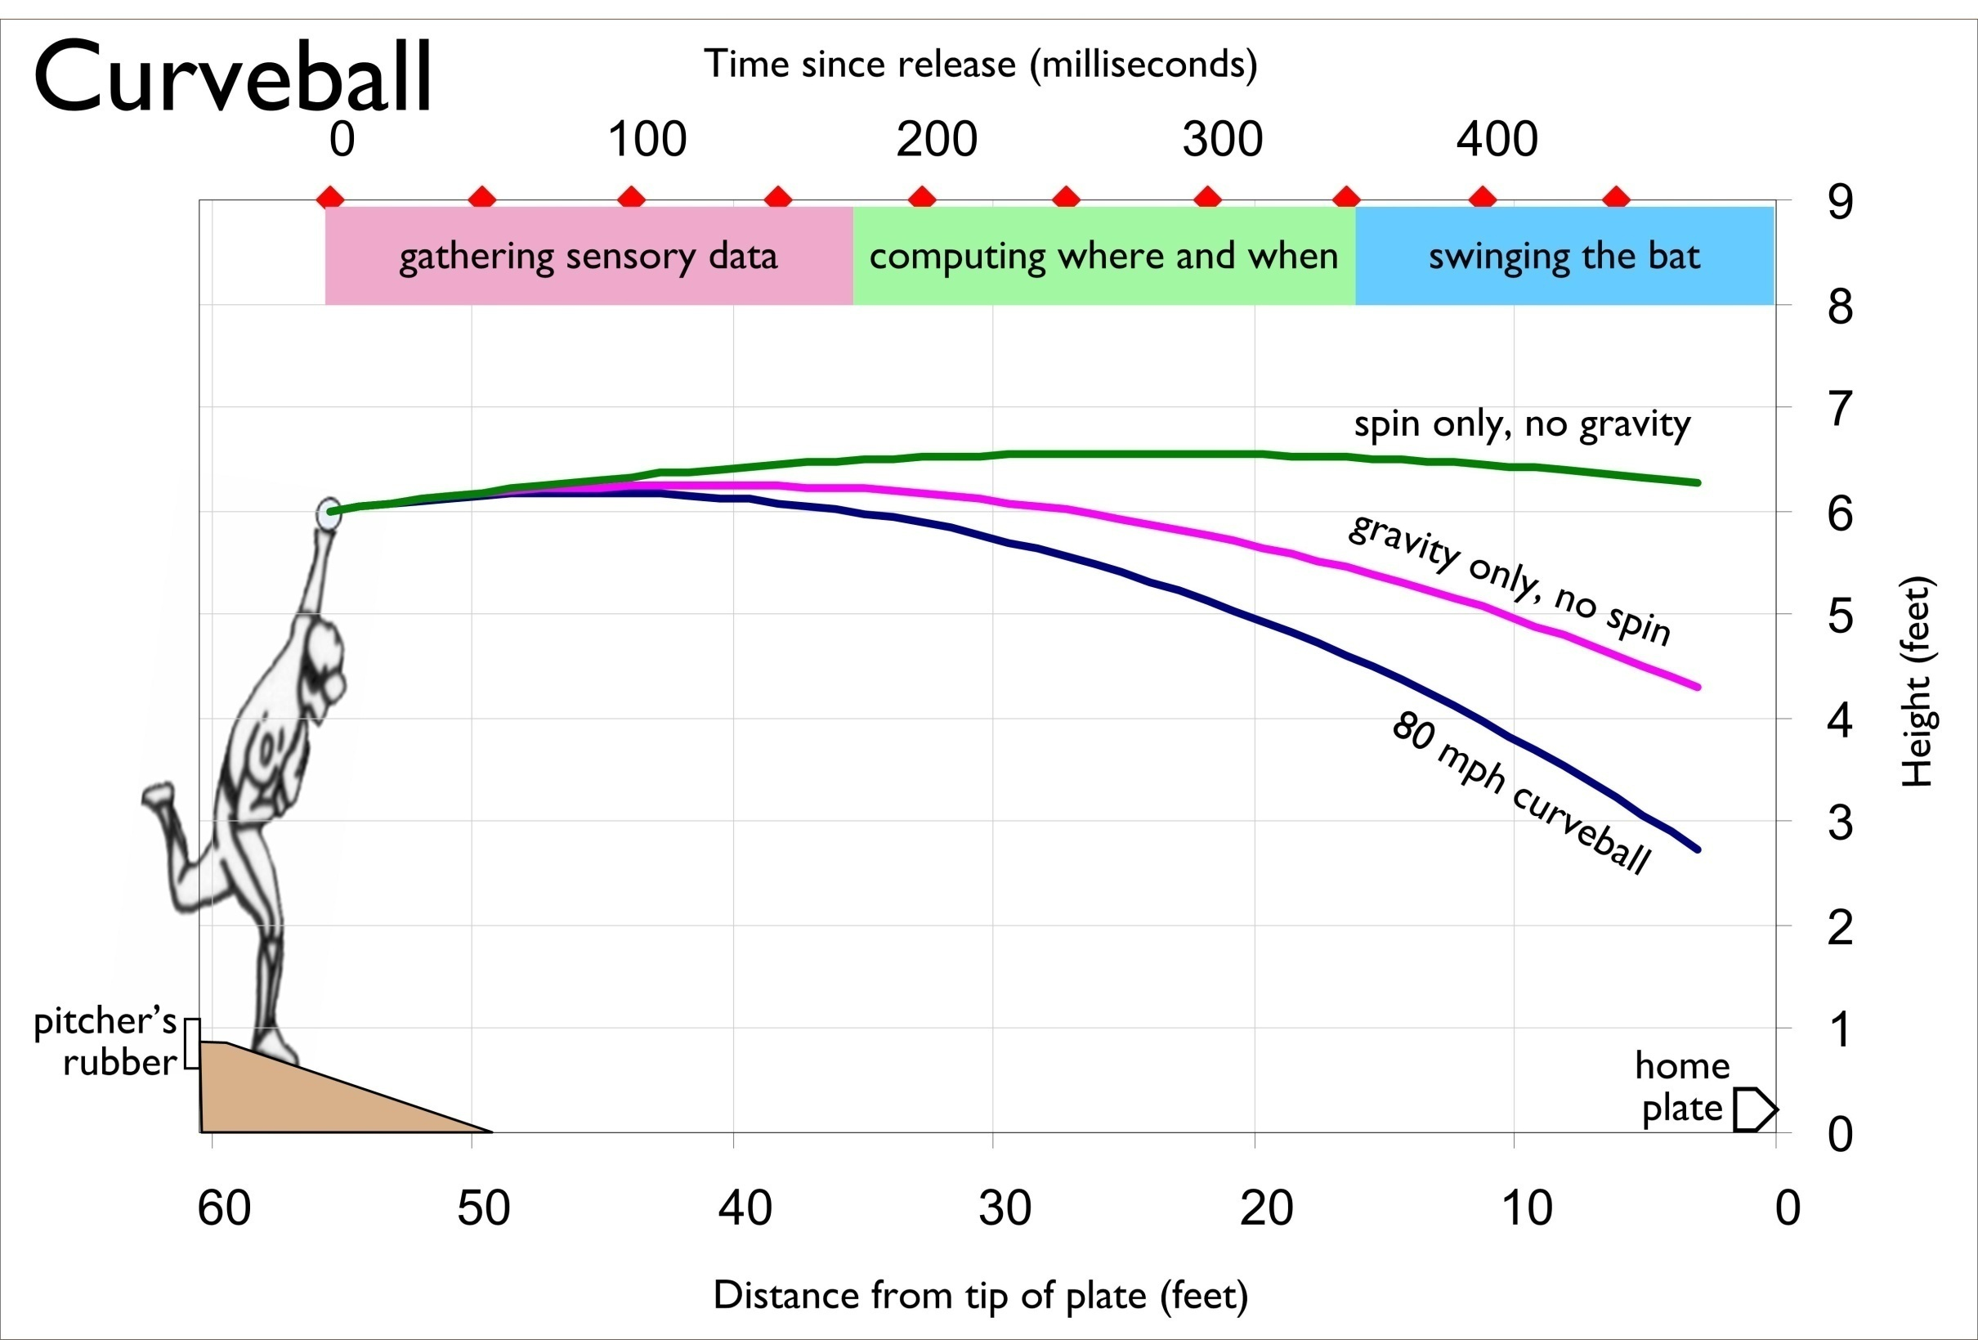
Notes:
launched two degrees upward with 2000 rpm of top spin.

Slide 5
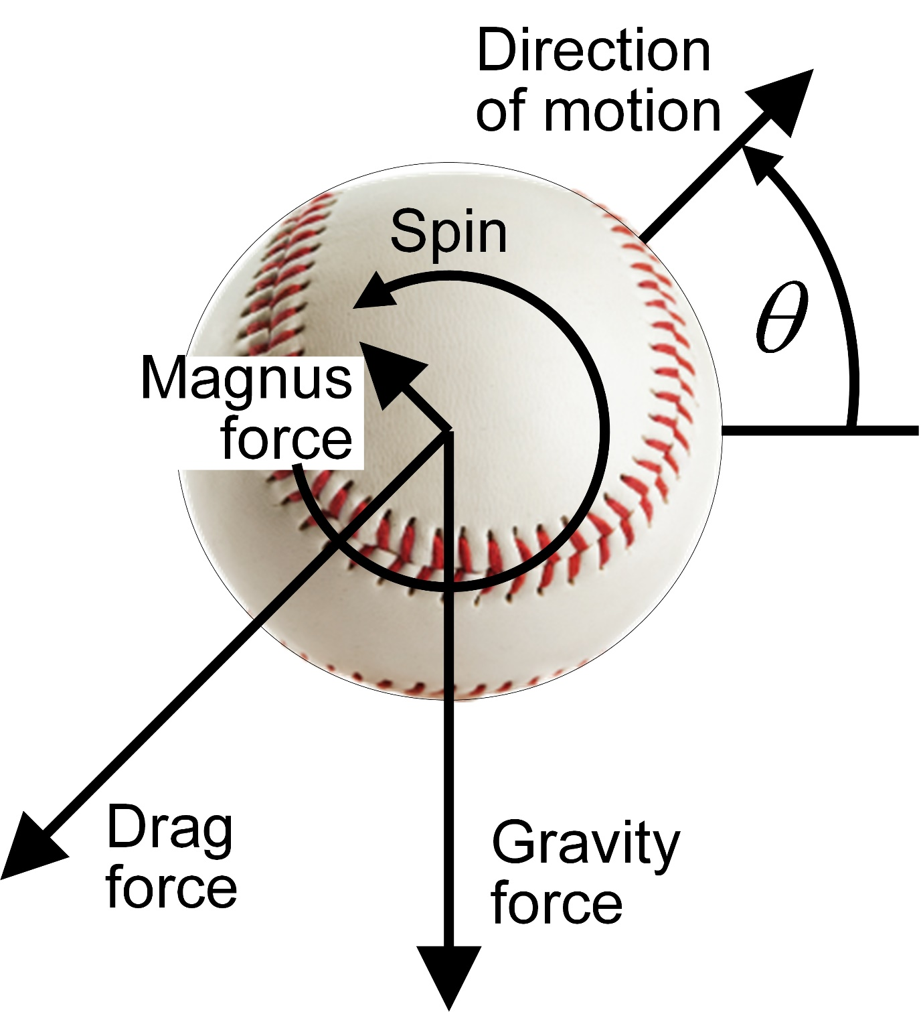
Forces acting on the ball

Slide 6
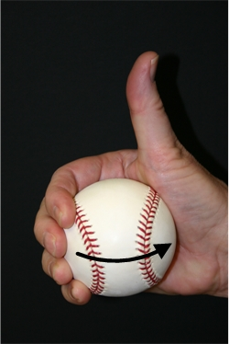
Angular right-hand rule

Slide 7
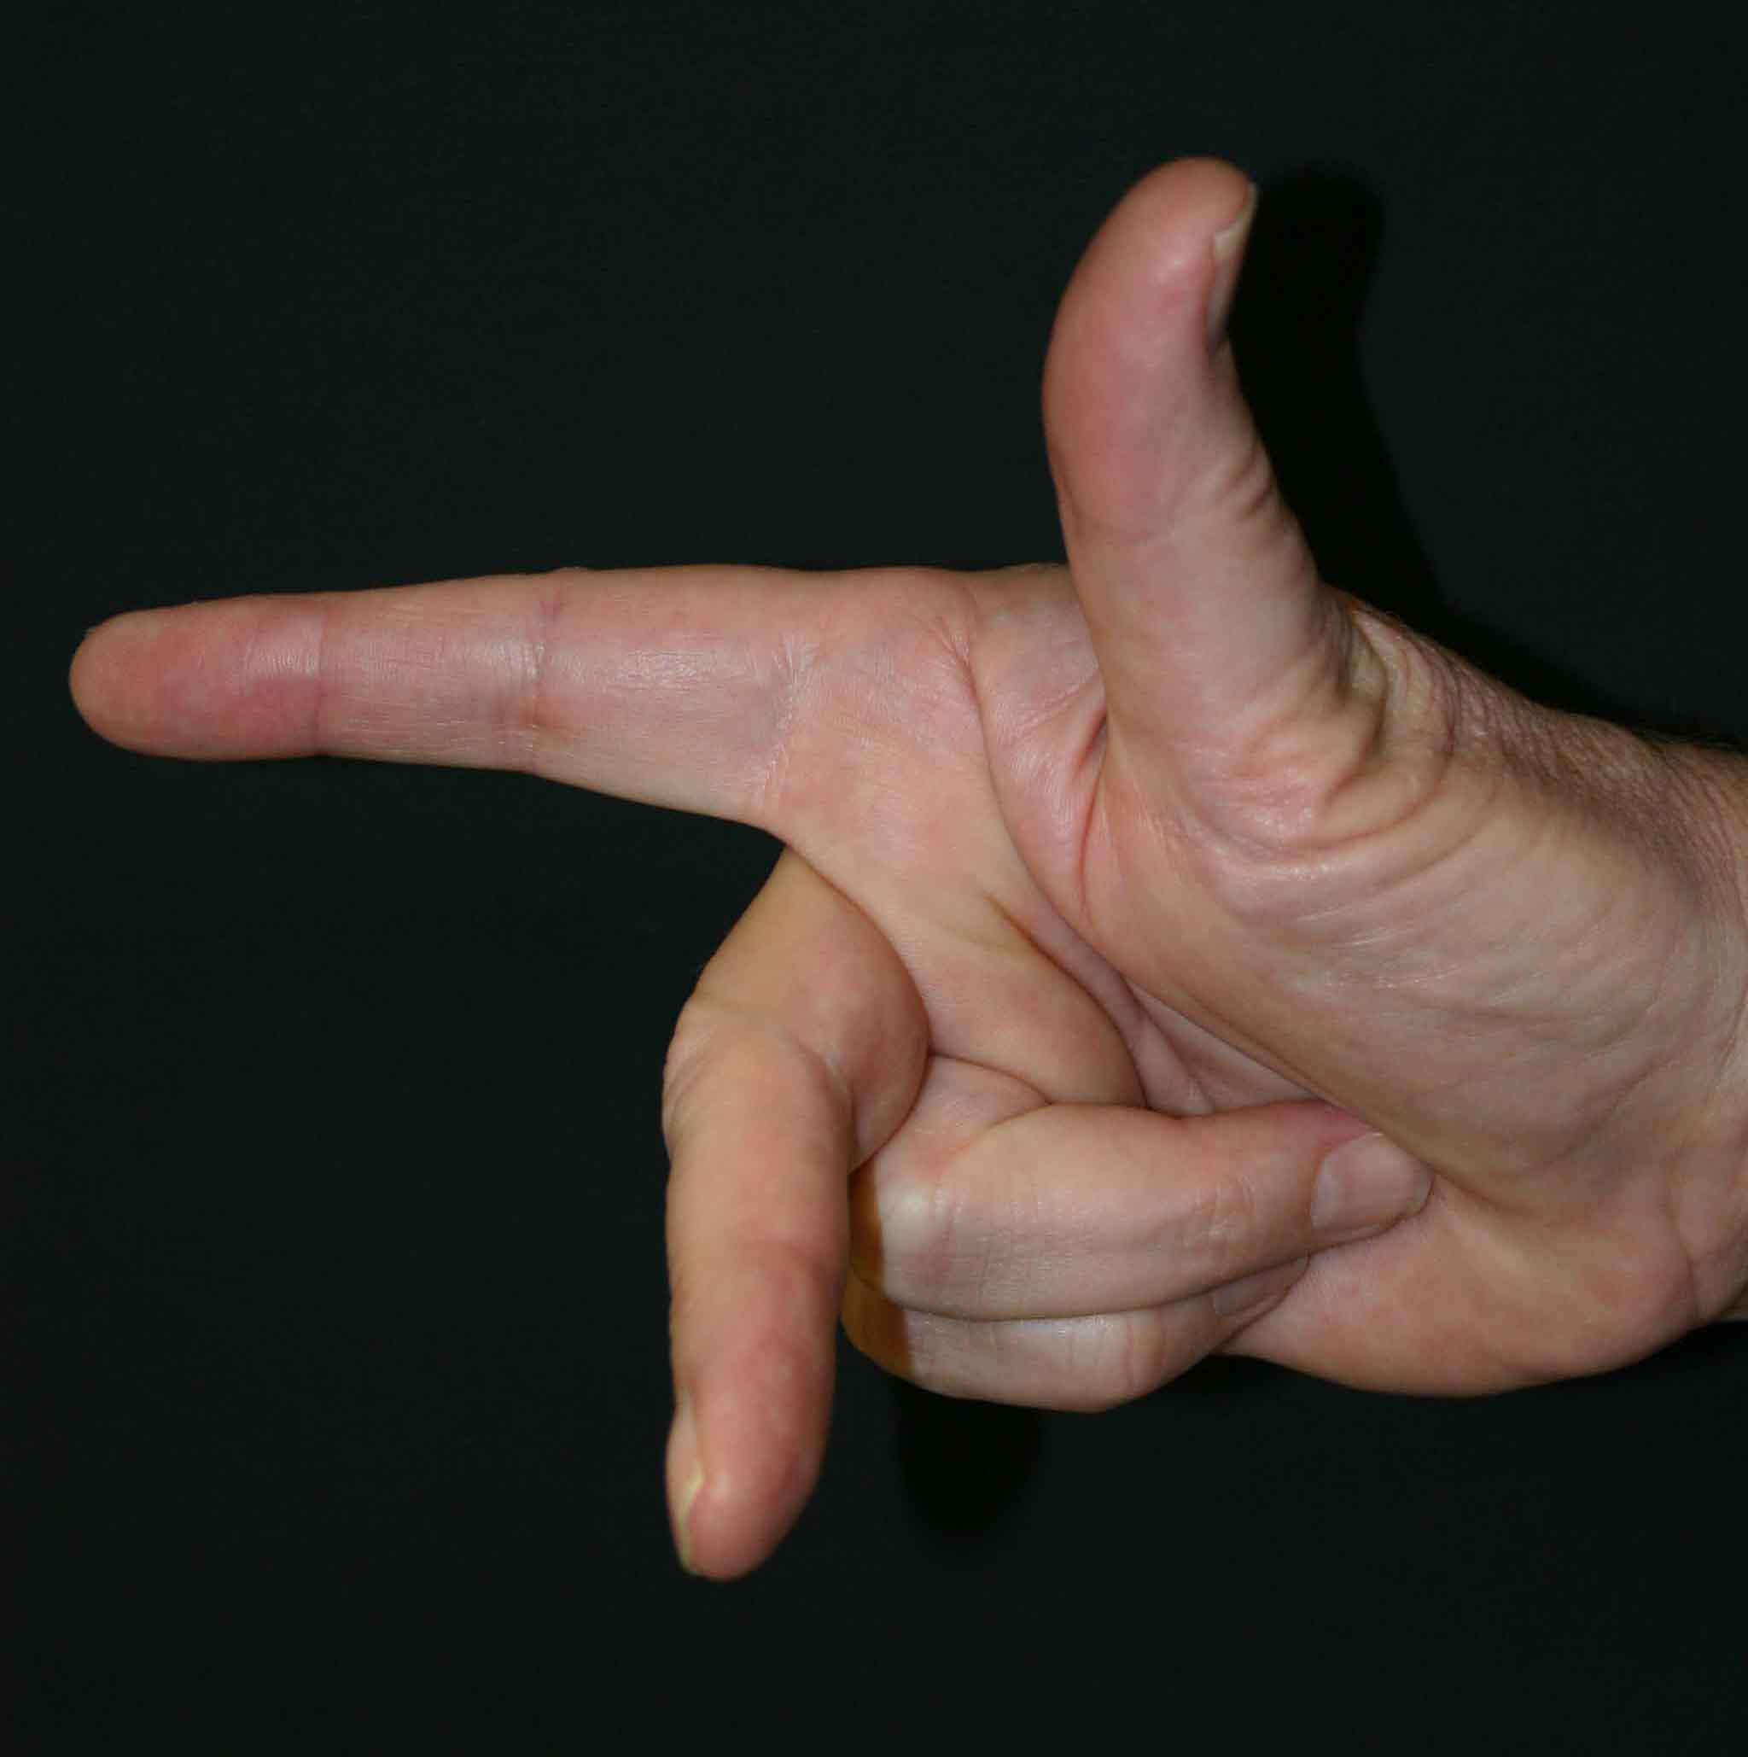
Coordinate right-hand rule

Slide 8
SaD Sid*
Thumb → Spin axis
Index finger → Direction of motion
Middle finger → Spin induced deflection
Notes:
This is the take-home message of the whole talk.

Slide 9
Tracking the Ball in Flight
Now that we understand the forces acting on the ball in flight, we will attack the problem of how the batter tracks the ball in flight.

Slide 10
Models for the Batter Tracking the Pitch
Neurophysiology Mental Model
Depth Perception Mental Model
Visual Image Processing Mental Model
Notes:
No one else has ever done this

Slide 11
Neurophysiology Model
Notes:
Study firing of single cells and pools of neurons in the cortex of the monkey

Slide 12
Neurophysiology Model
the human brain has neuronal circuitry that can do the needed computations.
the parameters of a pitch are within physiological thresholds
people can accurately estimate time-until-contact
Notes:
Recordings from cells in the monkey brain

Slide 13
The batter must predict when and where the ball will contact the bat

Slide 14
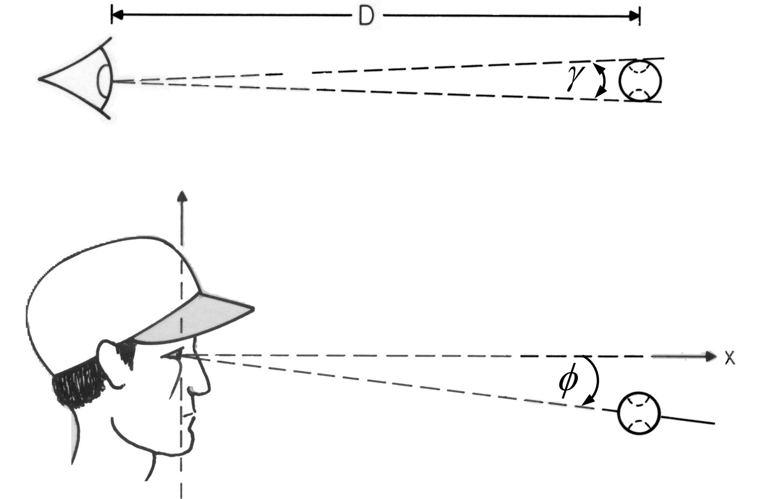

Slide 15
Time to contact

Slide 16
Notes:
During the swing, he could close his eyes and it would not affect the flight of the batted ball.
launched one-degree downward with 1200 rpm of back spin.

Slide 17
What the batter does
The first third, the batter gathers sensory information;
The middle third, he computes when and where the ball will contact the bat;
The final third is the swing of the bat.
The batter has to use information gathered in the first and second thirds to estimate time-until-contact and the ball position at the time of contact.

Slide 18
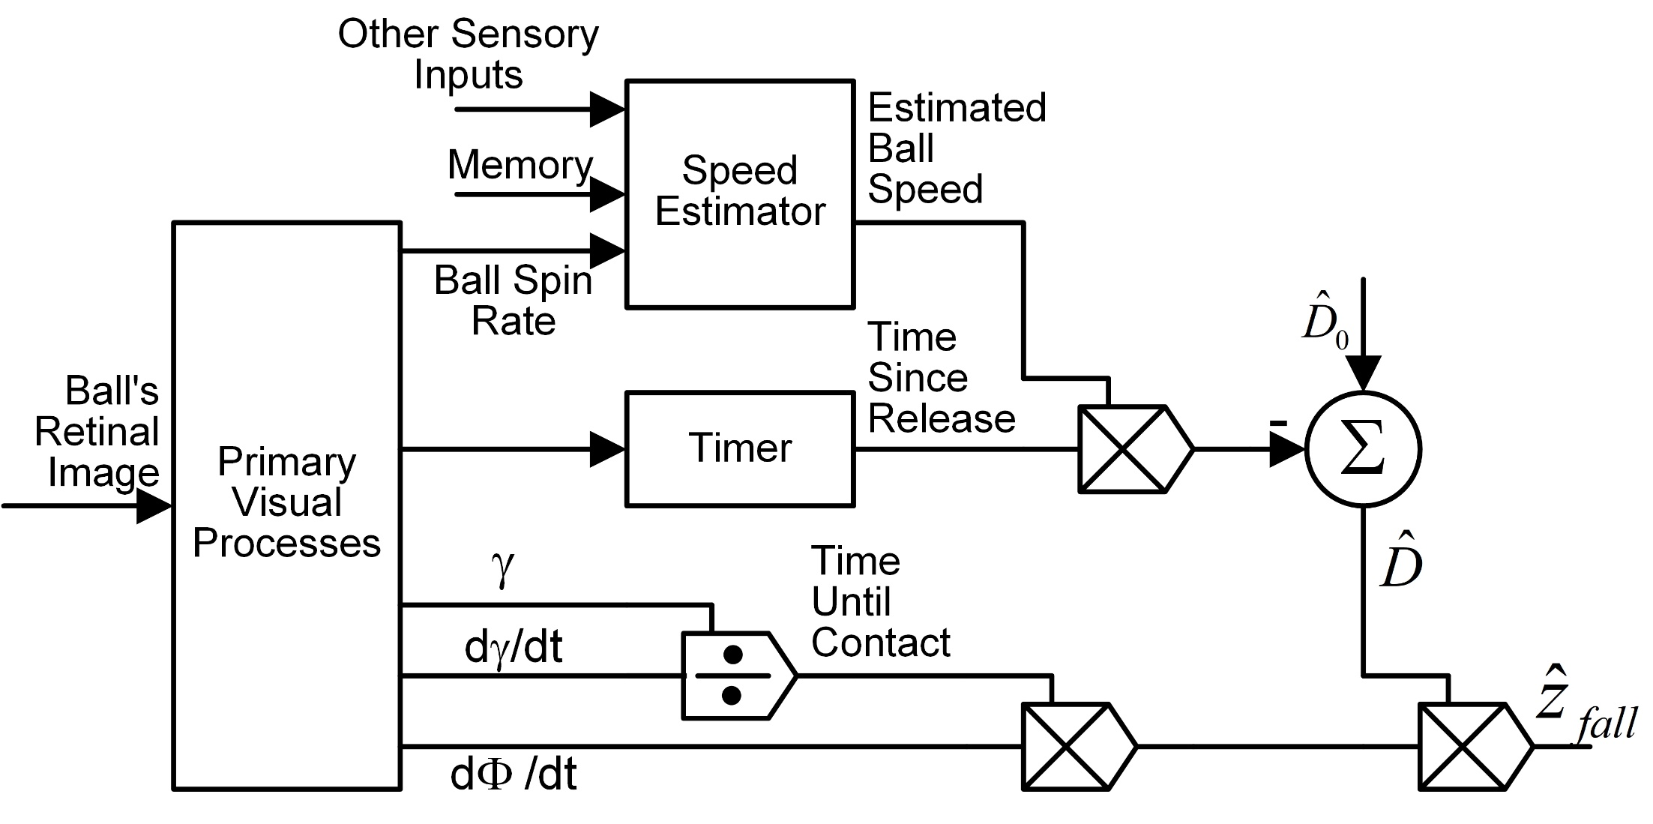

Slide 19
Neurophysiology Mental Model
Inputs
Angular size of the ball,
Rate of change of angular size,
Angular distance of the ball's image off of the fovea,
Retinal velocity (due to target motion),
Looming.
Outputs
Time and place of bat-ball contact

Slide 20
What is missing in this model?
Notes:
The batter has no direct access to the distance to the object

Slide 21
The Depth Perception Mental Model
Notes:
This is all brand new

Slide 22
You are bizarre
Notes:
The world is 3 dimensional.
You change it to 2 dimensions with images on your retinae.
Then you change it back to 3 dimensional in your brain.

Slide 23
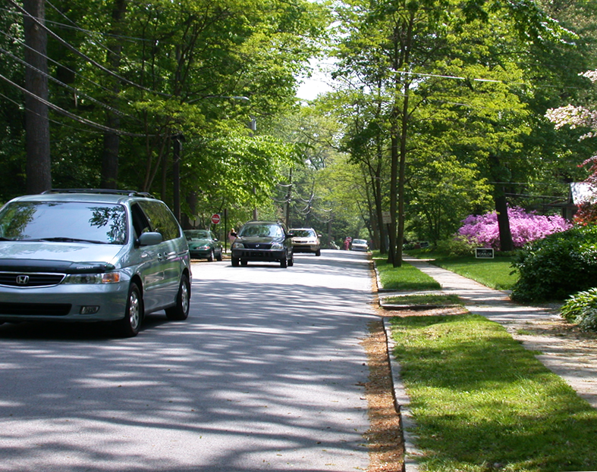
Notes:
Several monocular cues for distance perception: linear perspective, relative size, occlusion, texture gradient, color saturation, and luminance

Slide 24
Cue | Effective distance range | As objects get closer … | Likelihood of the batter using this cue to track the pitch
Binocular disparity | Six inches to 54 feet, or farther. | Disparity becomes larger | 10
Retinal speed for moving targets | Until exceeds 60 deg/s around 20 ft in front of the plate. | It becomes too fast | 10
Apparent size | Any distance | Images expand | 10
Luminance | Any distance | Increases | 6
Optical expansion | Any distance, but stronger at a closer range | Images expand | 4
Occlusion | Only exists at the release point | It goes away when the pitcher releases the ball | 3
Looming, an object heading straight at the head | Any distance, but stronger at closer range | Images expand | 2
Texture | Any distance | The texture becomes more distinct | 1, the seams
Luminance contrast | Any distance | Increases | 1
Motion parallax, due to observer motion | Any distance, but most effective at medium range | Cue becomes more useful | 1
Color saturation | Most effective at large distances | Image colors become more saturated | 1
Vergence angle | Four inches up to six feet* | Decreases | 0, too slow
Accommodation | *Four inches to six feet | Ciliary muscle effort increases allowing the lens to become short and fat | 0, too slow
Aerial perspective | Many miles | The only cue that gets better with distance | 0, too close
*The accommodative and vergence systems are capable of fixating targets at infinity, but the changes between six feet and infinity are imperceptibly small. The near point for accommodation is around four inches for a young adult. But this falls off rapidly with age.

Slide 25
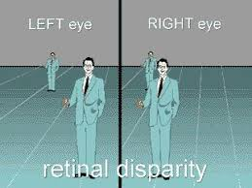
Binocular disparity
This is the best cue for depth

Slide 26
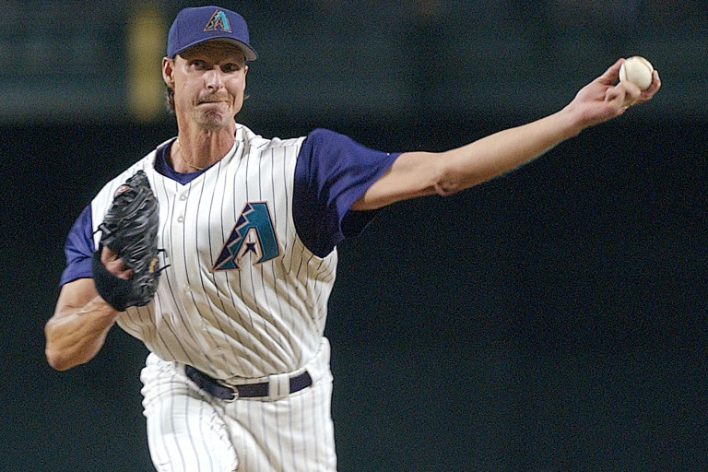
Retinal speed for moving targets

Slide 27
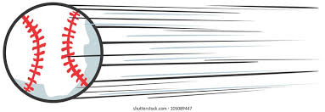
Retinal speed for moving targets

Slide 28
Apparent size
From the pitcher’s release point to the beginning of the swing, the apparent size of the baseball grows from 0.26° to 0.8°.

Slide 30
Luminance

Slide 31

Optical expansion

Slide 32
Looming
For an object heading directly at your head

Slide 33
Texture gradient

Slide 34
Luminance contrast
Luminance contrast is not an issue for baseball because, for the first two-thirds of the pitch, the background for the ball is the big featureless unchanging part of the center-field wall called the batter’s eye.
Notes:
In Boston it’s called the Green Monster

Slide 35
The pitcher’s release point

Slide 36
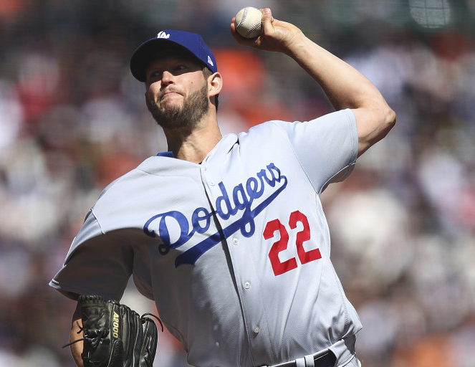
Notes:
Kershaw, None of these slides are from the viewpoint of the batter.

Slide 37
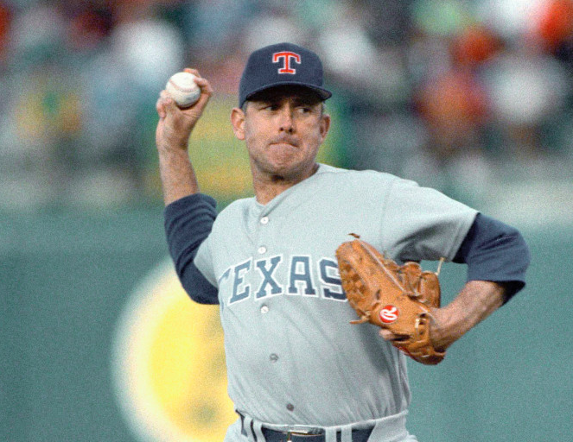
Notes:
Nolan Ryan

Slide 38
Notes:
Randy Johnson

Slide 39
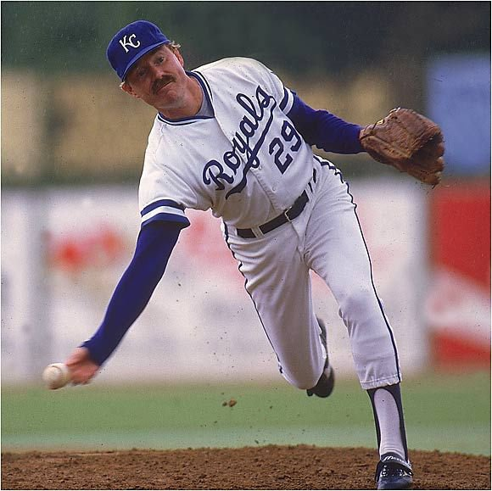

Slide 40
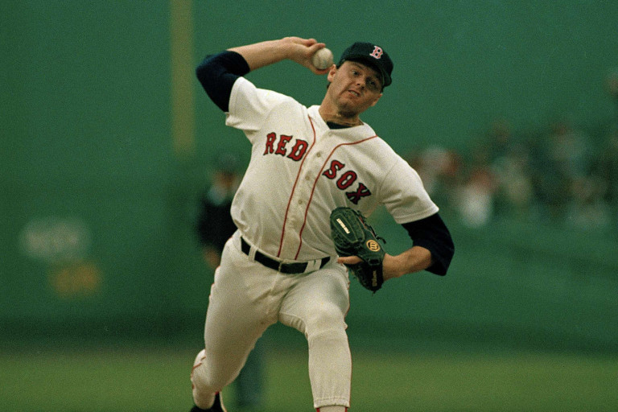

Slide 41
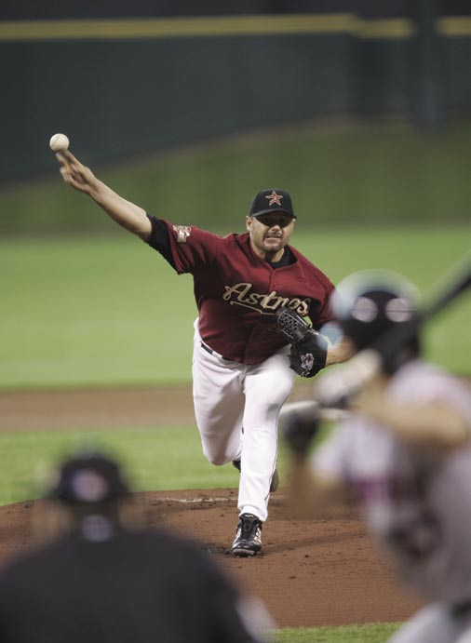
Notes:
Roger Clements

Slide 42
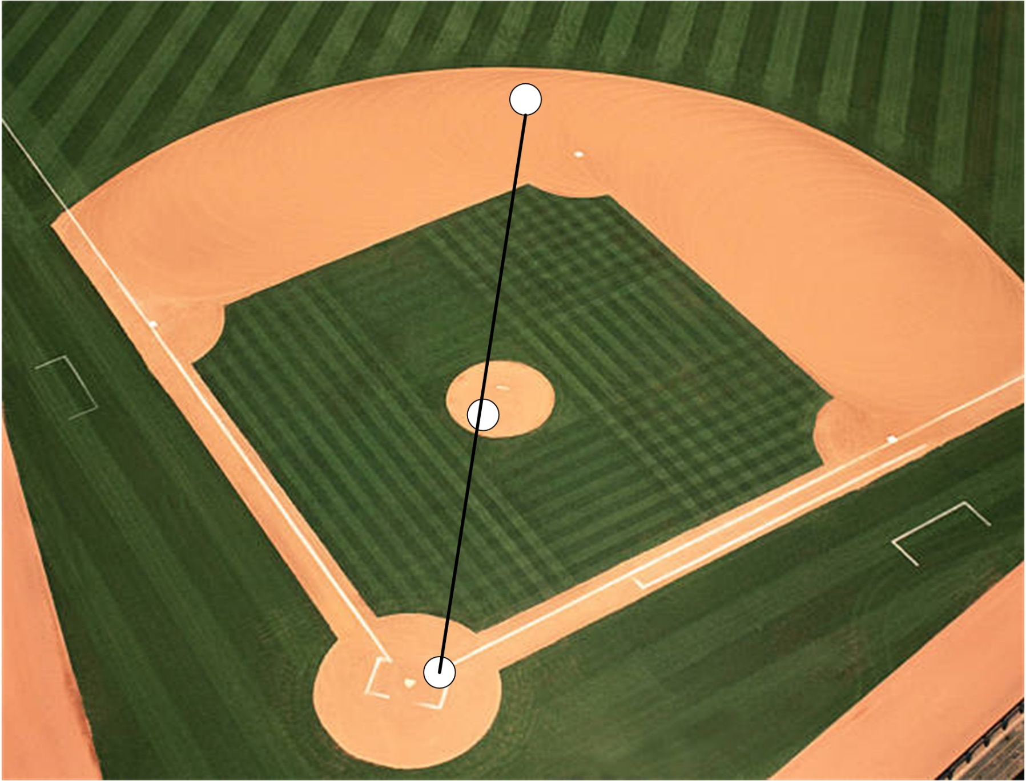
Could the shortstop stand directly behind the pitcher’s release point?

Slide 43

Motion parallax
Due to observer motion

Slide 44
Color saturation

Slide 45
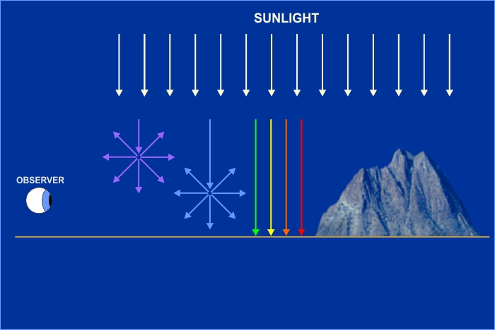
Aerial perspective

Slide 46
Illuminance
Constant except when the pitcher is in the sunlight and the batter is in the shade (or vice versa) because of the construction of the stadium and the movement of the sun and its shadow.

Slide 47
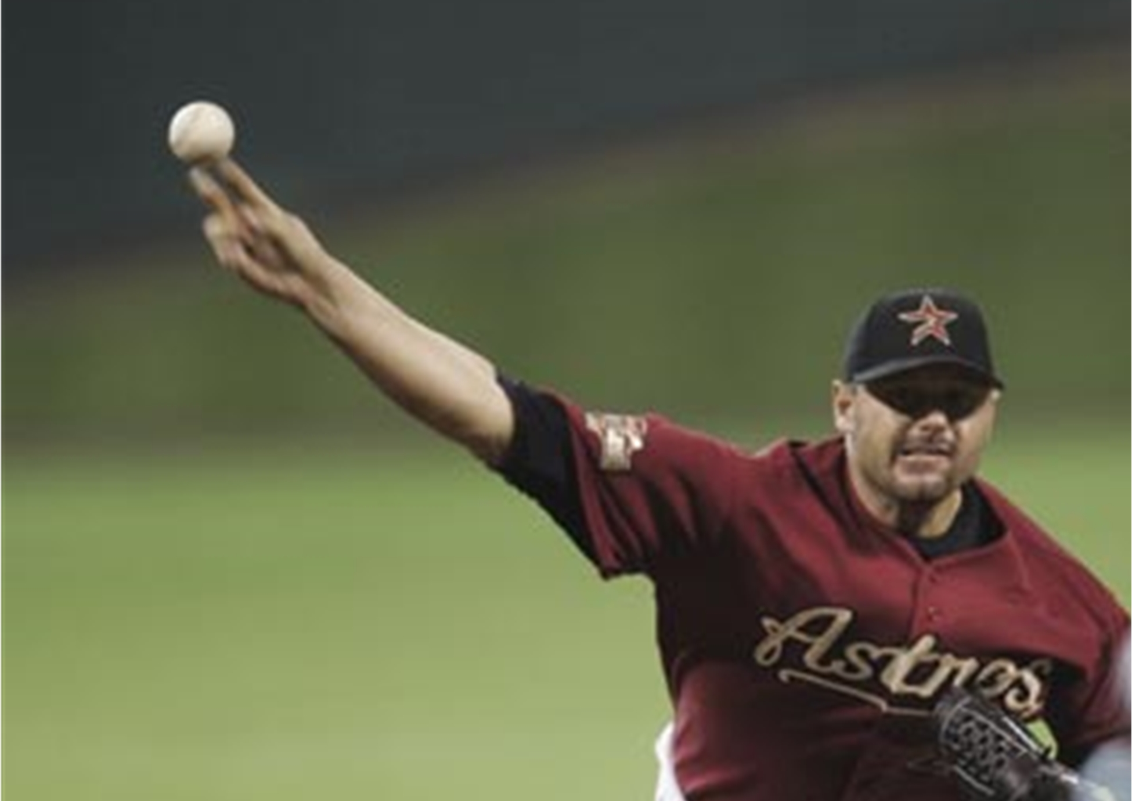

Slide 48
Occlusion
the large dark green wall in center field (called the batter’s eye) is always in the background of a pitch and the ball is always in the foreground. And the ball will never be in front of the pitcher's white uniform.
Notes:
Called the Green Monster in Boston

Slide 49
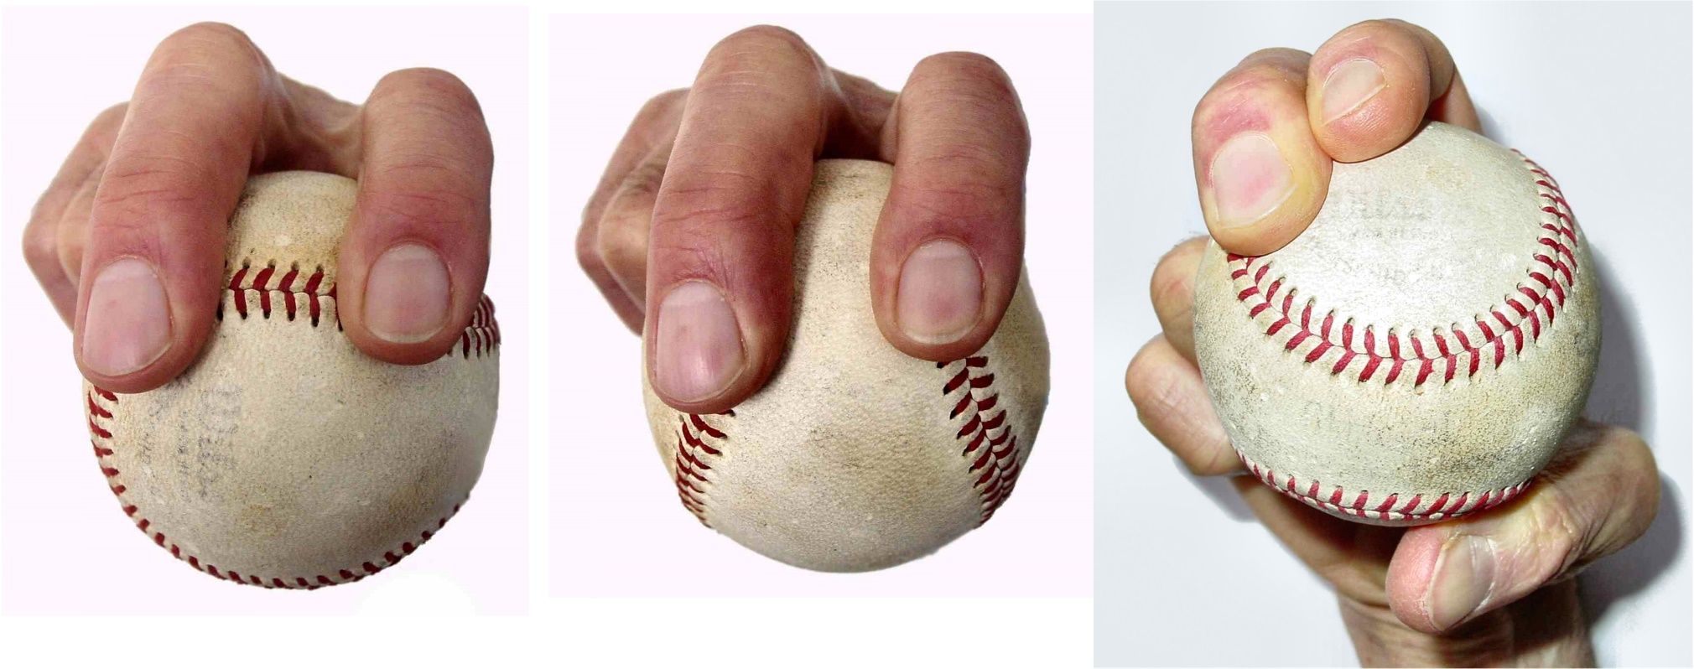
Occlusion
But the pitcher’s fingers are in front of the ball Therefore, occlusion offers formidable cues to help the batter track the ball

Slide 50

Linear perspective

Slide 51
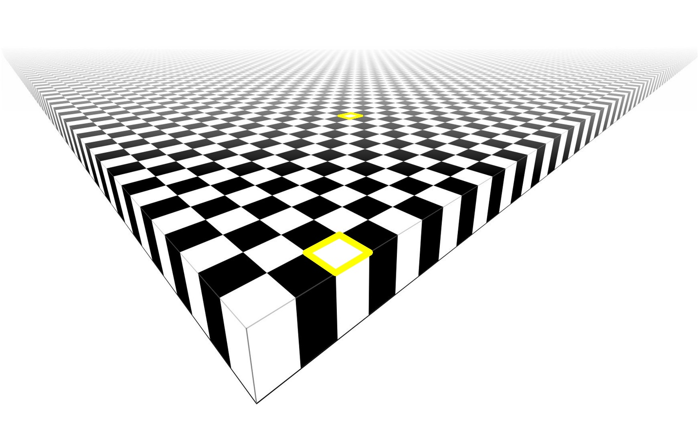
Aspect ratio
A two-point perspective drawing has two vanishing points.
Notes:
The size and shape of the objects are different.
There are two vanishing points.

Slide 52
Color saturation
Notes:
Color saturation is probably not useful because the ball is white and the red seams are just a blur because the ball is spinning so fast.
However, it might be useful in tracking a knuckleball.

Slide 53
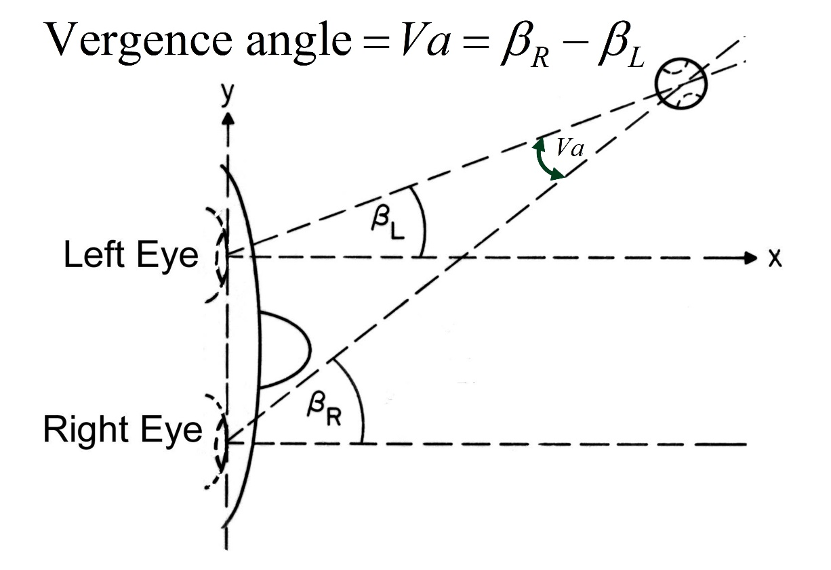
Vergence and accommodation
Too slow
Latencies of around 200 ms and durations of 300 ms.
Bahill and LaRitz (1984) specifically looked for vergence eye movements but found none.
Notes:
The vergence eye movement system and the accommodation system would not send useful cues until after the swing had started both because of their effective distance range (less than six feet) and their slow time responses. Both of them have latencies of around 200 ms and durations on the order of 300 ms. The stimuli for vergence are retinal disparity and blur. The stimulus for accommodation is retinal blur. Bahill and LaRitz²² (1984) specifically looked for vergence eye movements but found none.

Slide 54

Aerial perspective

Slide 55
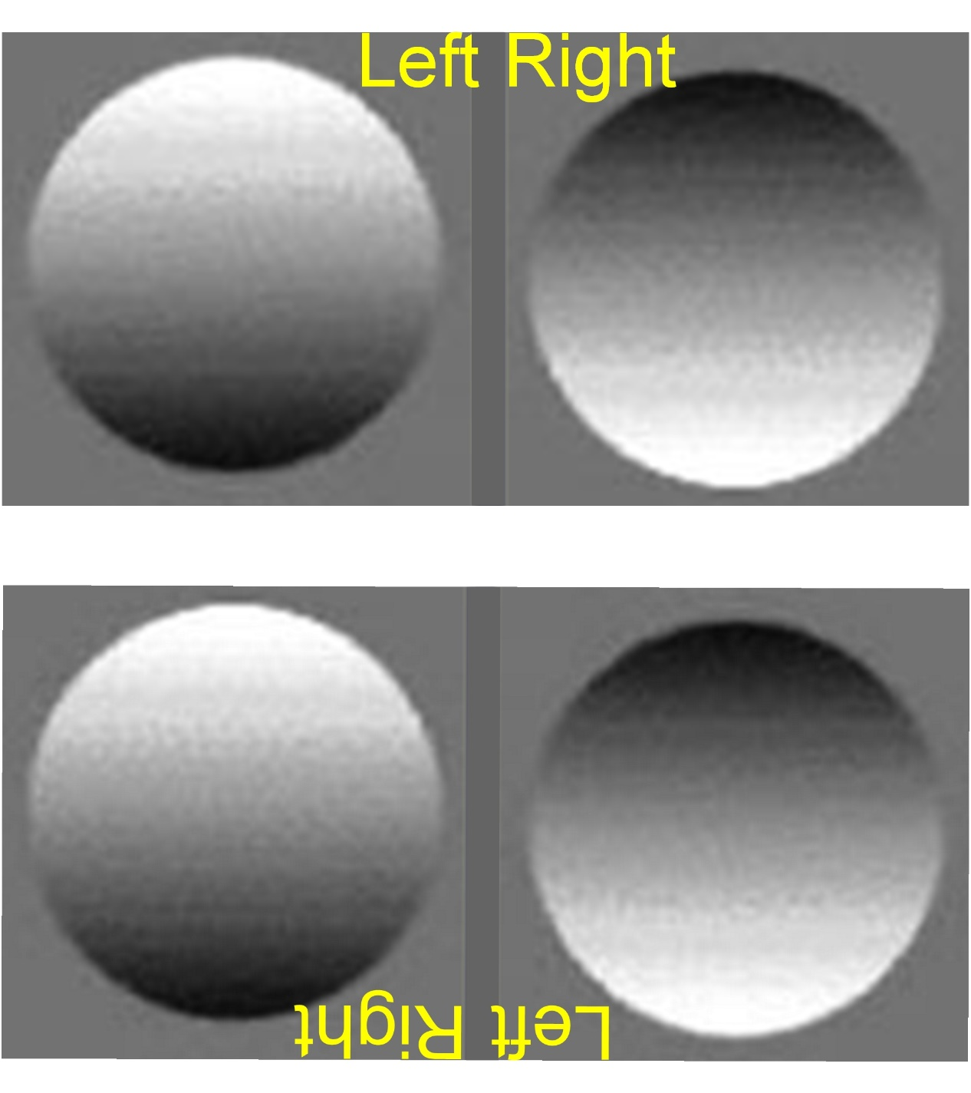
Shadows and shading
Notes:
Humans assume that an illuminating source is above them. Therefore, in this figure, the objects on the left seem to be hills, whereas the objects on the right seem to be depressions. However, the upper-right figure is the same as the lower-left figure. The figure has been turned upside down as proven the “Left” and “Right” labels.
It’s your brain that assumes light comes from above making the left side seem like hills and the right side seem like valleys.

Slide 56
Cues for the Depth Perception Mental Model
Binocular disparity,
Linear perspective,
Occlusion,
Apparent size,
Texture,
Luminance,
Luminance contrast,
Color,
Color saturation,
Focus,
Aerial (or atmospheric) perspective,
Aspect ratio,
Relative motion,
Motion parallax (due to observer motion),
Optical expansion,
Vergence angle,
Accommodation.

Slide 57
Cues used in pictures and paintings
Linear perspective,
Occlusion,
Size,
Texture gradient,
Luminance,
Color saturation,
Color,
Focus,
Aerial perspective (with distance fog and color shifts),
Aspect ratio,
Shading and shadows.
Notes:
What’s missing? Binocular disparity, all motion cues, and vergence and accommodation.

Slide 59
Visual Image Processing Mental Model
Notes:
Psychophysics, watch what the human does, often stimulus - response

Slide 60
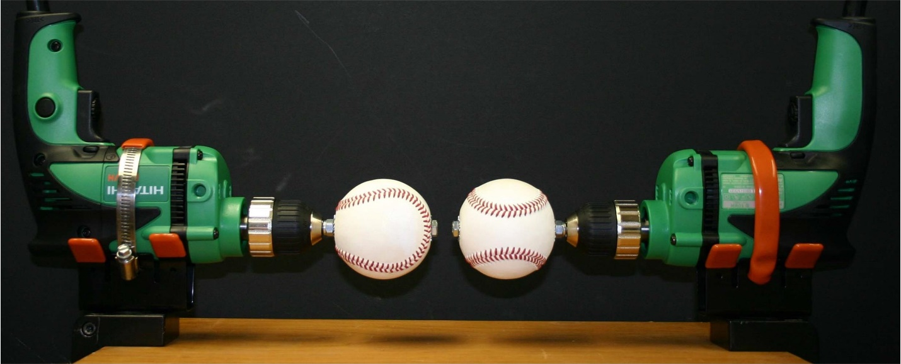

Slide 61
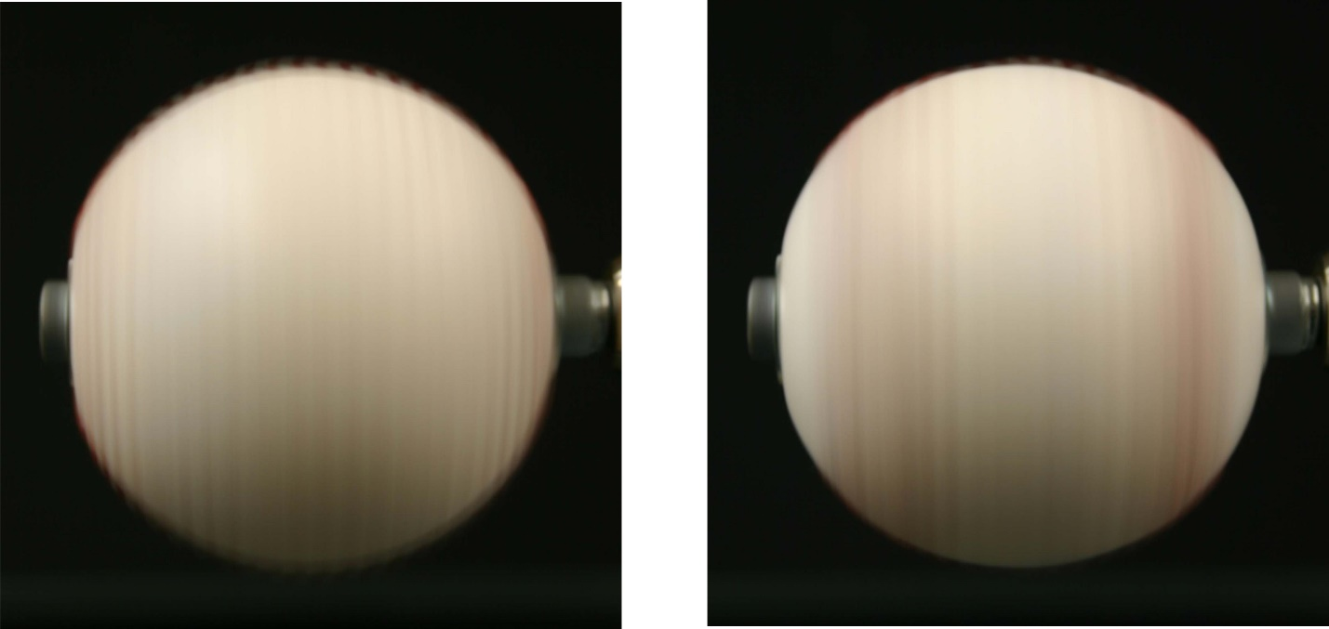
Simulated fastballs

Slide 62
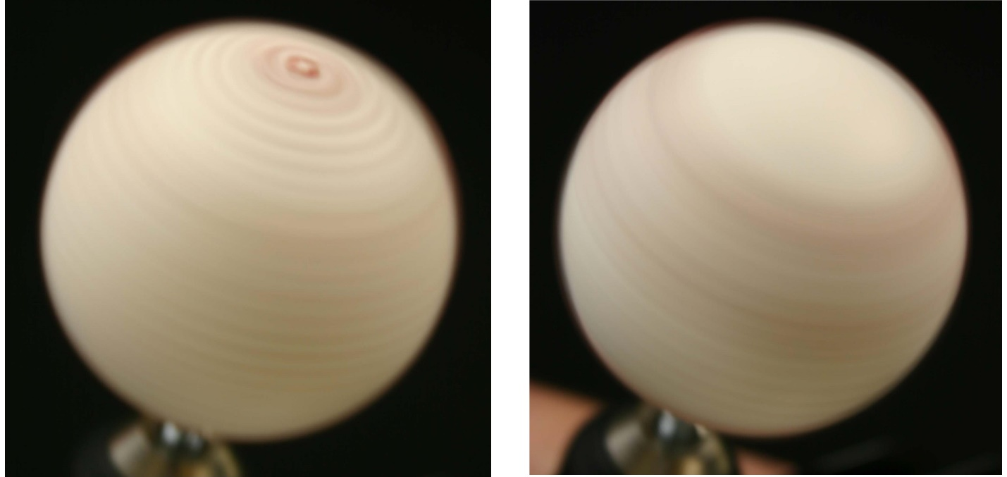
Simulated sliders

Slide 63
Video
A video of drills spinning four- and two-seam fastballs shows the difference even more dramatically. http://sysengr.engr.arizona.edu/baseball/index.html

Slide 64
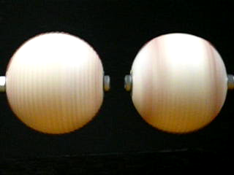
Fastballs

Slide 65
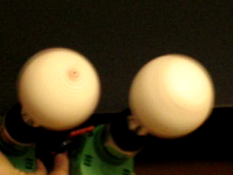
Sliders

Slide 66
Critical-flicker-fusion frequency

Slide 67
Conclusion
The pitcher should use a four-seam grip for fastballs to remove the perceptual cue of the two red stripes and the flicker.
Then, he should use the two-seam grip for the slider, to remove the cue of the red dot.

Slide 68
Cues for the Visual Image Processing Mental Model
Angle of the pitcher’s arm,
Release point,
Launch angle,
Position of the fingers (the grip),
Ball’s spin rate and spin axis,
Critical-flicker-fusion-frequency

Slide 69
Combining all three models

Slide 70
To track the pitch the batter probably uses
  Retina/cortical cues
angular size of the ball
rate of change of angular size
angular distance of the ball's image off of the fovea
ball’s retinal velocity
Depth perception cues
  binocular disparity
  apparent size
  retinal speed
Visual image processing cues
angle of pitching arm
release point
launch angle
position of the fingers (the grip)
spin rate
spin axis

Slide 71
Cues Applied to Baseball

Slide 72
Cue | Effective distance range | As objects get closer … | Likelihood of the batter using this cue to track the pitch
Binocular disparity | Six inches to 54 feet, or farther. | Disparity becomes larger | 10
Retinal speed for moving targets | Until exceeds 60 deg/s around 20 ft in front of the plate. | It becomes too fast | 10
Apparent size | Any distance | Images expand | 10
Luminance | Any distance | Increases | 6
Optical expansion | Any distance, but stronger at a closer range | Images expand | 4
Occlusion | Only exists at the release point | It goes away when the pitcher releases the ball | 3
Looming, an object heading straight at the head | Any distance, but stronger at closer range | Images expand | 2
Texture | Any distance | The texture becomes more distinct | 1, the seams
Luminance contrast | Any distance | Increases | 1
Motion parallax, due to observer motion | Any distance, but most effective at medium range | Cue becomes more useful | 1
Color saturation | Most effective at large distances | Image colors become more saturated | 1
Vergence angle | Four inches up to six feet* | Decreases | 0, too slow
Accommodation | *Four inches to six feet | Ciliary muscle effort increases allowing the lens to become short and fat | 0, too slow
Aerial perspective | Many miles | The only cue that gets better with distance | 0, too close
*The accommodative and vergence systems are capable of fixating targets at infinity, but the changes between six feet and infinity are imperceptibly small. The near point for accommodation is around four inches for a young adult. But this falls off rapidly with age.

Slide 73
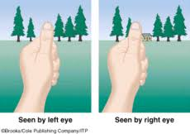
Binocular disparity
Binocular disparity is the batter’s best cue for the distance to the ball during the pitch

Slide 74
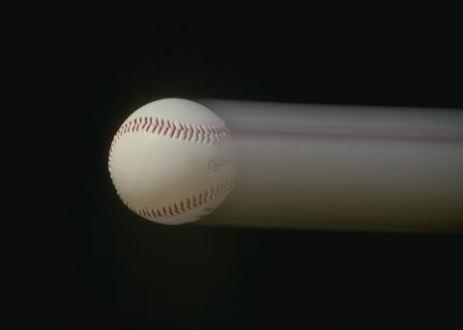
Retinal speed for moving targets

Slide 75
Apparent size
From the pitcher’s release point to the beginning of the swing, the apparent size of the baseball grows from 0.26° to 0.8°.

Slide 76
Wow!
It seems that binocular disparity, retinal speed for moving targets, and apparent size are the only depth perception cues that the batter can use in tracking the pitch!

Slide 77
To track the pitch the batter probably uses
  Retina/cortical cues
angular size of the ball
rate of change of angular size
angular distance of the ball's image off of the fovea
ball’s retinal velocity
Depth perception cues
  binocular disparity
  apparent size
  retinal speed
Visual image processing cues
angle of pitching arm
release point
launch angle
position of the fingers (the grip)
spin rate
spin axis

Slide 78
Future research
The AI model
A test for binocular disparity
  put an optometrist’s black patch over the batter’s non dominant eye

Slide 80
Take to OLLI
Strobe light
Meter stick
Ball with bolt

Slide 81
Other depth perception cues
Shadows,
Relative height,
Pupil diameter,
Vertical disparity,
Optical flow,
Symmetry,
Spatial frequency.

Slide 82
Other cues and processes
Signals from teammates,
Study of videos,
Critical flicker fusion frequency,
Markov models for pitch count etc.,
Kalman filters,
Strategy from baseball folklore.

