Slide 1
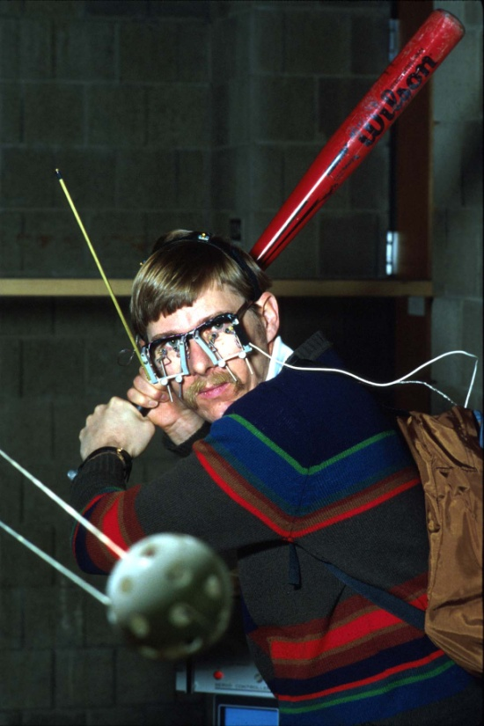

Batters use Depth Perception to Track Baseballs and Softballs
A. Terry Bahill
Emeritus Professor of
Systems Engineering
University of Arizona
terry@sie.arizona.edu
©, 2017-2024, Bahill

Slide 2
Good Advice
Once on my way to teach class, an old navy Chief Petty Officer told me
Tell’em what you’re gonna to tell’em
tell’em
and then tell’em what you told ‘em

Slide 3
Slide show
This slide show is available at
http://sysengr.engr.arizona.edu/OLLI/index.html

Slide 4
David Heeger’s Depth, Size, and Shape
A. Terry Bahill
Emeritus Professor of
Systems Engineering
University of Arizona
terry@sie.arizona.edu
©, 2024, Bahill

Slide 5
Depth, Size, and Shape
https://www.cns.nyu.edu/~david/courses/perception/lecturenotes/depth/depth-size.html

Slide 6
Linear Perspective (railroad tracks), Horizon Line, and Camera Height (eye level)
A. Terry Bahill
Emeritus Professor of
Systems Engineering
University of Arizona
terry@sie.arizona.edu
©, 2017-2024, Bahill

Slide 7
Horizon
In perspective drawing theory, eye level = camera height.
An artist must be taught that the horizon line goes through the vanishing point. For a photographer this is automatic.
My Samsung A42 smartphone always gives the horizon line when used as a camera. I don’t know why.
Notes:
Almost all of the women are walking away from us

Slide 8
A picture will seem more natural if the horizon is 1/3 of the way down from the top or 1/3 of the way up from the bottom.

Slide 9

Camera height
= Eye level
Notes:
Linear perspective.
Aerial (or atmospheric) perspective
Is the camera height = the horizon line?

Slide 10
Notes:
Linear Perspective

Slide 11
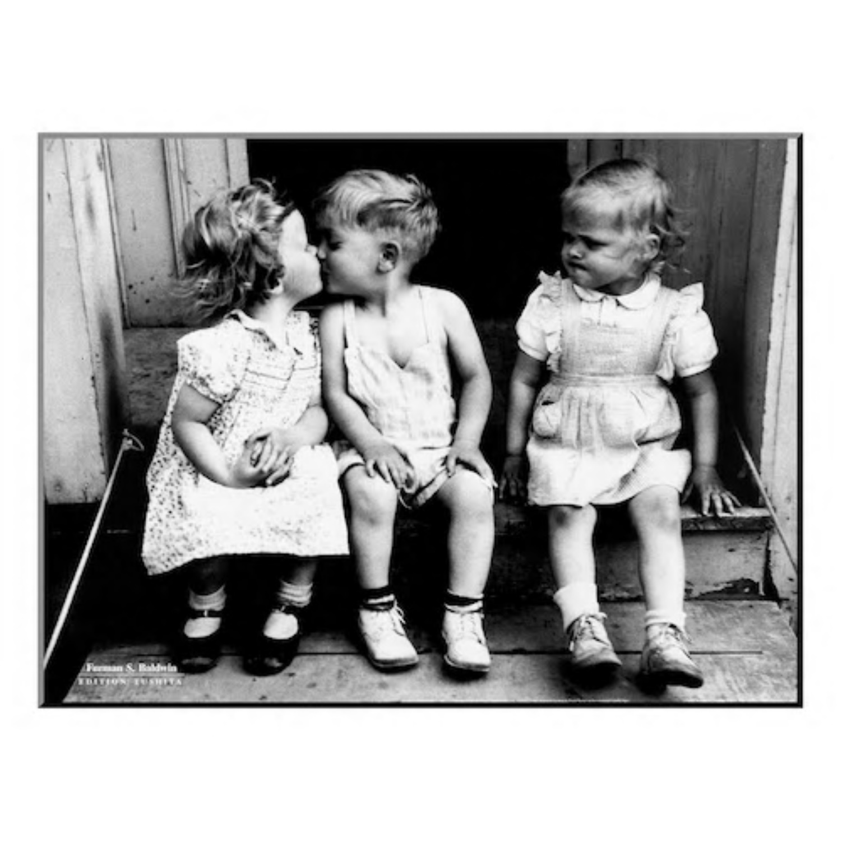

Slide 12
Notes:
Linear perspective.

Slide 13


Notes:
Horizon is 1/6th of the way from the top.
Color contrast.

Slide 14

Notes:
9
The horizon is about 1/3 of the way down from the top.
Eye level is slightly above that.
The lady is in sharp focus.
Why are there three rails?

Slide 15

Notes:
5
The Horizon is about in the middle, which is not good.
The Horizon is below eye level, but the object of interest is way below.
She is below us, about to get killed.

Slide 16
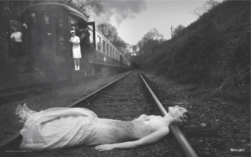

Notes:
5
The Horizon is in the middle, which wastes the top half of the picture.
The horizon is at eye level, but the object of interest (the lady) is below eye level.

Slide 17


Notes:
Blurred background and sharp focus on lady.
Horizon might be 1/3rd of the way from the top.
Color contrast.

Slide 18

Notes:
9
The horizon is way off the top.
The eye level is way up on top.
Surprisingly, the image is good.

Slide 19

Notes:
9
The Horizon is 1/3 of the way up from the bottom.
The subject is above eye level, foreboding.
She seems to be evil and has power over us.
This looks bizarre because the horizon is below eye level.

Slide 20


Notes:
6
The horizon is in the middle.
Eye level is near the top.
Why is this still good?

Slide 21

Notes:
6
The Horizon is in the middle.
The picture Looks natural. The horizon is below eye level.
Objects of interest are the dog, the girl’s belly button, and her legs.

Slide 22

Notes:
1
Not a good picture. The Horizon is in the middle. The Object of interest is the sun? the guitar?

Slide 23

Notes:
2
The Horizon is in the middle. The object of interest is the guitar?

Slide 24

Notes:
6
The Horizon is slightly below the middle.
The Object of interest is the blue dress.
Color contrast.
The horizon is below eye level.

Slide 25

Notes:
2
The Horizon is about ¼ of the way down from the top.
The horizon is above eye level.
The red shoes give color contrast.

Slide 26

Notes:
7
The Horizon is in the middle.
The Objects of interest are the red hat and the red dress.
Color contrast. The distance is blue.
The horizon is at eye level.

Slide 27

Notes:
4
The Horizon is 1/3 of the way down from the top.
The horizon is way above eye level.
Distant objects are blurry.
Color contrast.

Slide 28

Notes:
1
The Horizon is in the middle and it is not horizontal.
The object of interest is the suitcase?
Is this interesting?
It’s a fish eye lens, or something because the rail ties are not straight.

Slide 29

Notes:
3
The Horizon is in the middle.
The Object of interest is the lady’s dress.
Near objects are in sharp focus: Distance is out of focus.
Linear perspective does not need straight rr tracks.

Slide 30


Slide 31


Slide 32

Customer support dog: How can I help you?
Customer: My screen is frozen.
Dog: Have you tried throwing up and then eating the barf?

Slide 33
Anatomical Location
Your depth perception mental model does not have a specific anatomical location in your brain.
In fact, it does not even have a specific type of representation.
Quite likely it is a network property.

Slide 34
Switch
Switch to the other slide show entitled
“Batters use Depth Perception to Track Baseballs and Softballs”

Slide 35
Batters Use Depth Perception to Track Baseballs and Softballs
A. Terry Bahill
Emeritus Professor of
Systems Engineering
University of Arizona
terry@sie.arizona.edu
©, 2017-2024, Bahill

Slide 37
Christopher Baird’s Twenty-one Cues for Depth Perception
A. Terry Bahill
Emeritus Professor of
Systems Engineering
University of Arizona
terry@sie.arizona.edu
©, 2024, Bahill

Slide 38
Twenty-one Cues for Depth Perception
https://www.wtamu.edu/~cbaird/sq/2023/07/28/why-does-a-person-with-only-one-working-eye-have-zero-depth-perception/

Slide 39
Animal Color Vision
A. Terry Bahill
Emeritus Professor of
Systems Engineering
University of Arizona
terry@sie.arizona.edu
©, 2024, Bahill

Slide 40
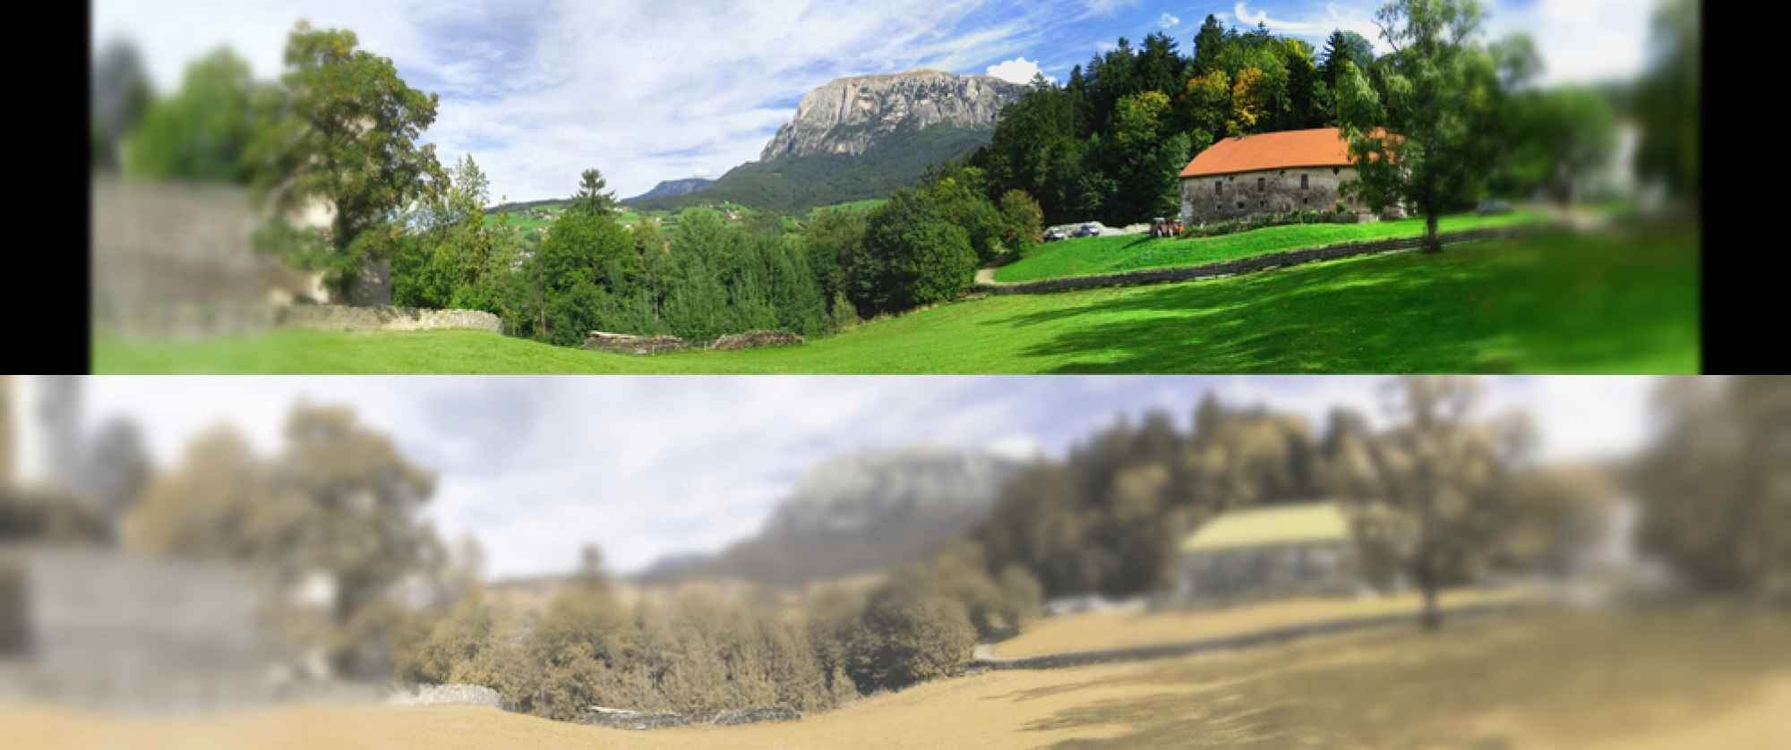
Dog vision

Slide 41
Animal Color Vision
https://www.youtube.com/watch?v=VphtcDhHj40&list=RDCMUC4rlAVgAK0SGk-yTfe48Qpw&index=5

Slide 42

Notes:
Depth cue: occlusion

Slide 43

Notes:
Depth cue: occlusion,

Slide 44
Optical Illusions
A. Terry Bahill
Emeritus Professor of
Systems Engineering
University of Arizona
terry@sie.arizona.edu
©, 2024, Bahill

Slide 45
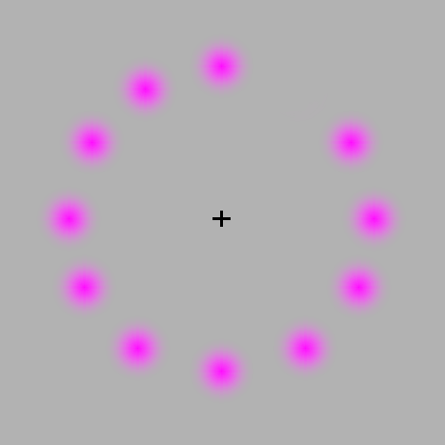

Slide 46
Optical illusions
https://www.youtube.com/watch?v=4kusBzkjods
https://www.youtube.com/watch?v=llLVk2fqylA

